Slide 1

2025: Ferdinand cup SPA-2025
Drivers’ briefing

Slide 2
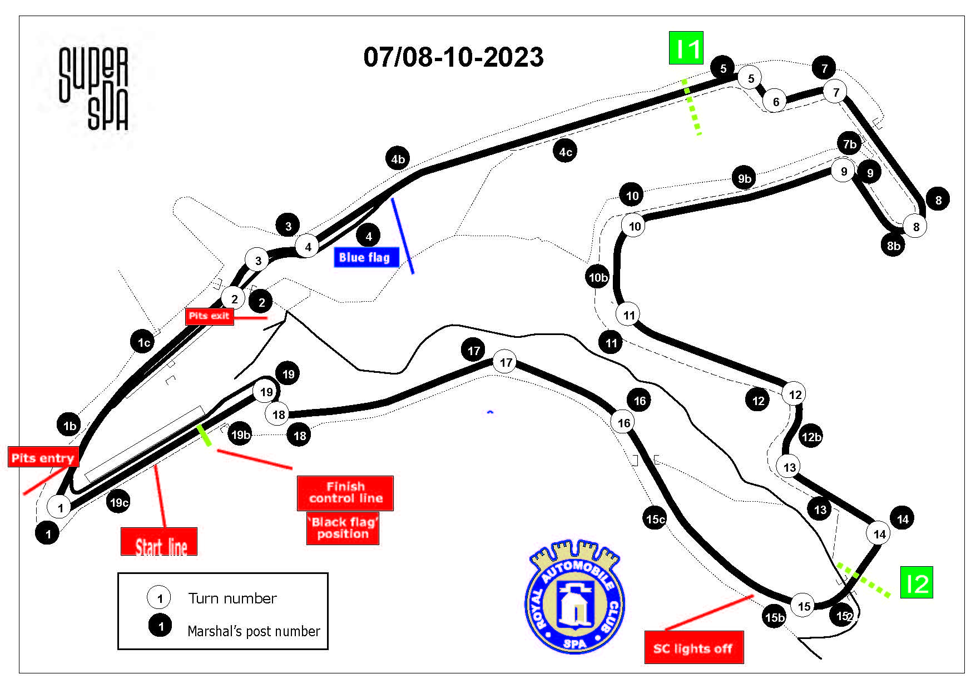
Circuit map

Slide 3
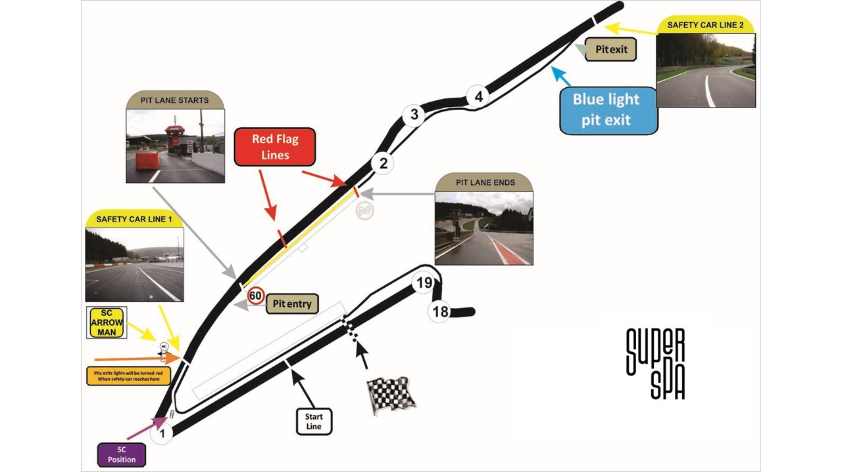
Pit Lane Map

Slide 4
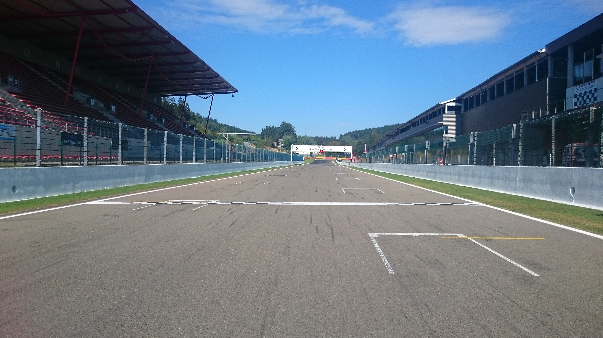
Control – Finish Line

Slide 5
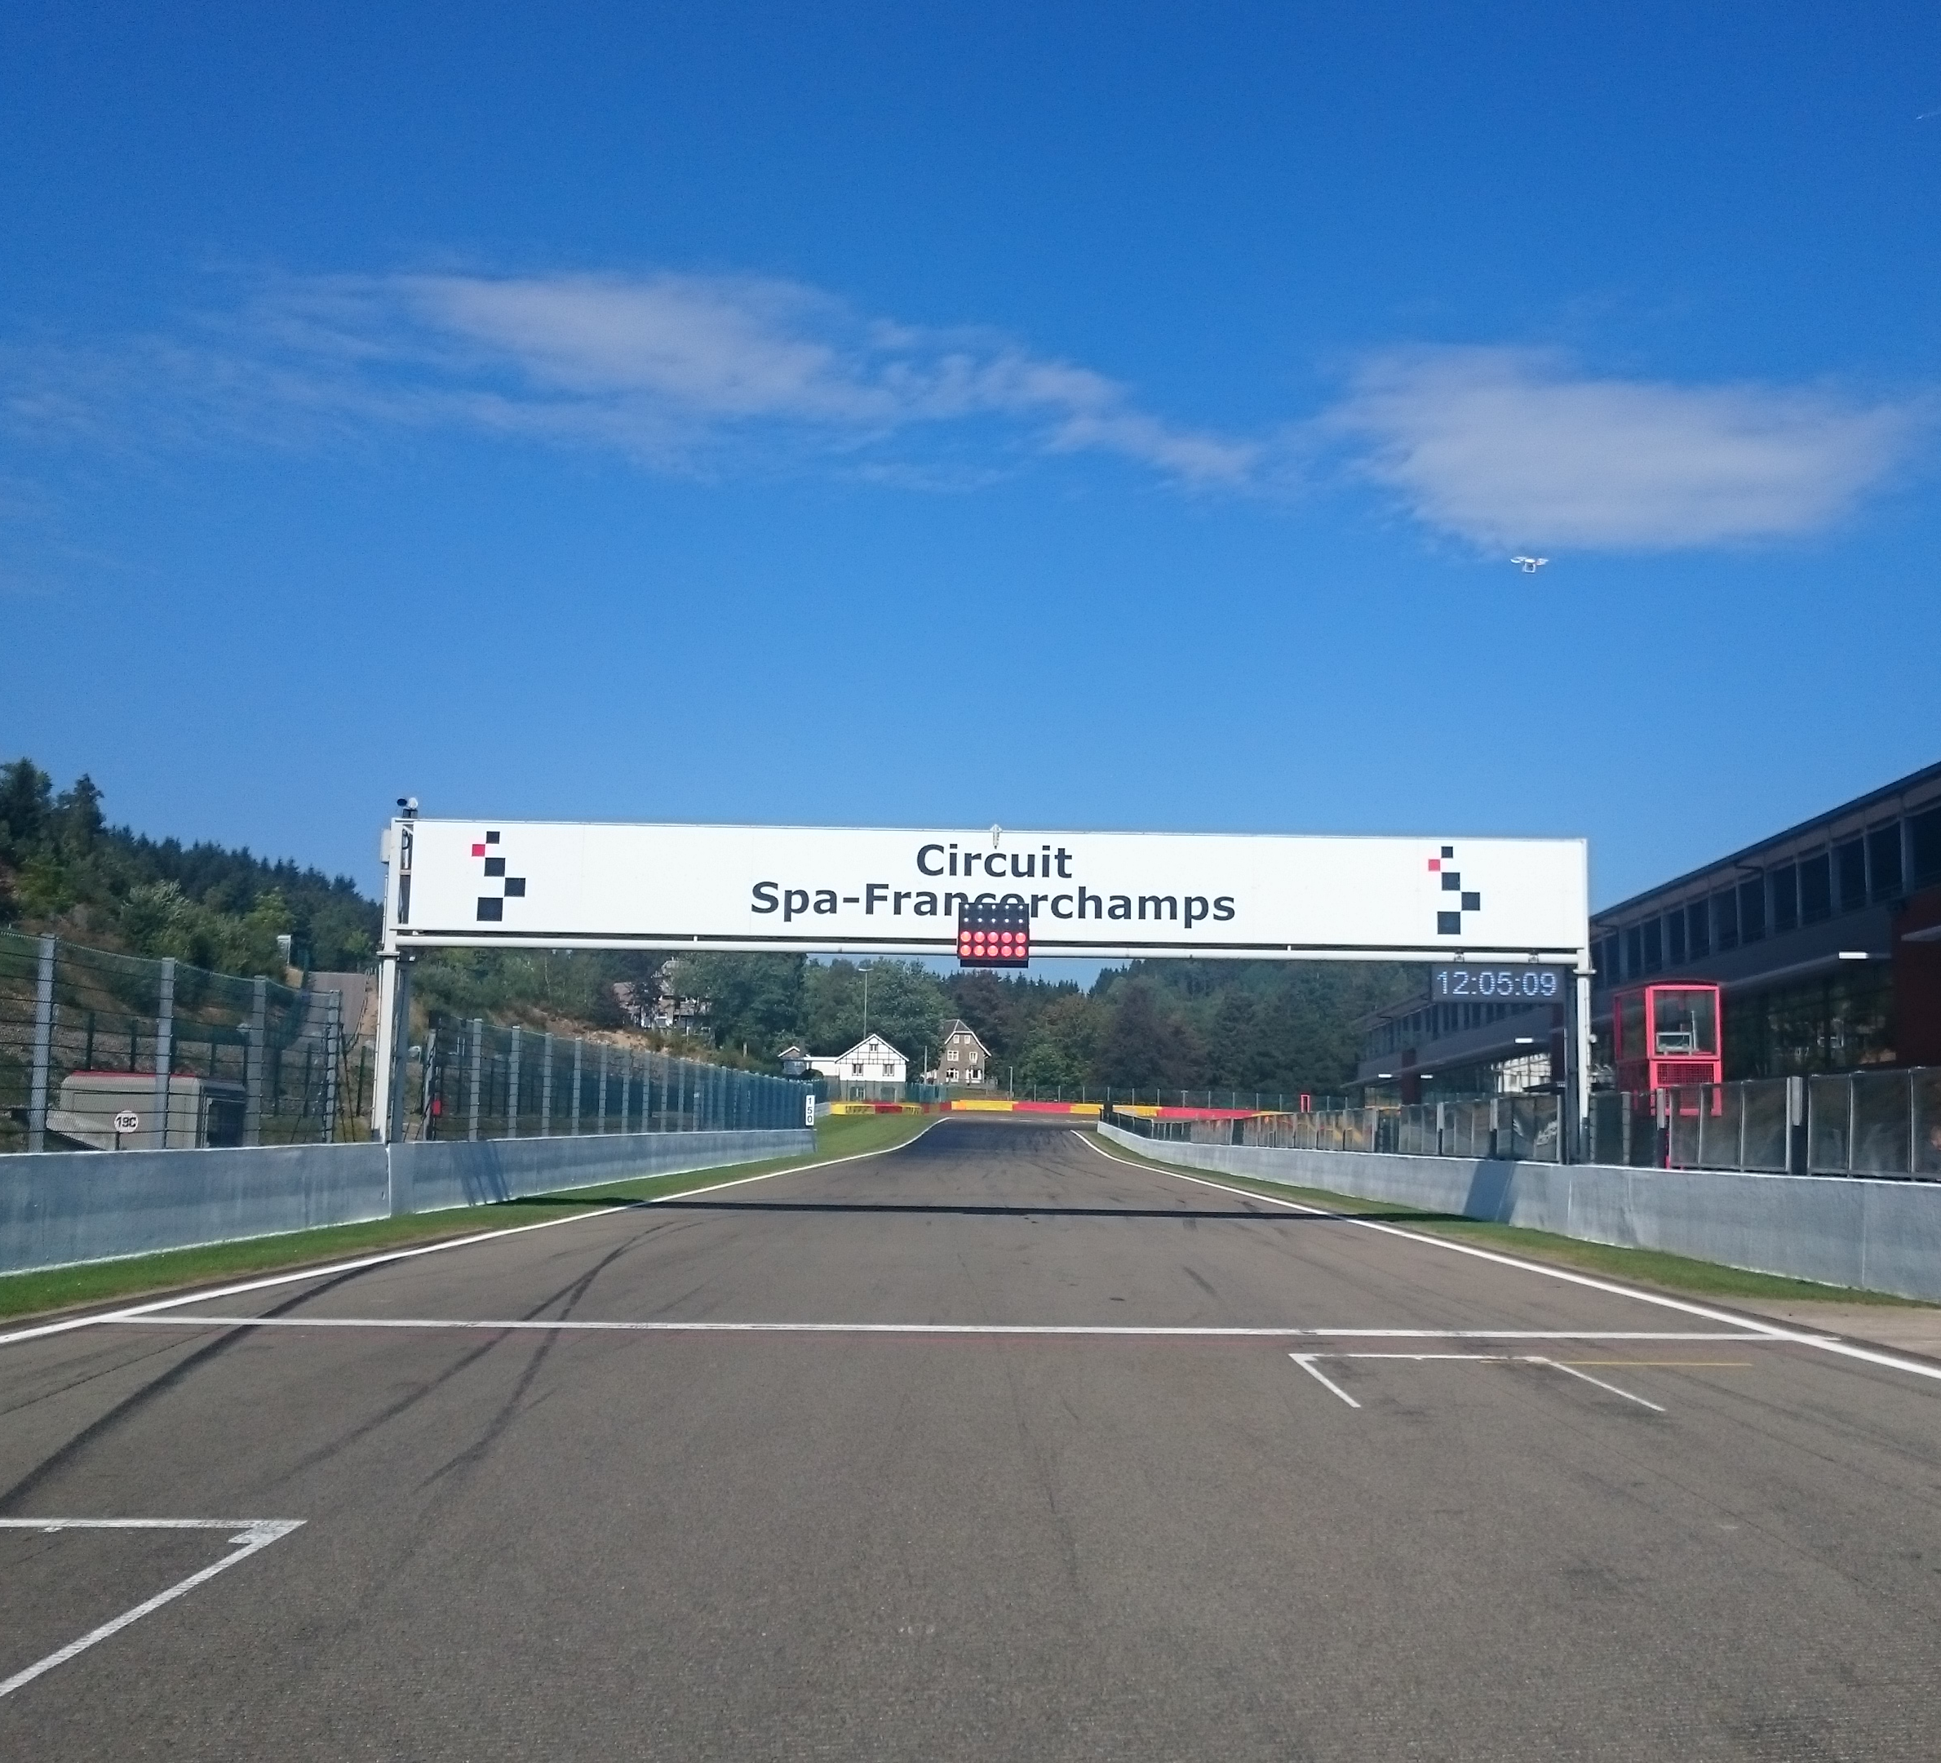
Start Line

Slide 6
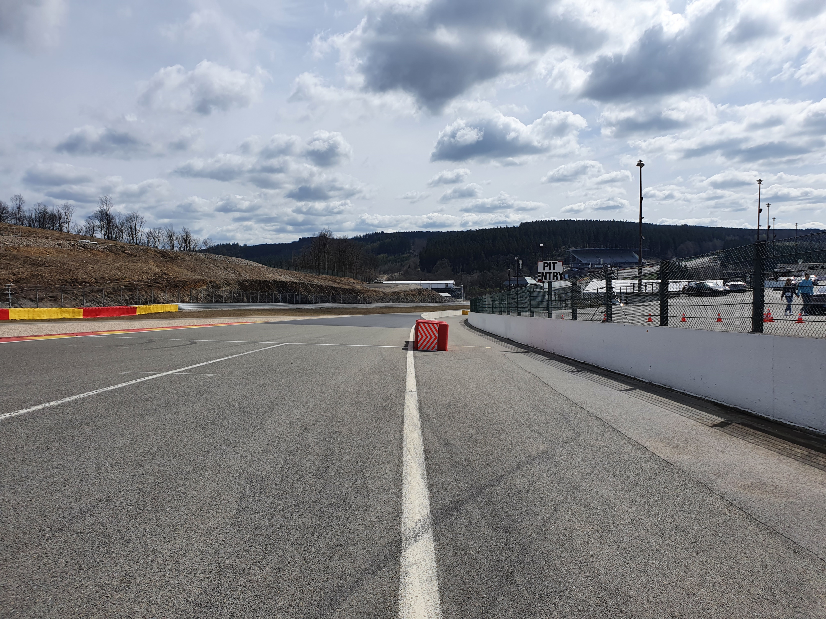
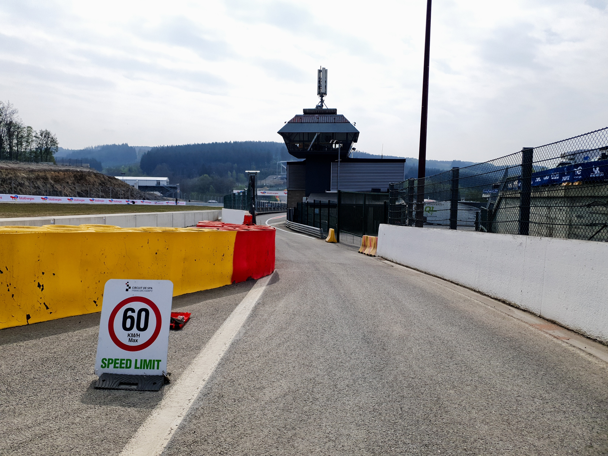

Pits entry
RHS after T1

Slide 7
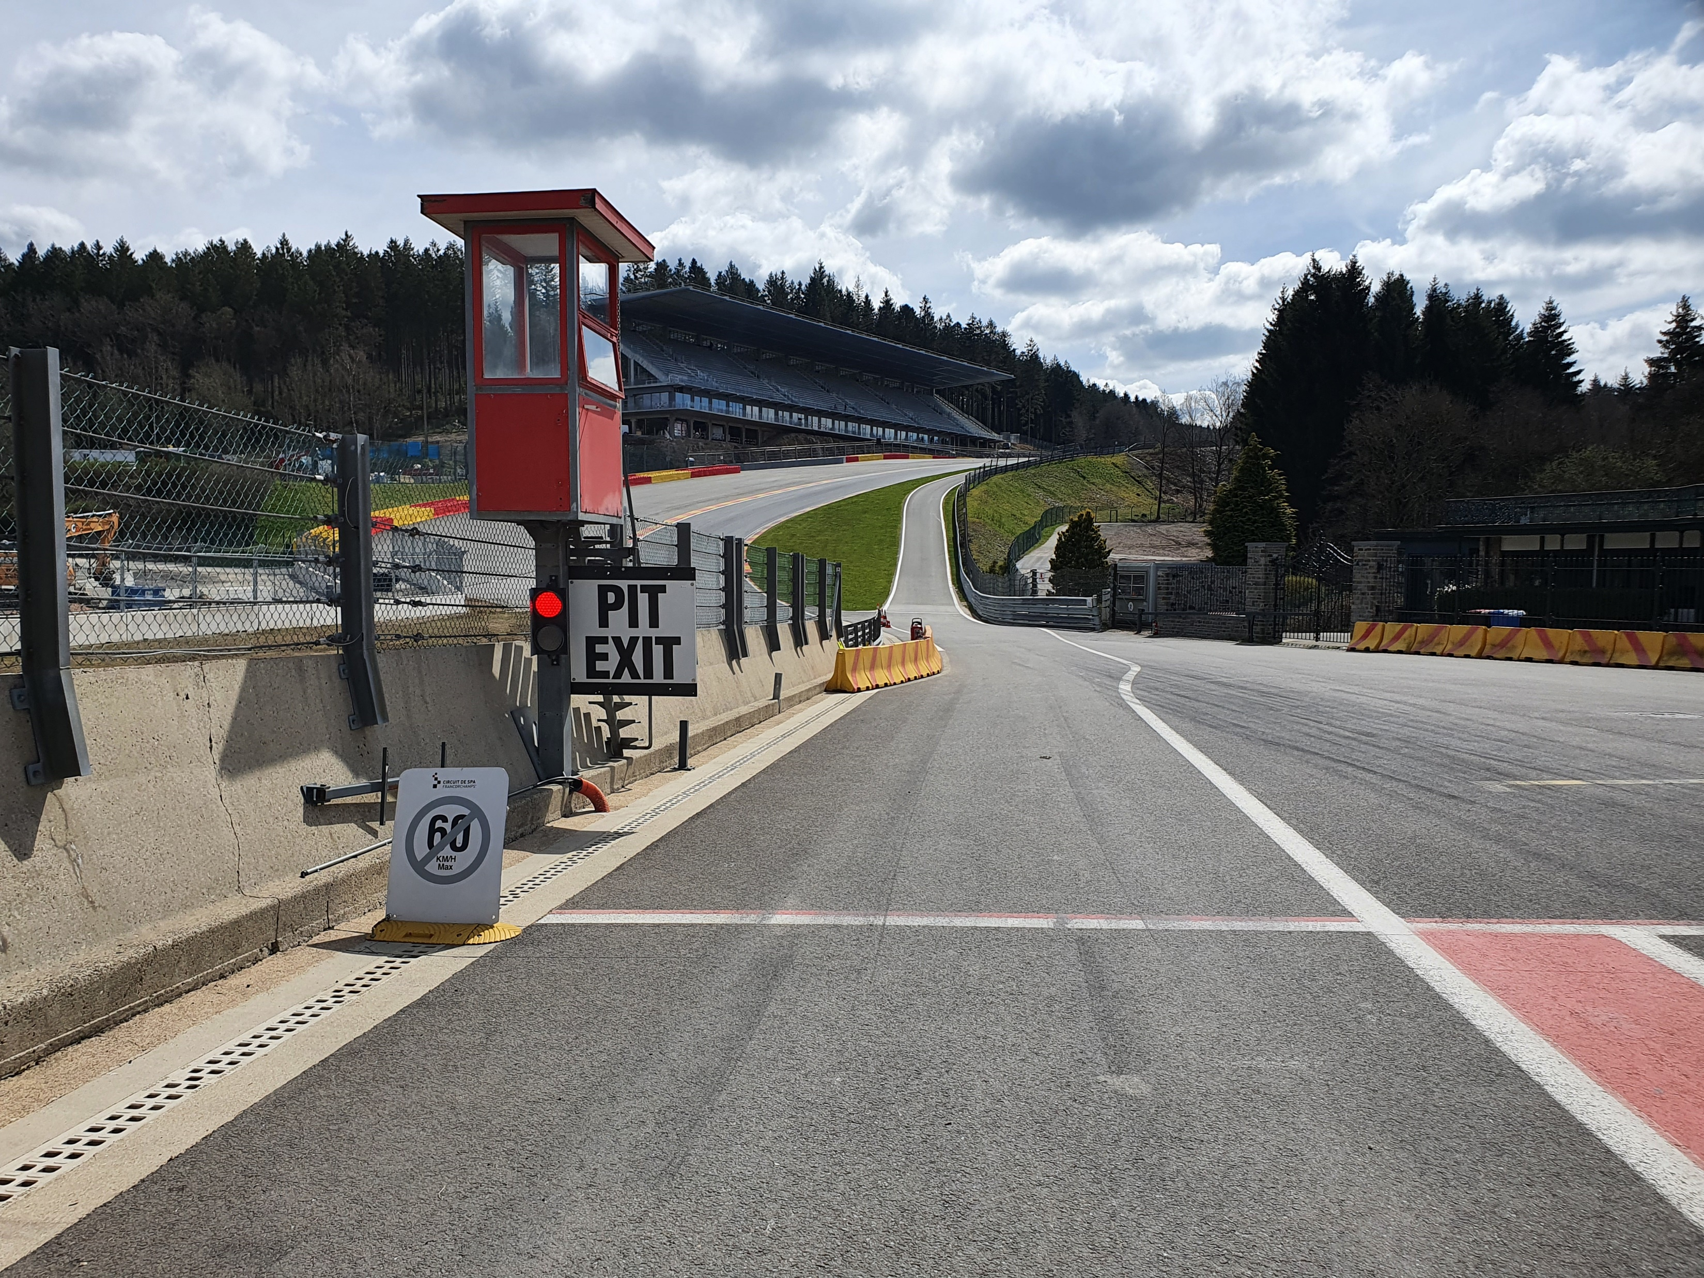
Pits exit – speed limit ends

Slide 8
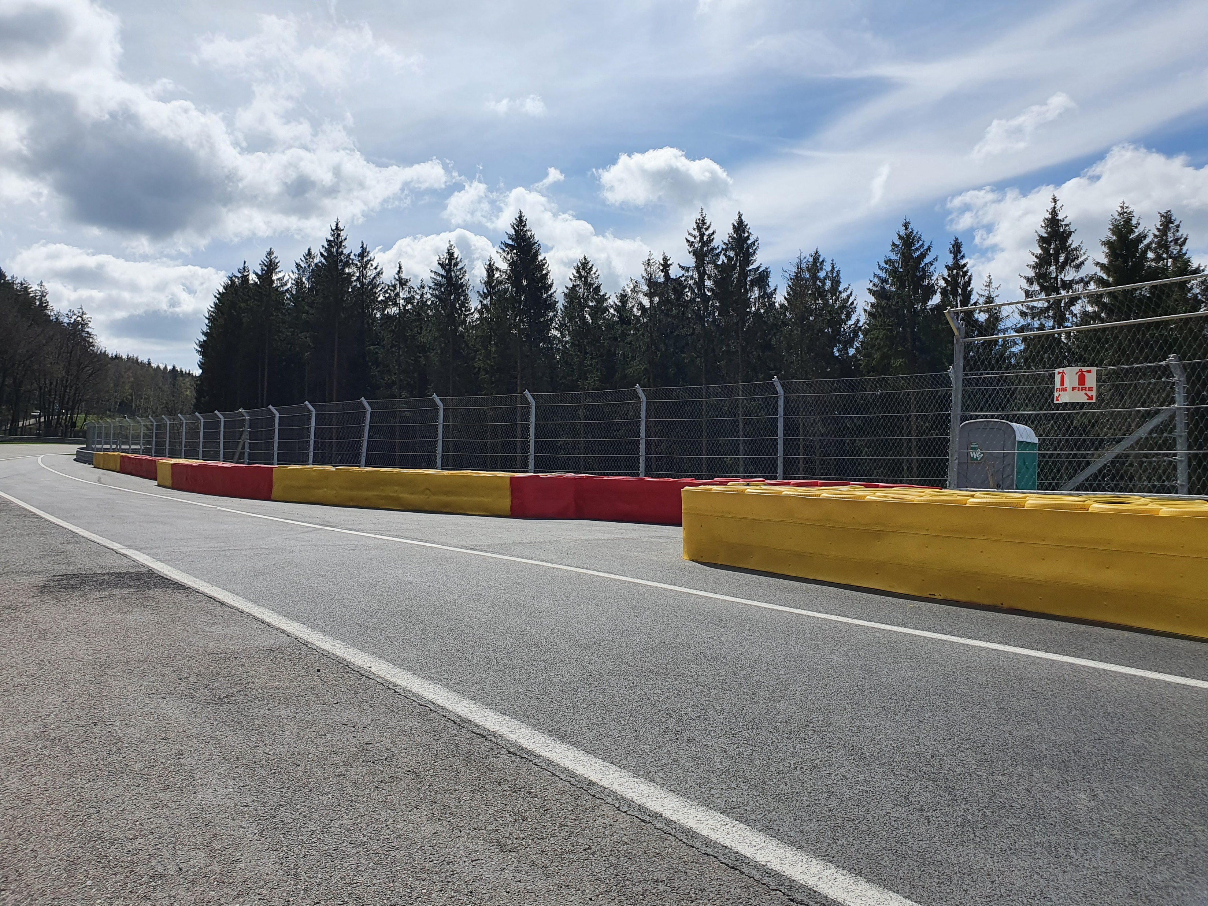


Repeater Blue Flag Marshal @ Pits exit

Slide 9
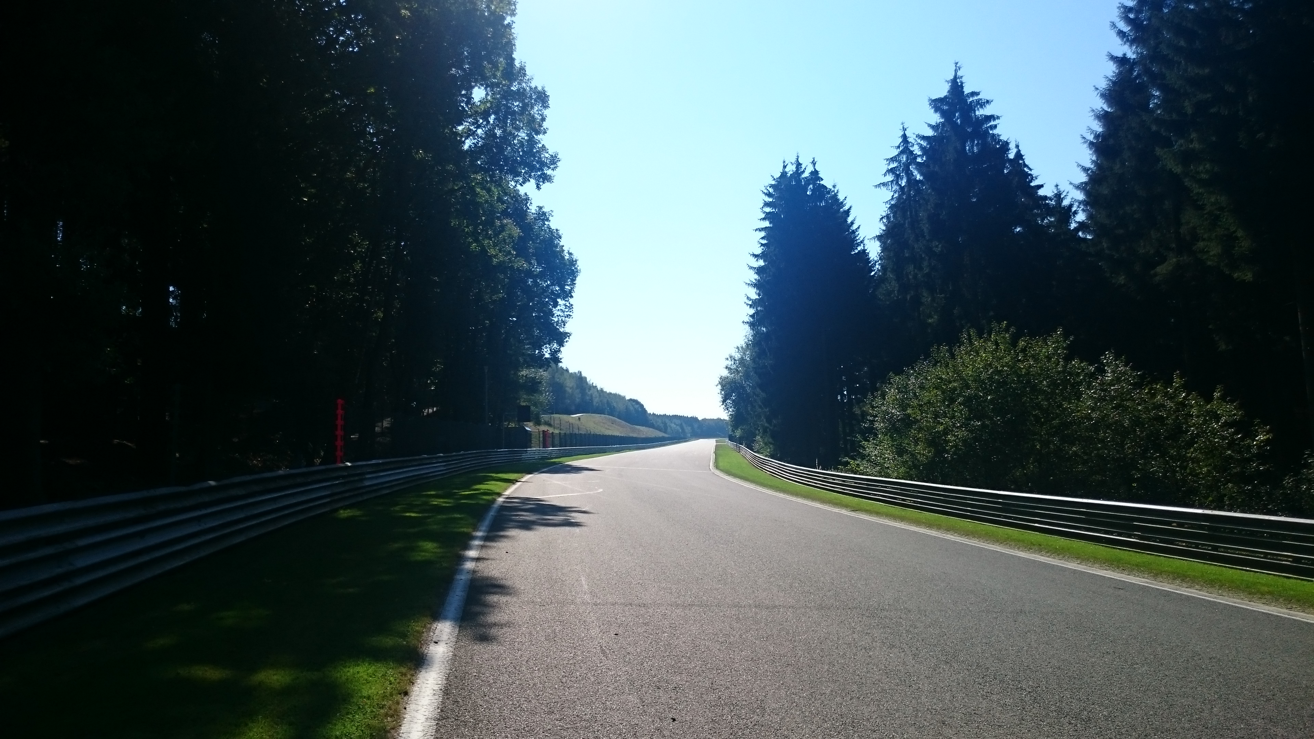

Track marshal repeater blue light @ pit exit

Slide 10
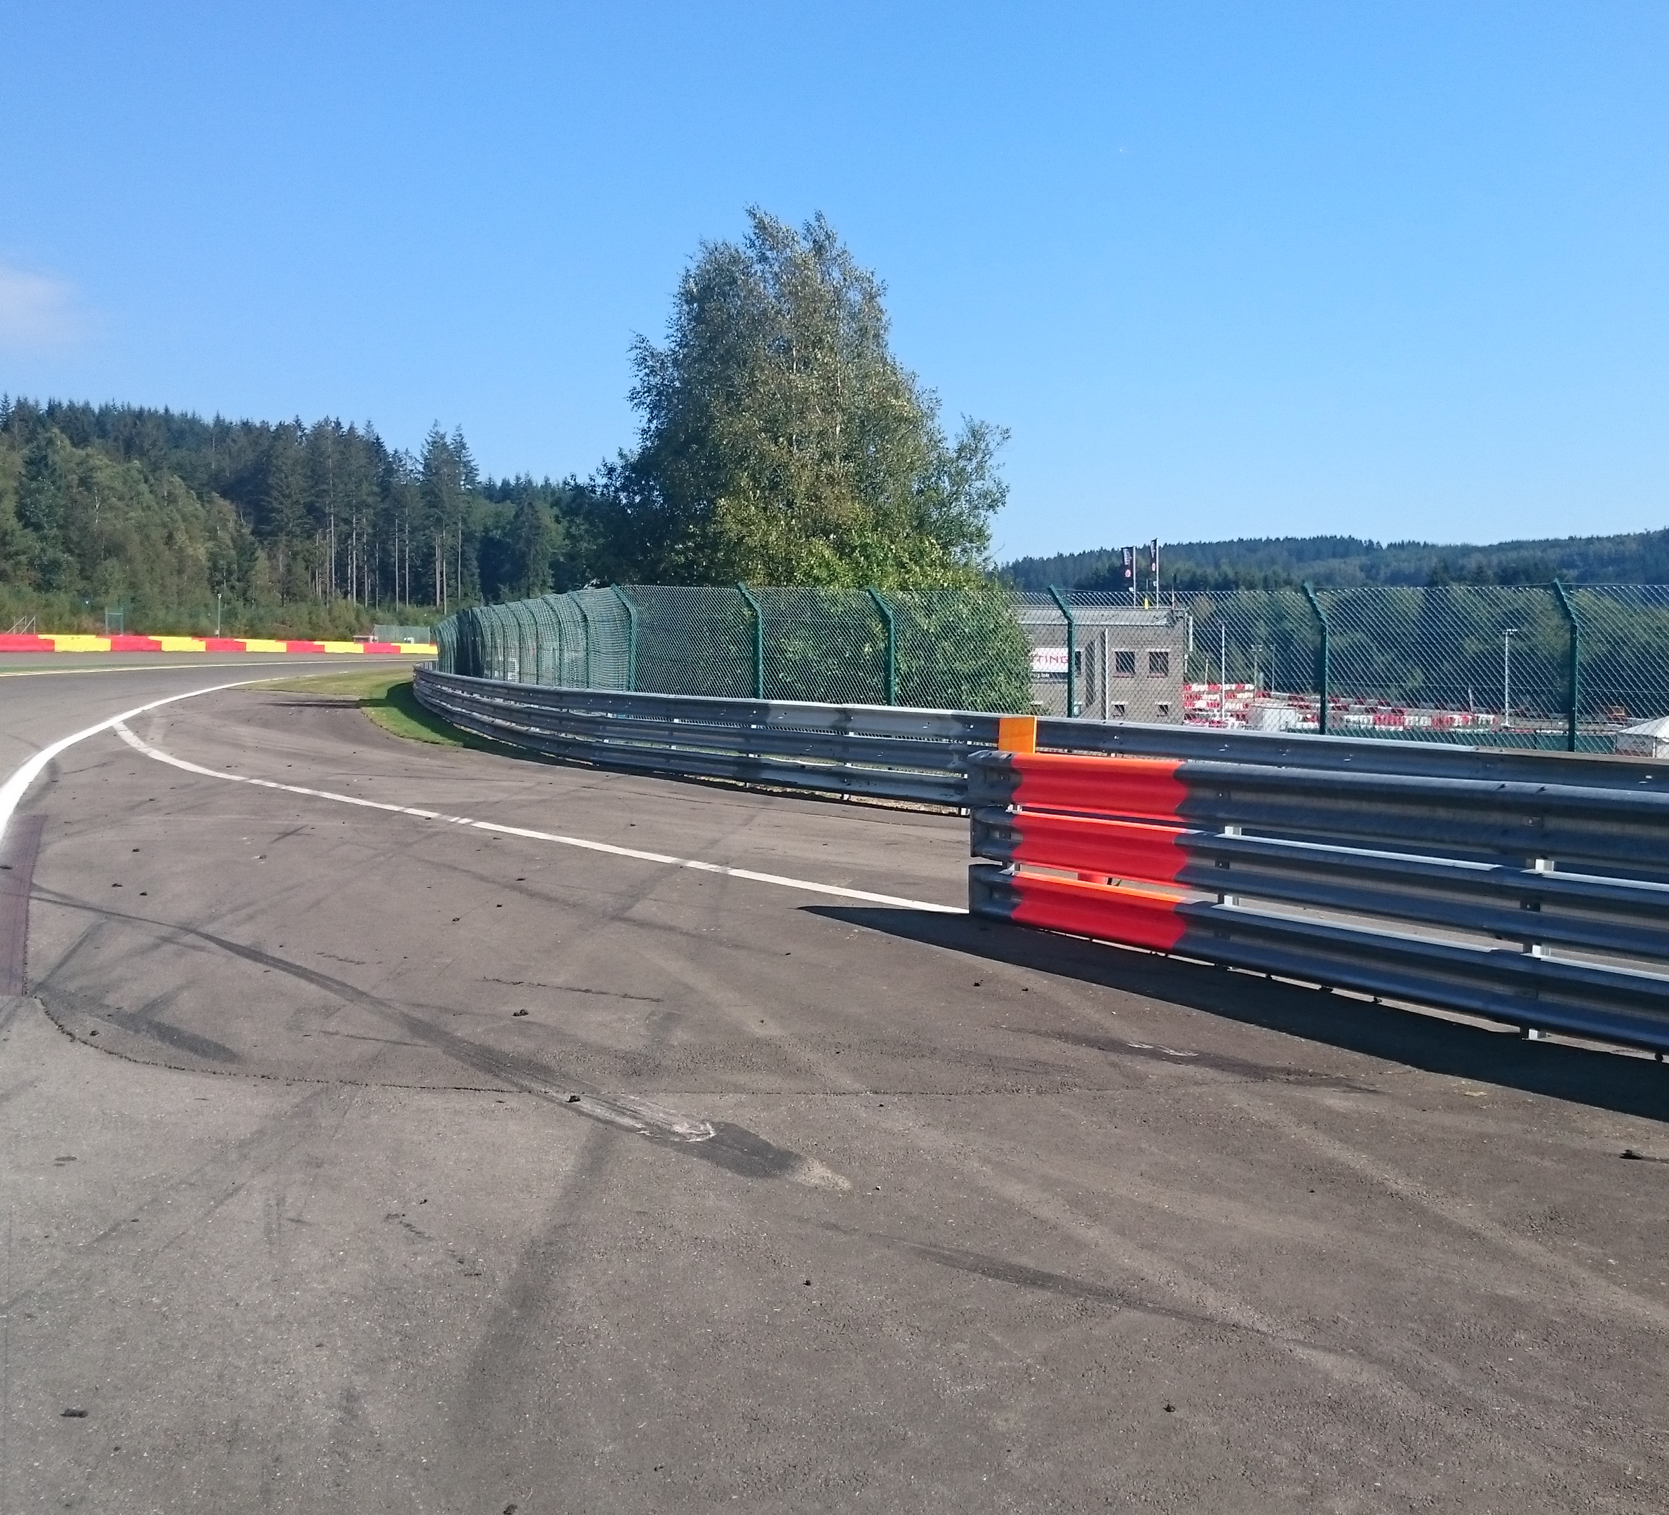
Openings for cars

Slide 11
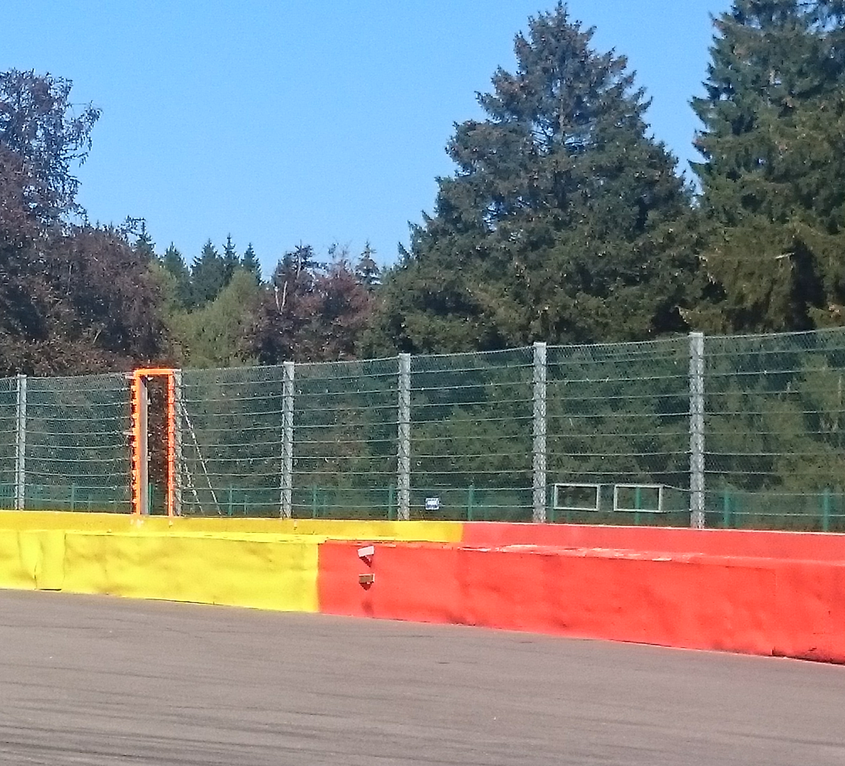
Emergency windows

Slide 12
End of the Races
No deceleration lap - ! Marshals on Track after T1 !
All cars by T1 La Source to Endurance Pit Lane
To your paddock area
All the cars

Slide 13
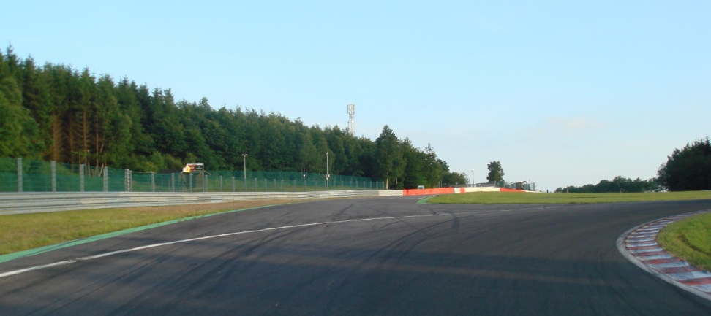
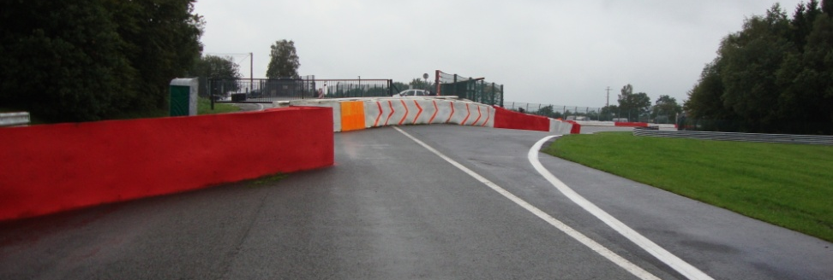
Escape road @ Turns 5 – 7

Slide 14
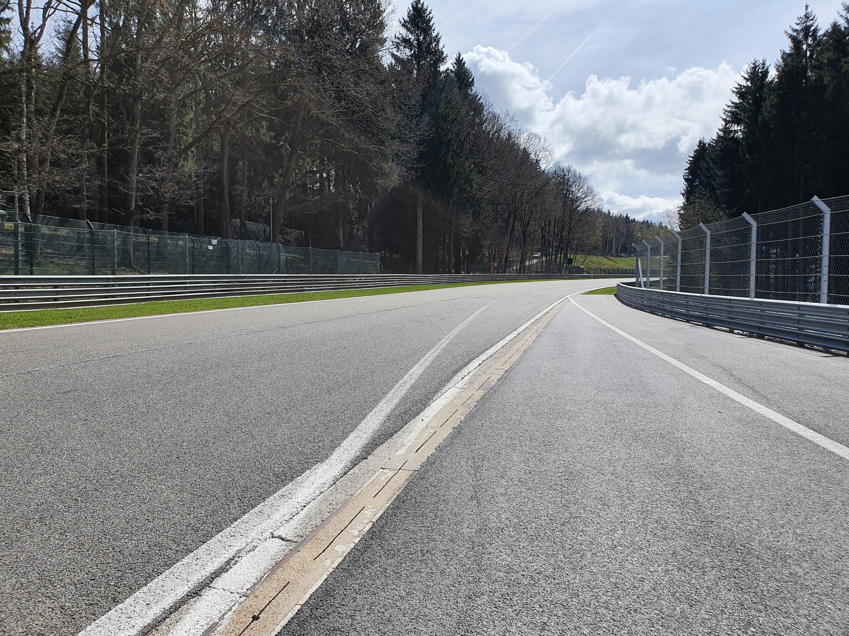
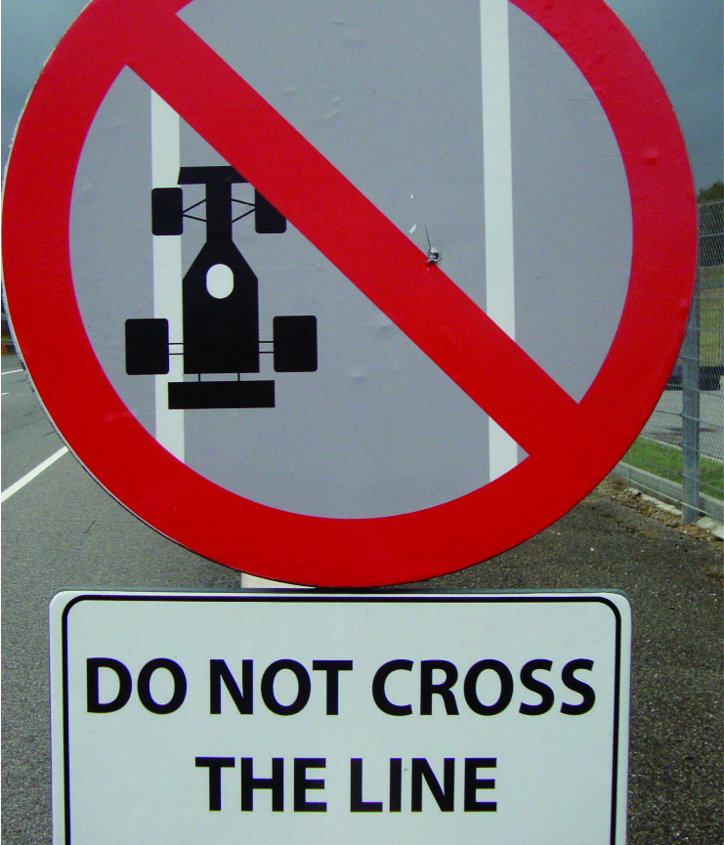
Pits entry & exit Lines & bollards
Pit Entry after La Source
Pictures Pit exit endurance after T4

Slide 15
Formation lap from Eau rouge gate
Join the Green paddock (assembly area) time in the written briefing notes « Go to Green paddock»
When aproaching the starting grid it will be directly the start -> light procedure

Slide 16
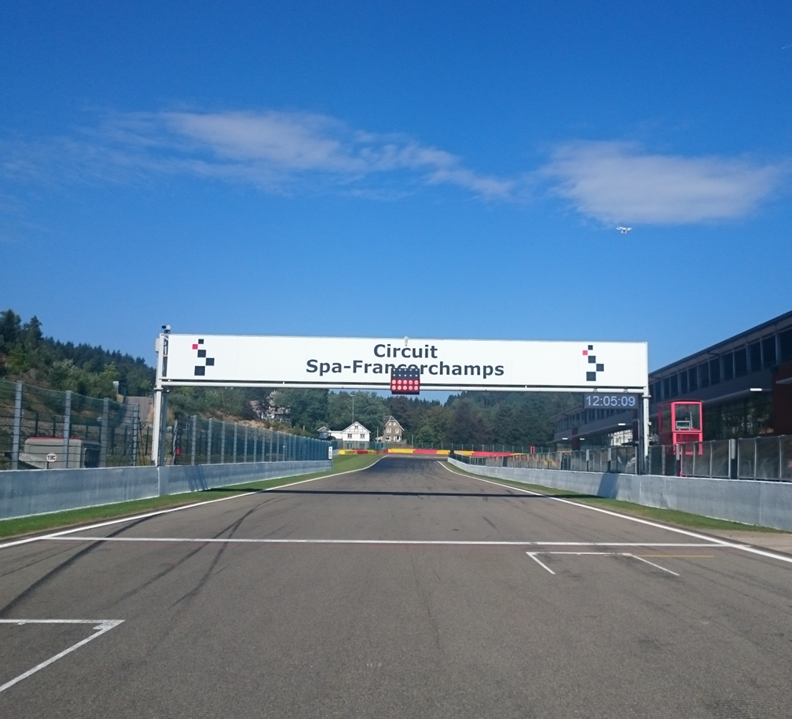
Start line

Slide 17
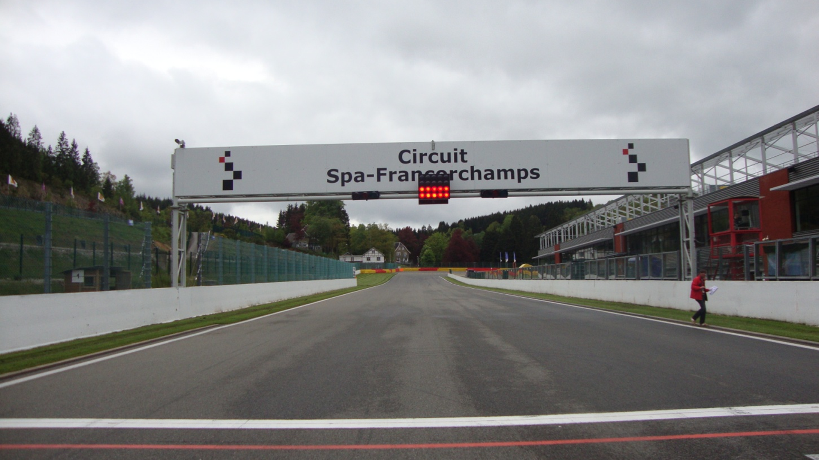
Start Lights: Red On/Off

Slide 18
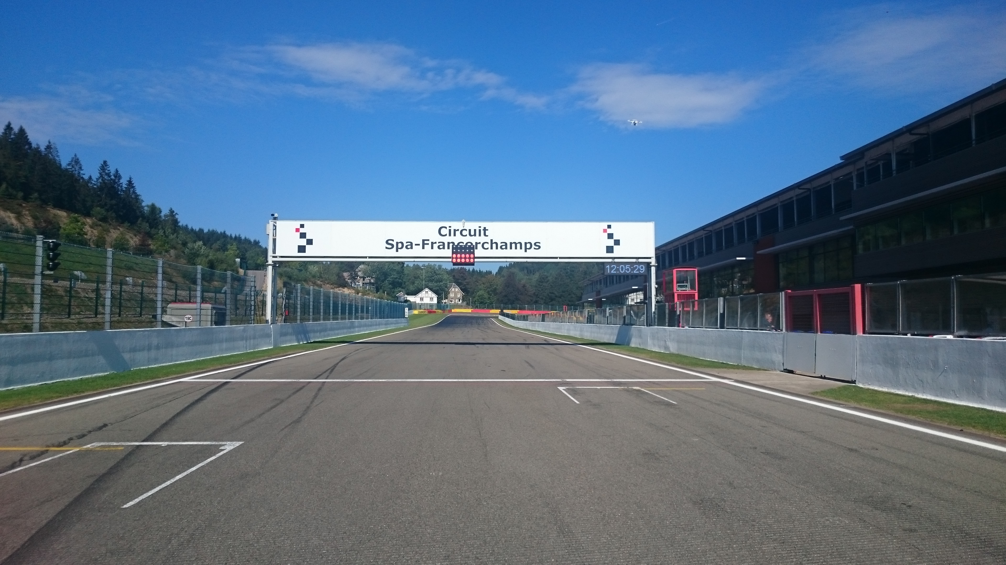


Aborted Start Lights

Slide 19
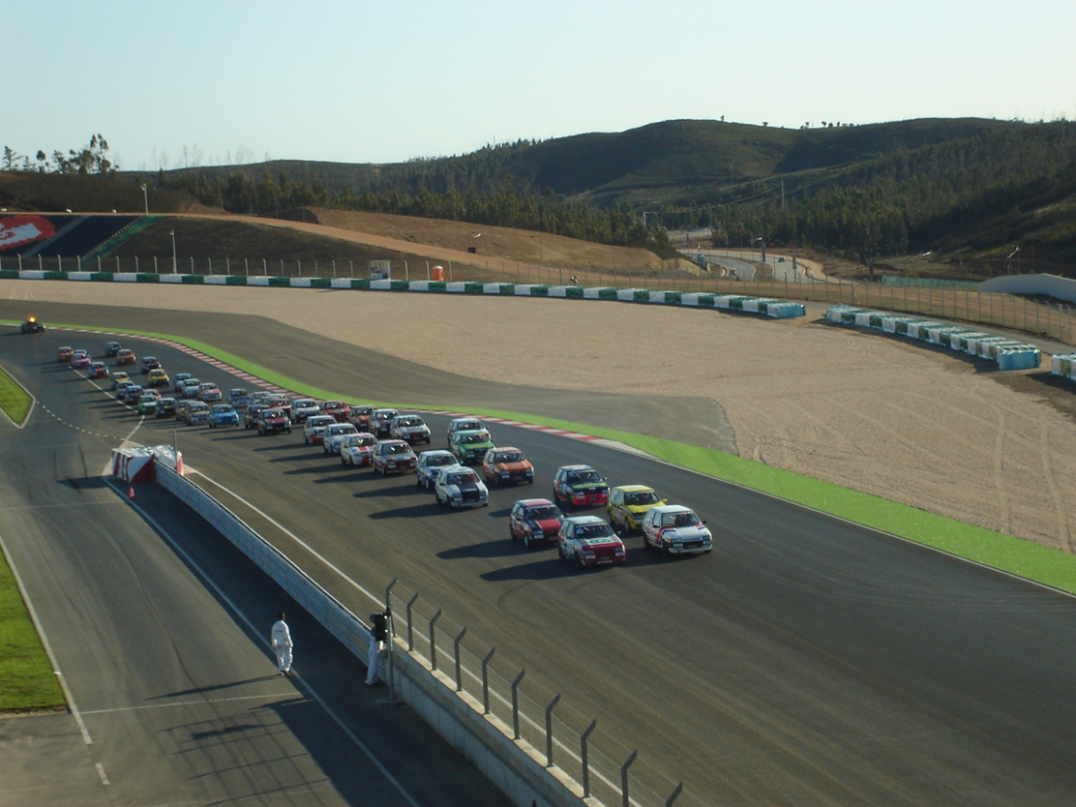
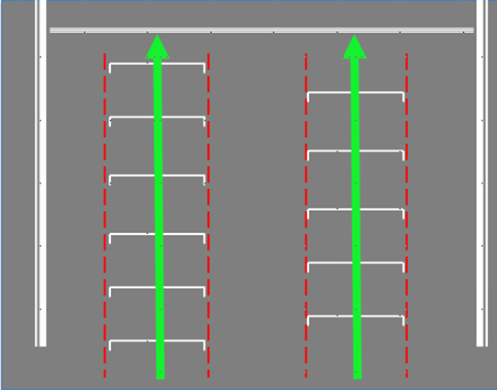
Example of right formation
The cars must hold the starting formation by driving from the beginning over the „starting boxes“ on their respective sides (starting corridors).

Slide 20
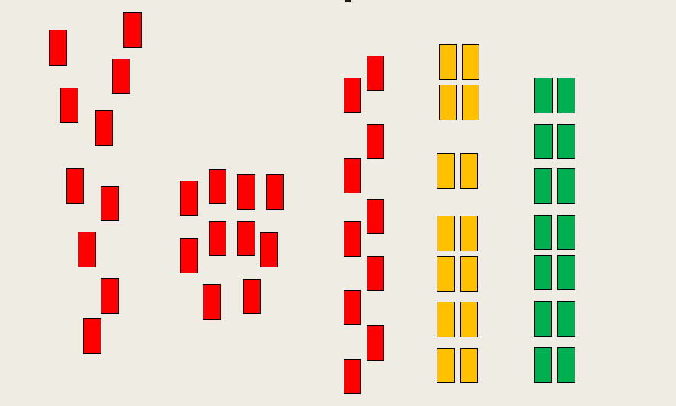
Formation: Red = No Green = Yes

Slide 21
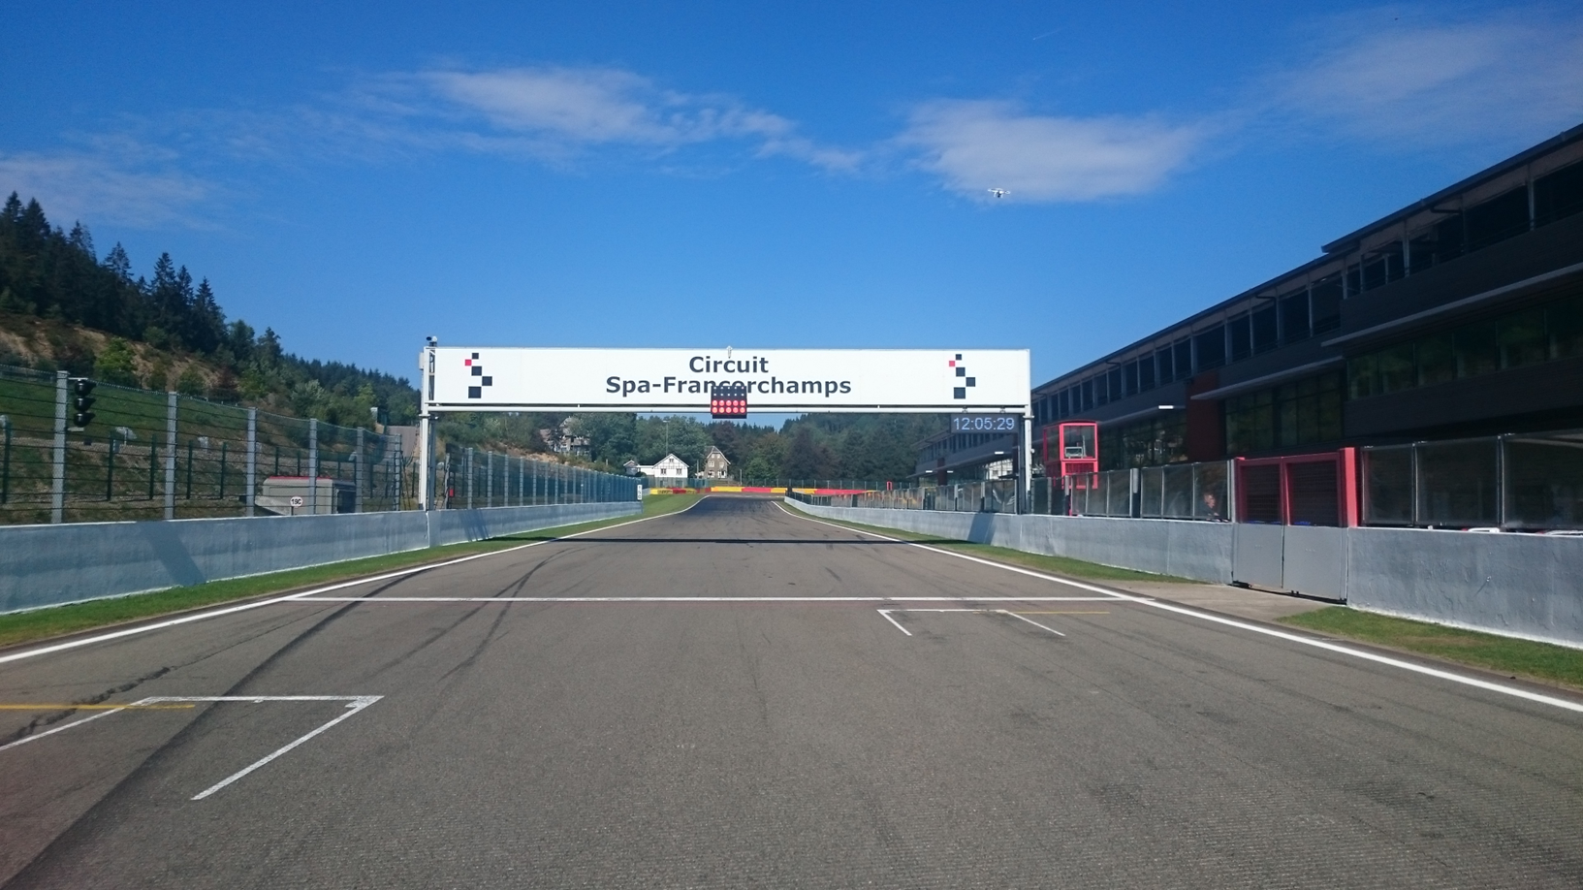
Red Flag Line – Race Suspended

Slide 22
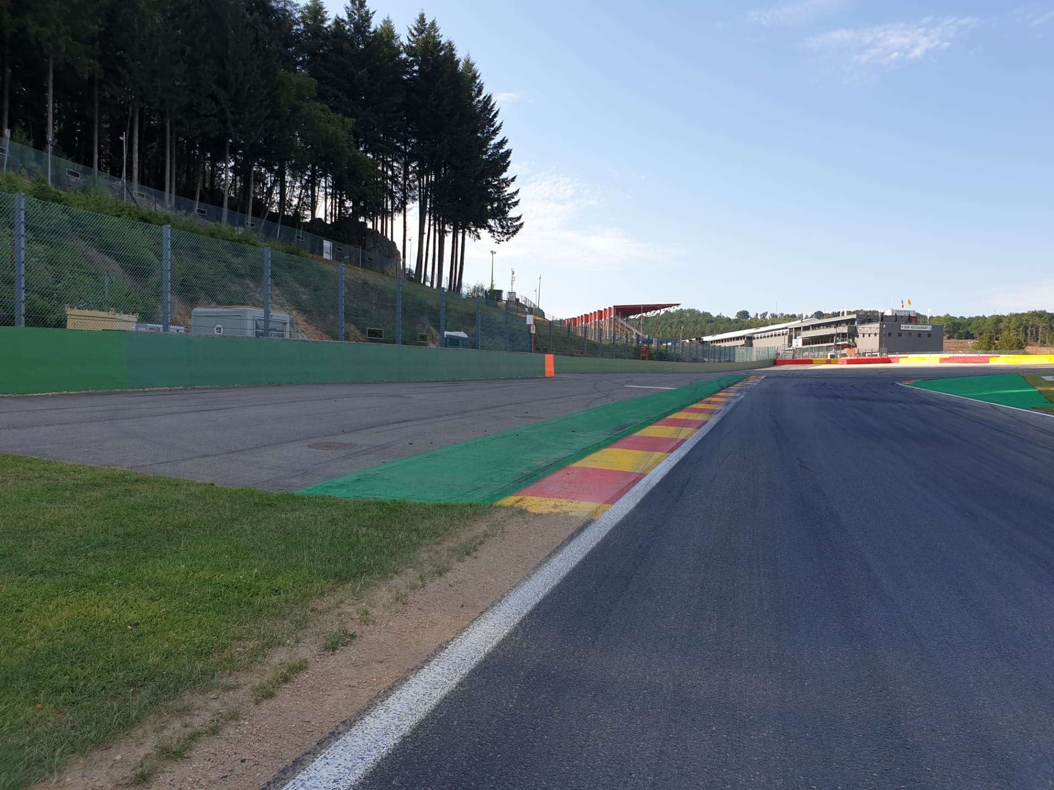

Safety-Car Arrow Man
SC

Slide 23
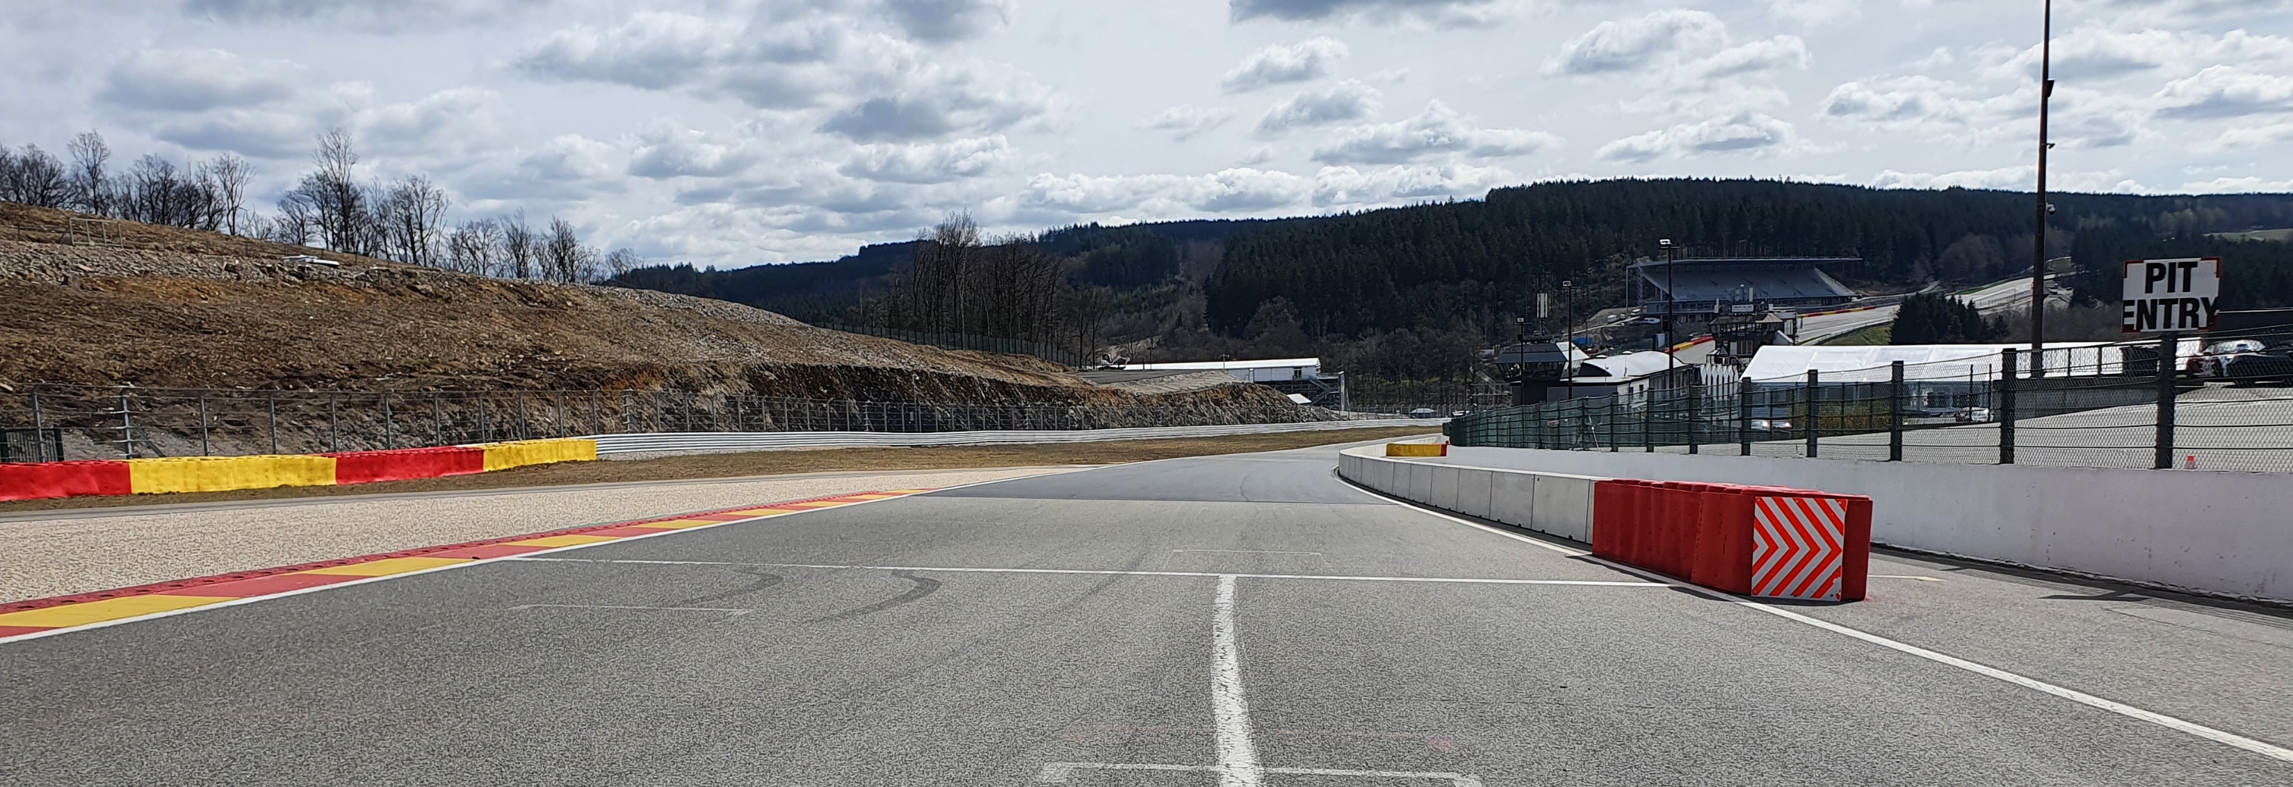
Safety Car Line 1

Slide 24
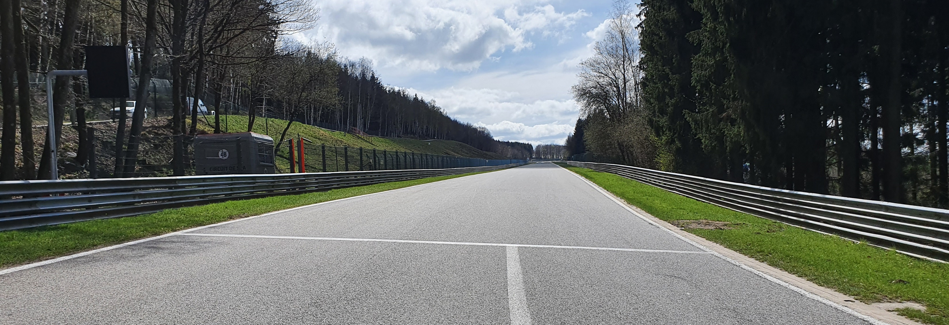
Safety Car Line 2

Slide 25
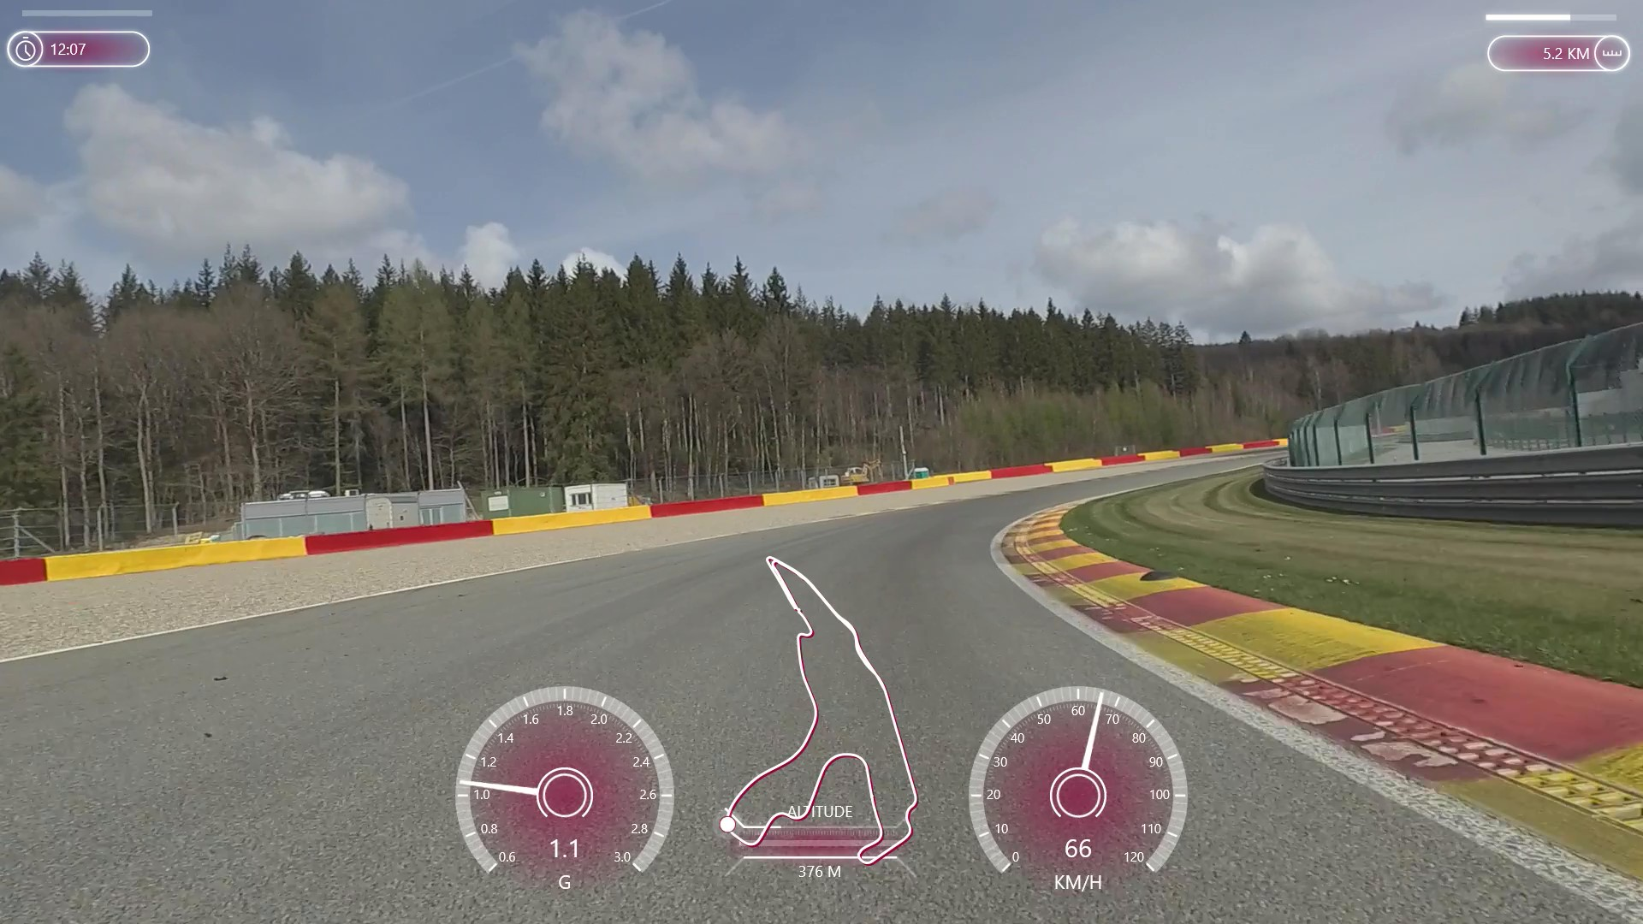
Safety-Car Lights OFF

Slide 26
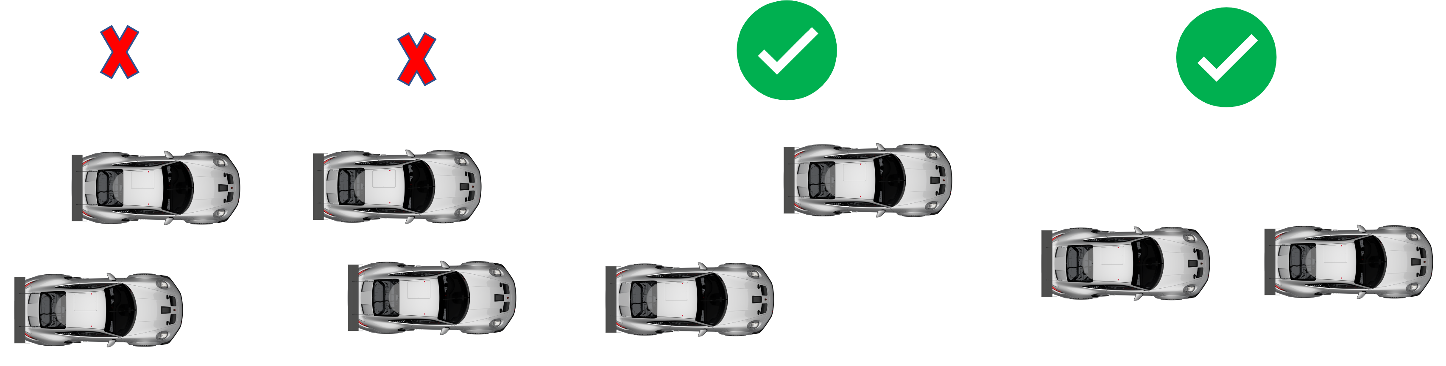
Re-start under safety-car

Slide 27
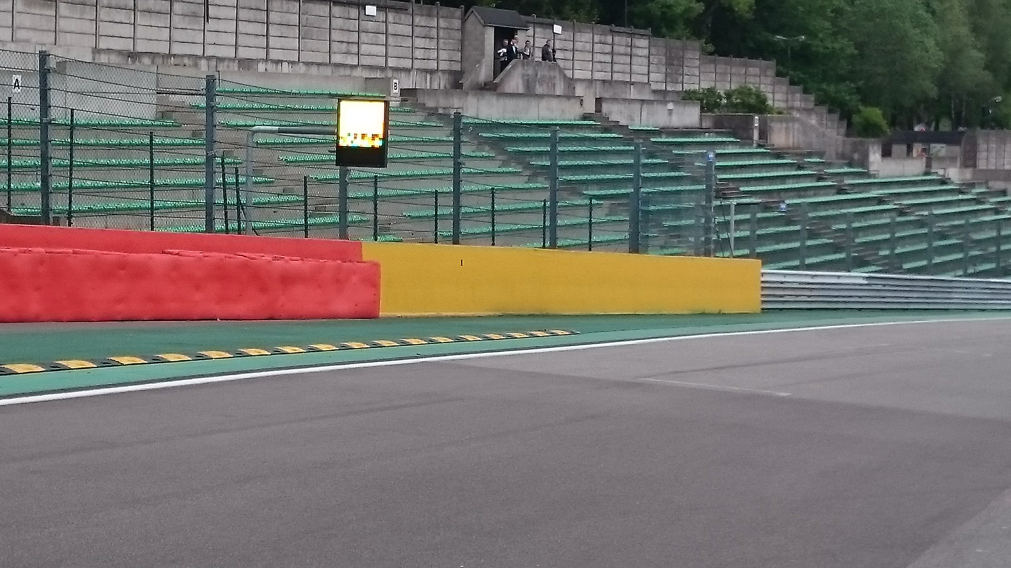
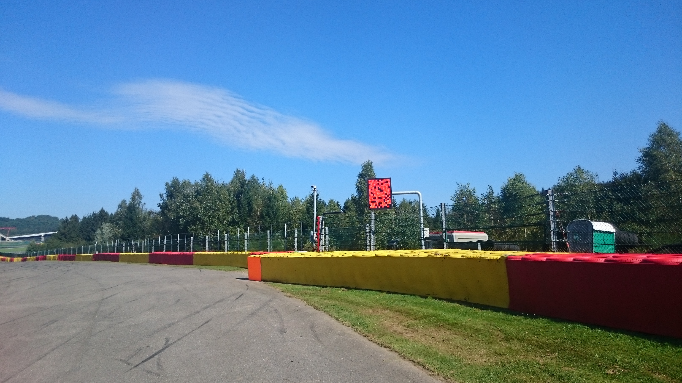
Yellow Flags – Marshaling Lights System

Slide 28
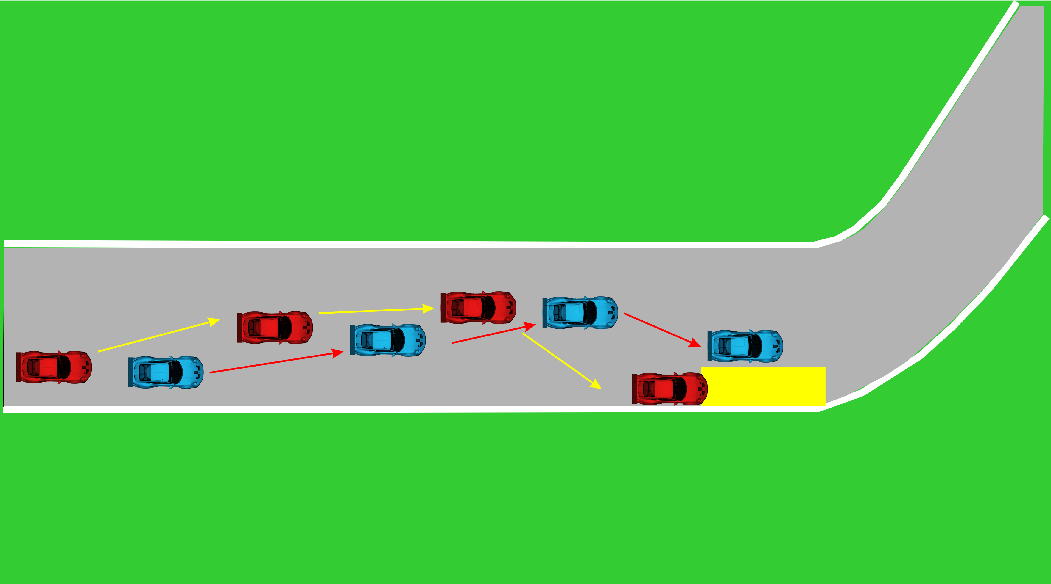
Overtaking

Slide 29
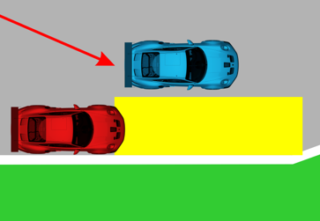
Overtaking

Slide 30
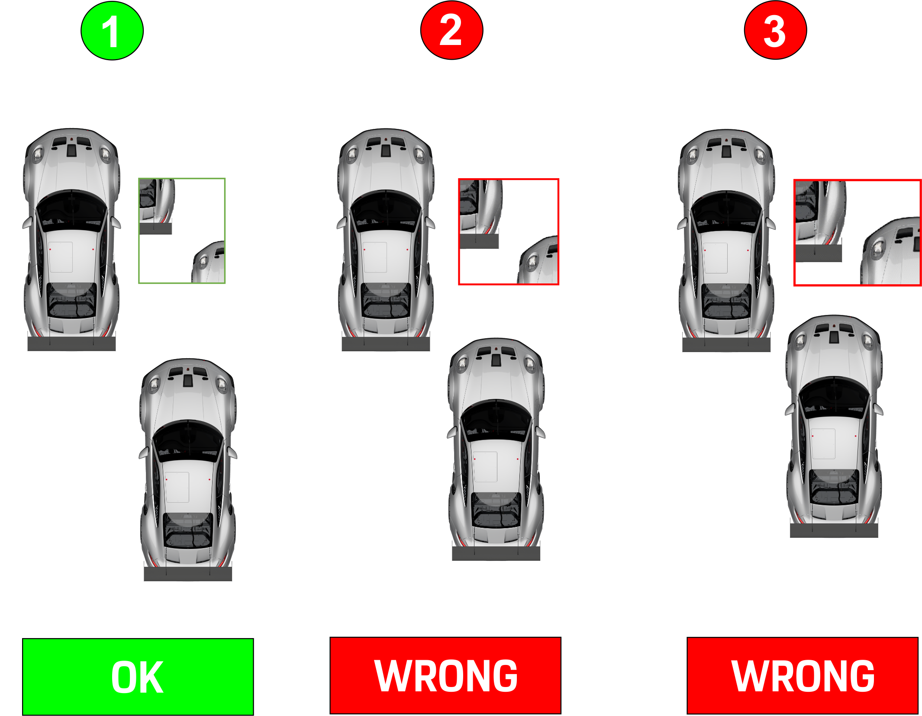
Overtaking

Slide 31
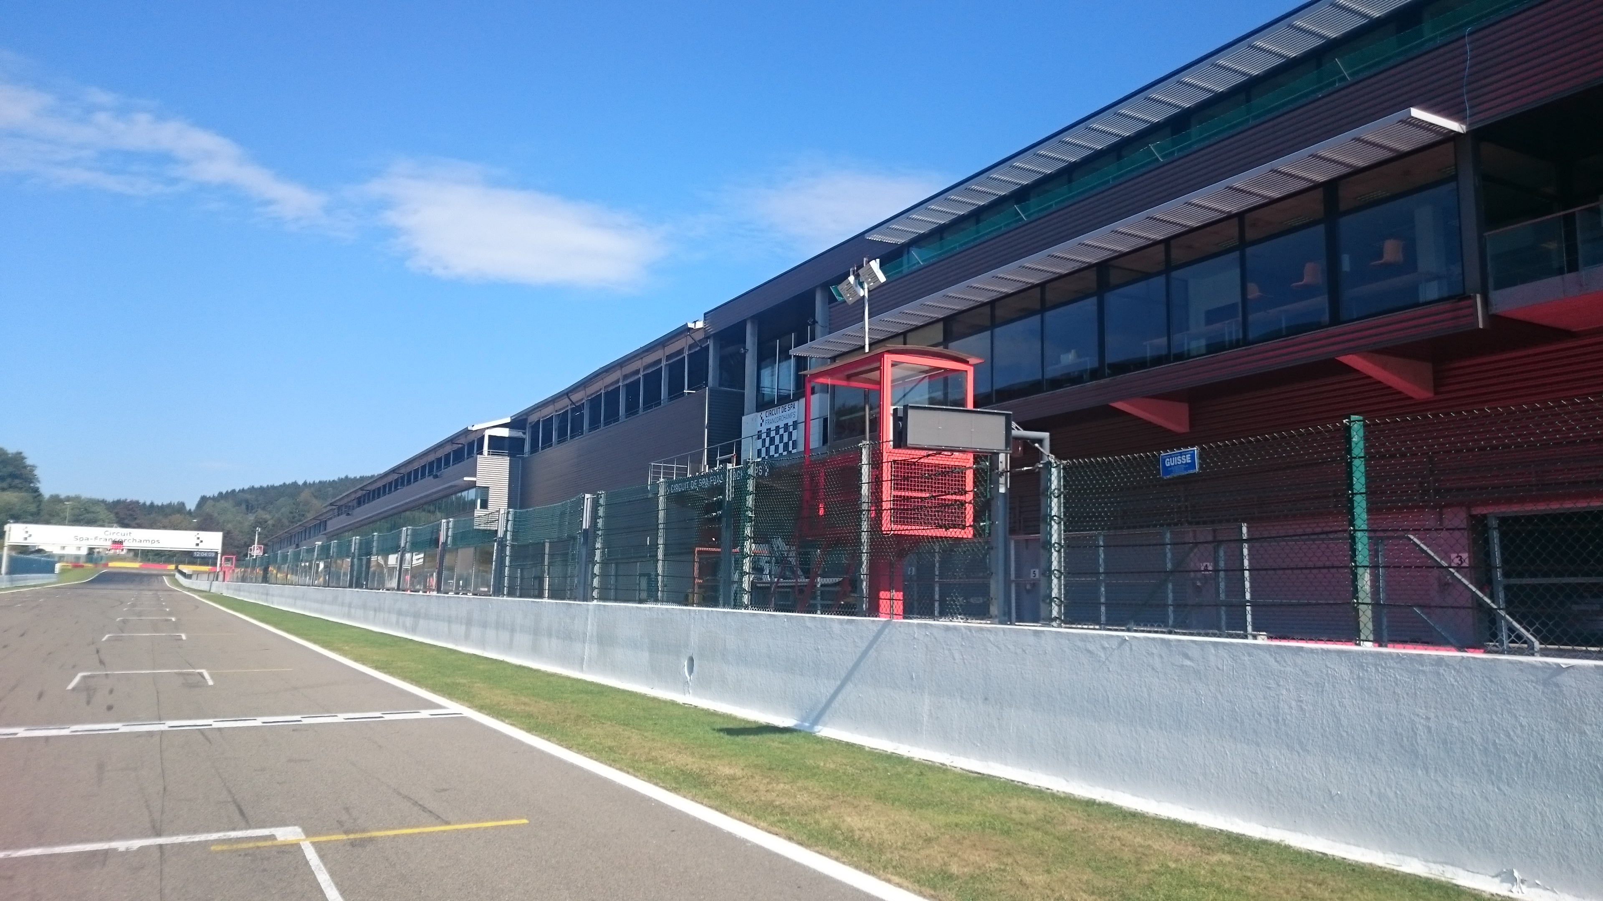




Signaling Platform

Slide 32
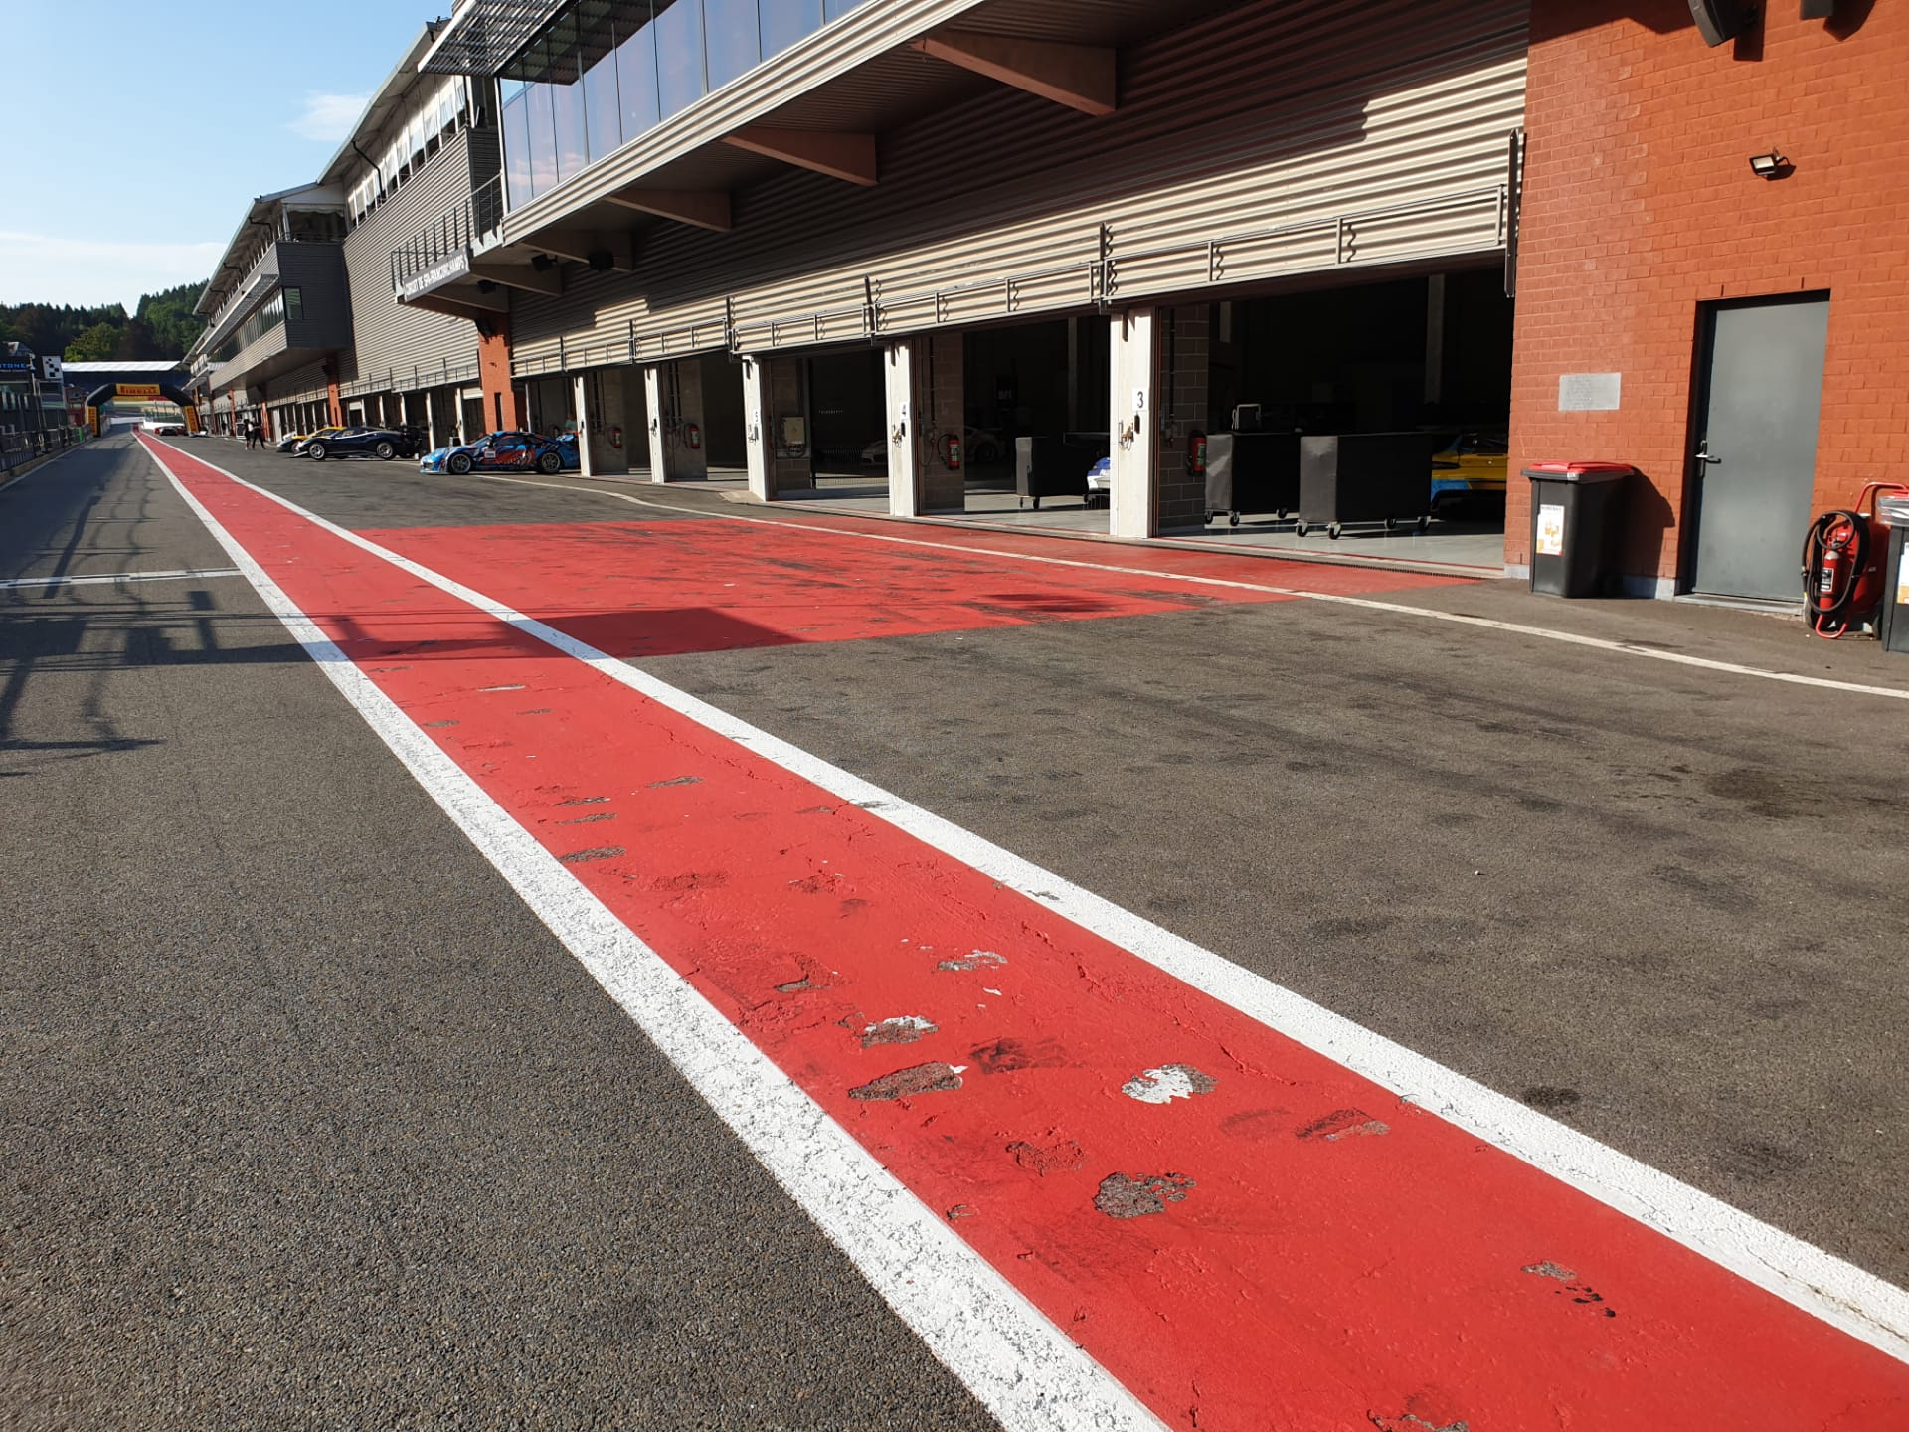
Stop & Go penalty box

Slide 33
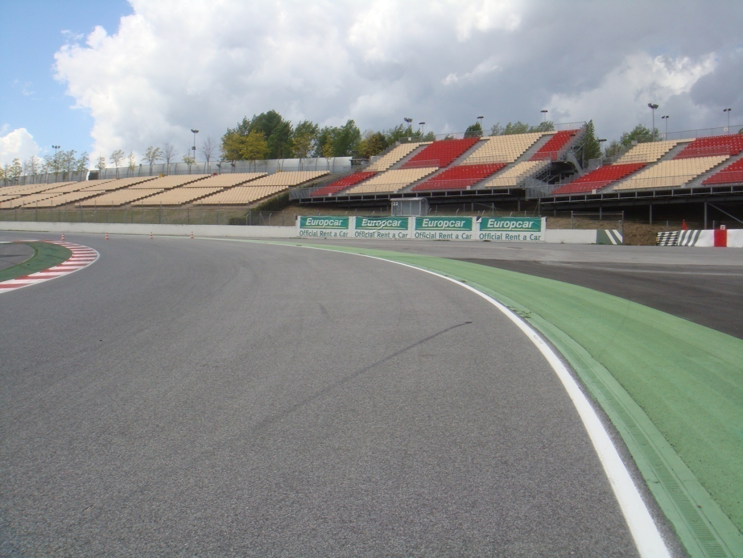
Appendix L – Track Limits

Slide 34
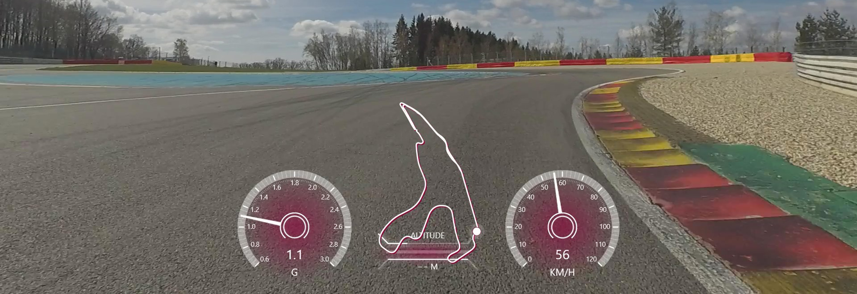
T5

Slide 35
Pit window
R1: between 20' & 30’
R2: between 25' & 35' 150sec
Pit In/Pit Out 120 sec

Slide 36
Track access & Track exit
Track access : Green paddock assembling area -> Eau Rouge gate
Track exit T1 – no deceleration lap
Track exit

Slide 37
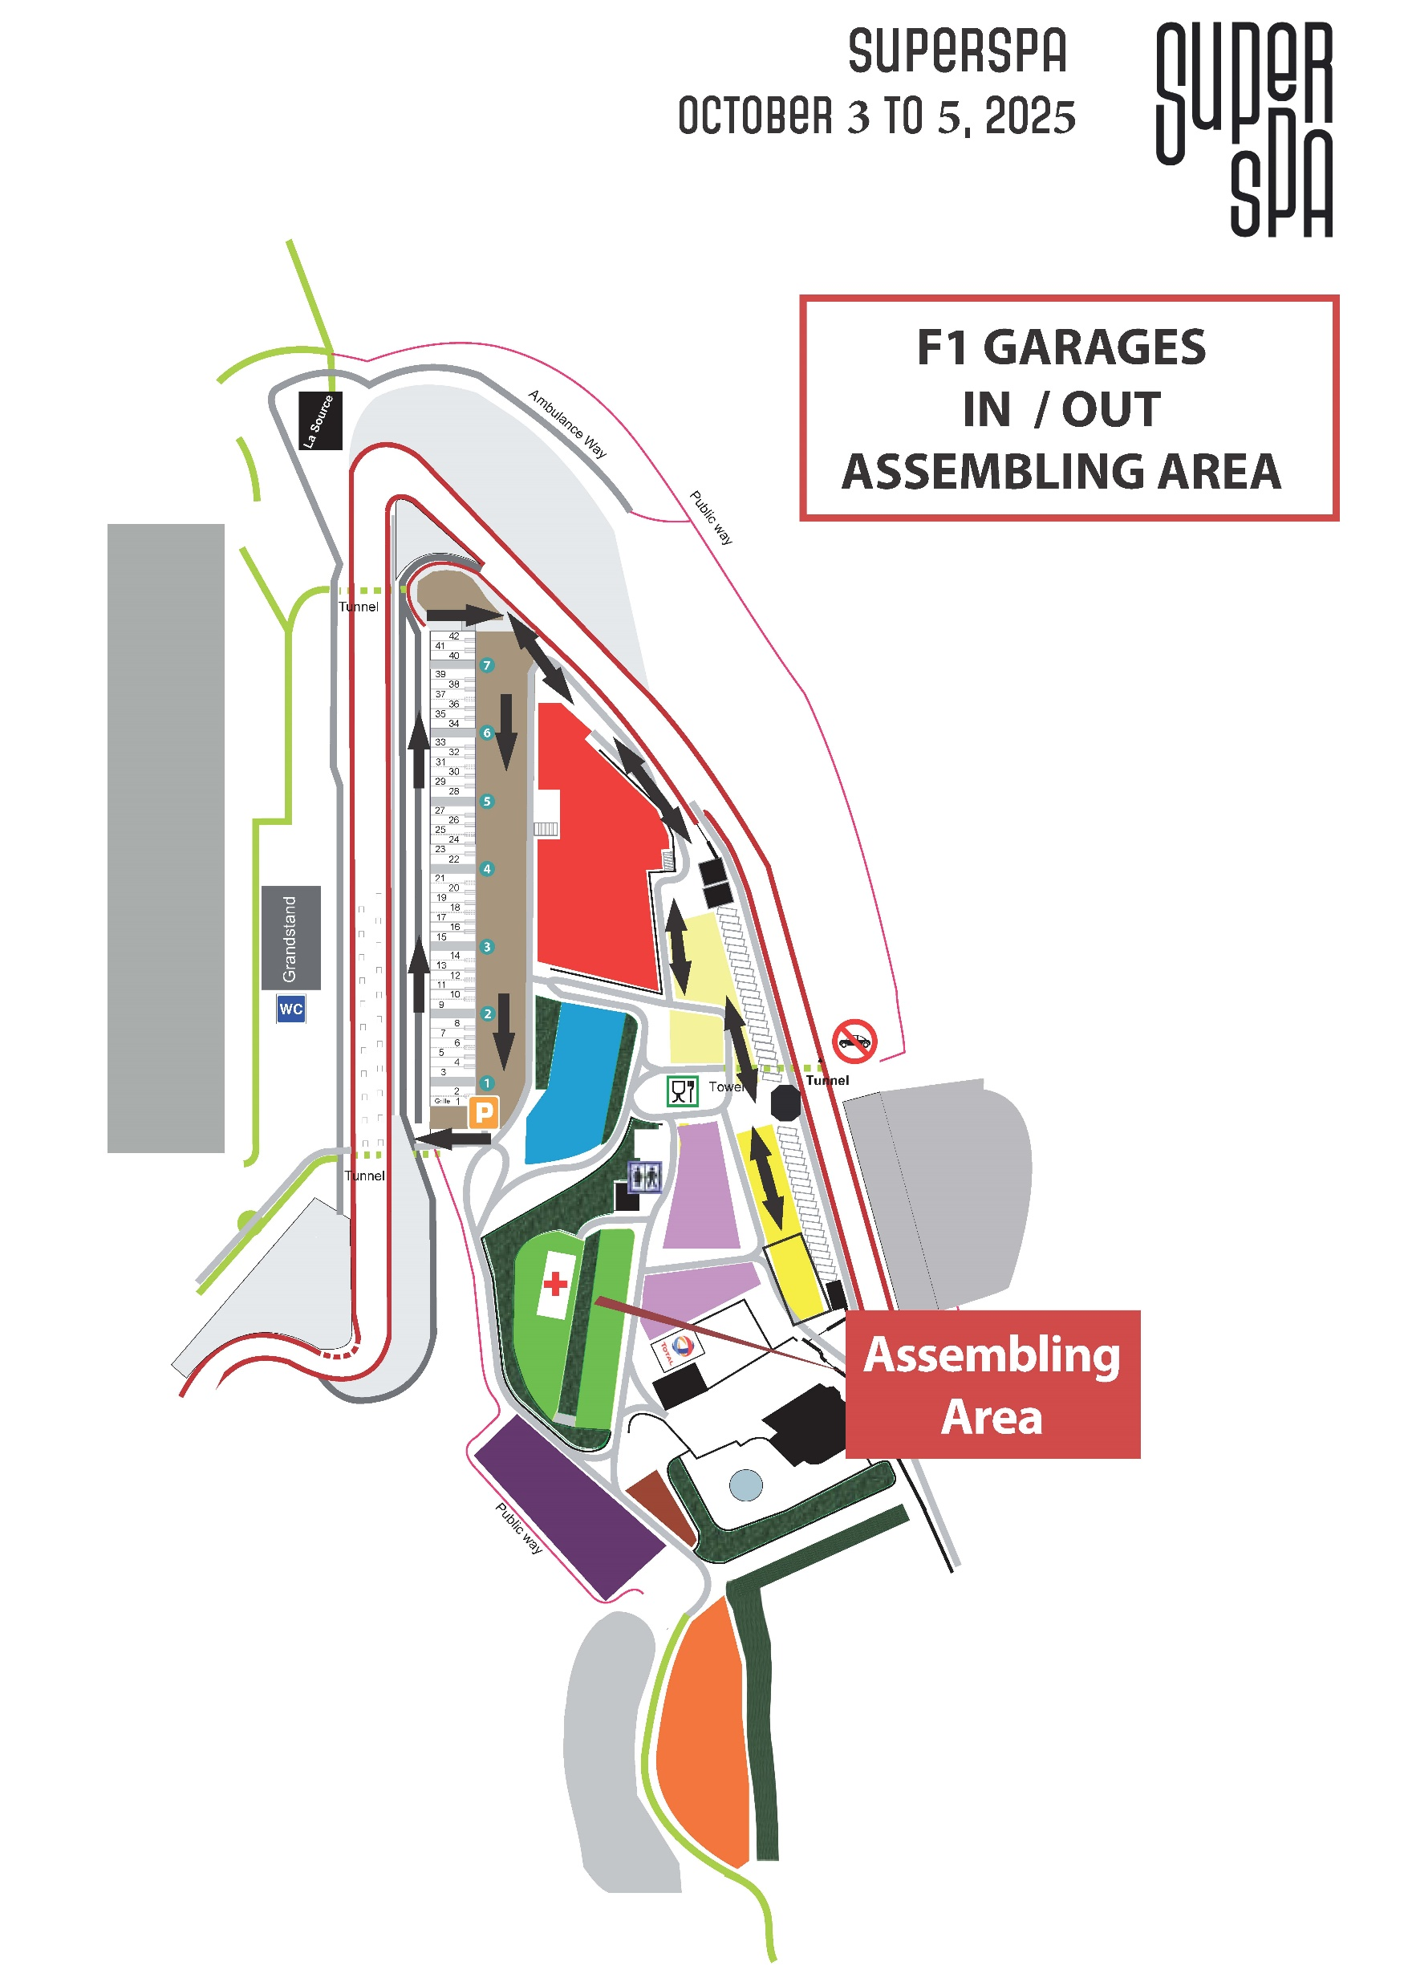
Assembling area

Slide 38
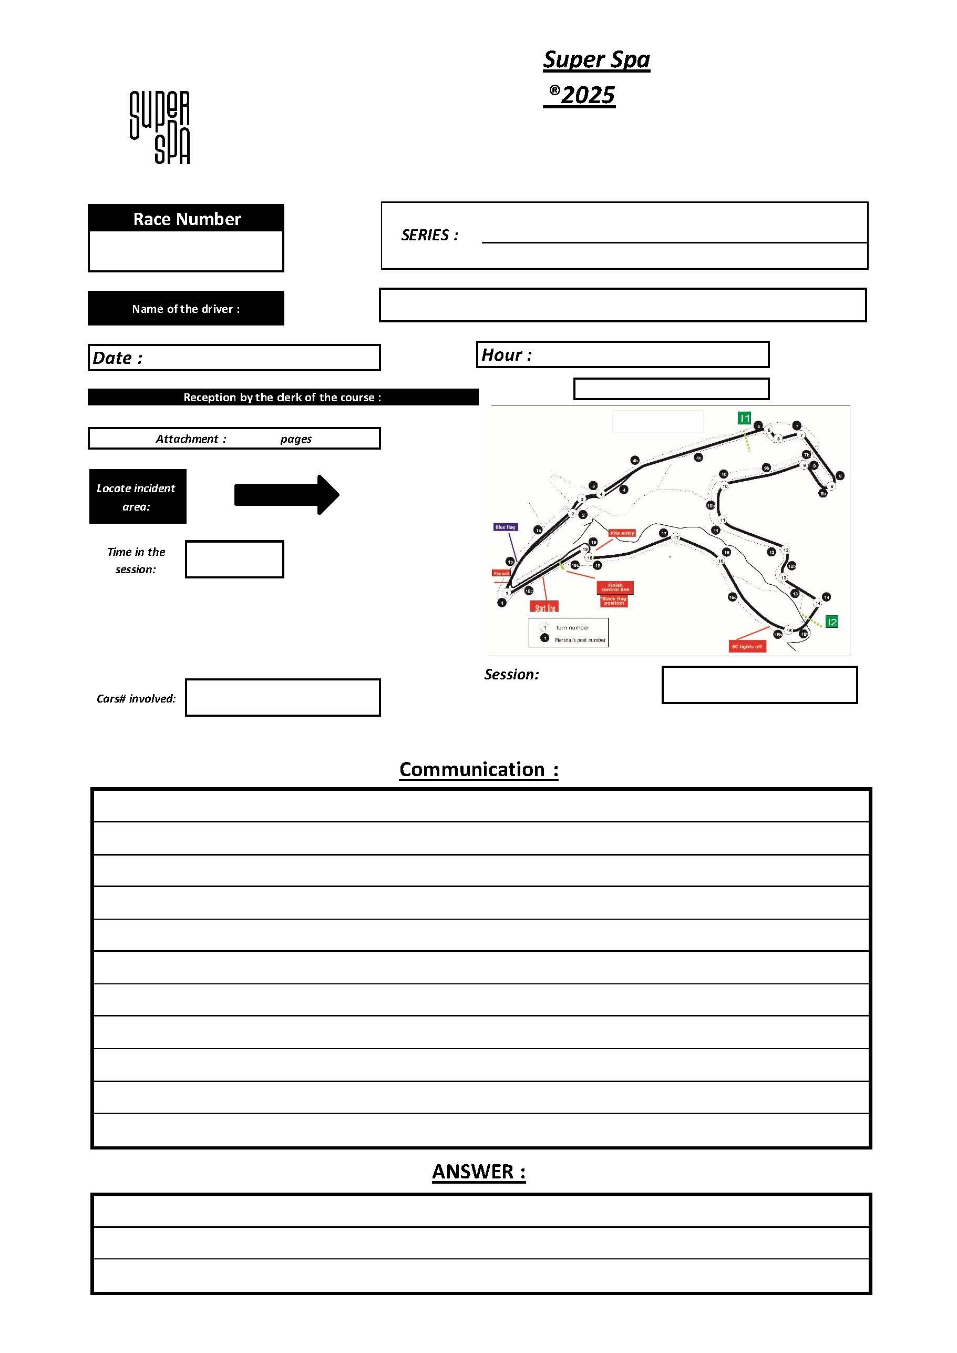
Enquiry Form

Slide 39

Have a nice & safe Race

