Slide 1

2025: FORMULA FORD 1600 Drivers’ briefing

Slide 2
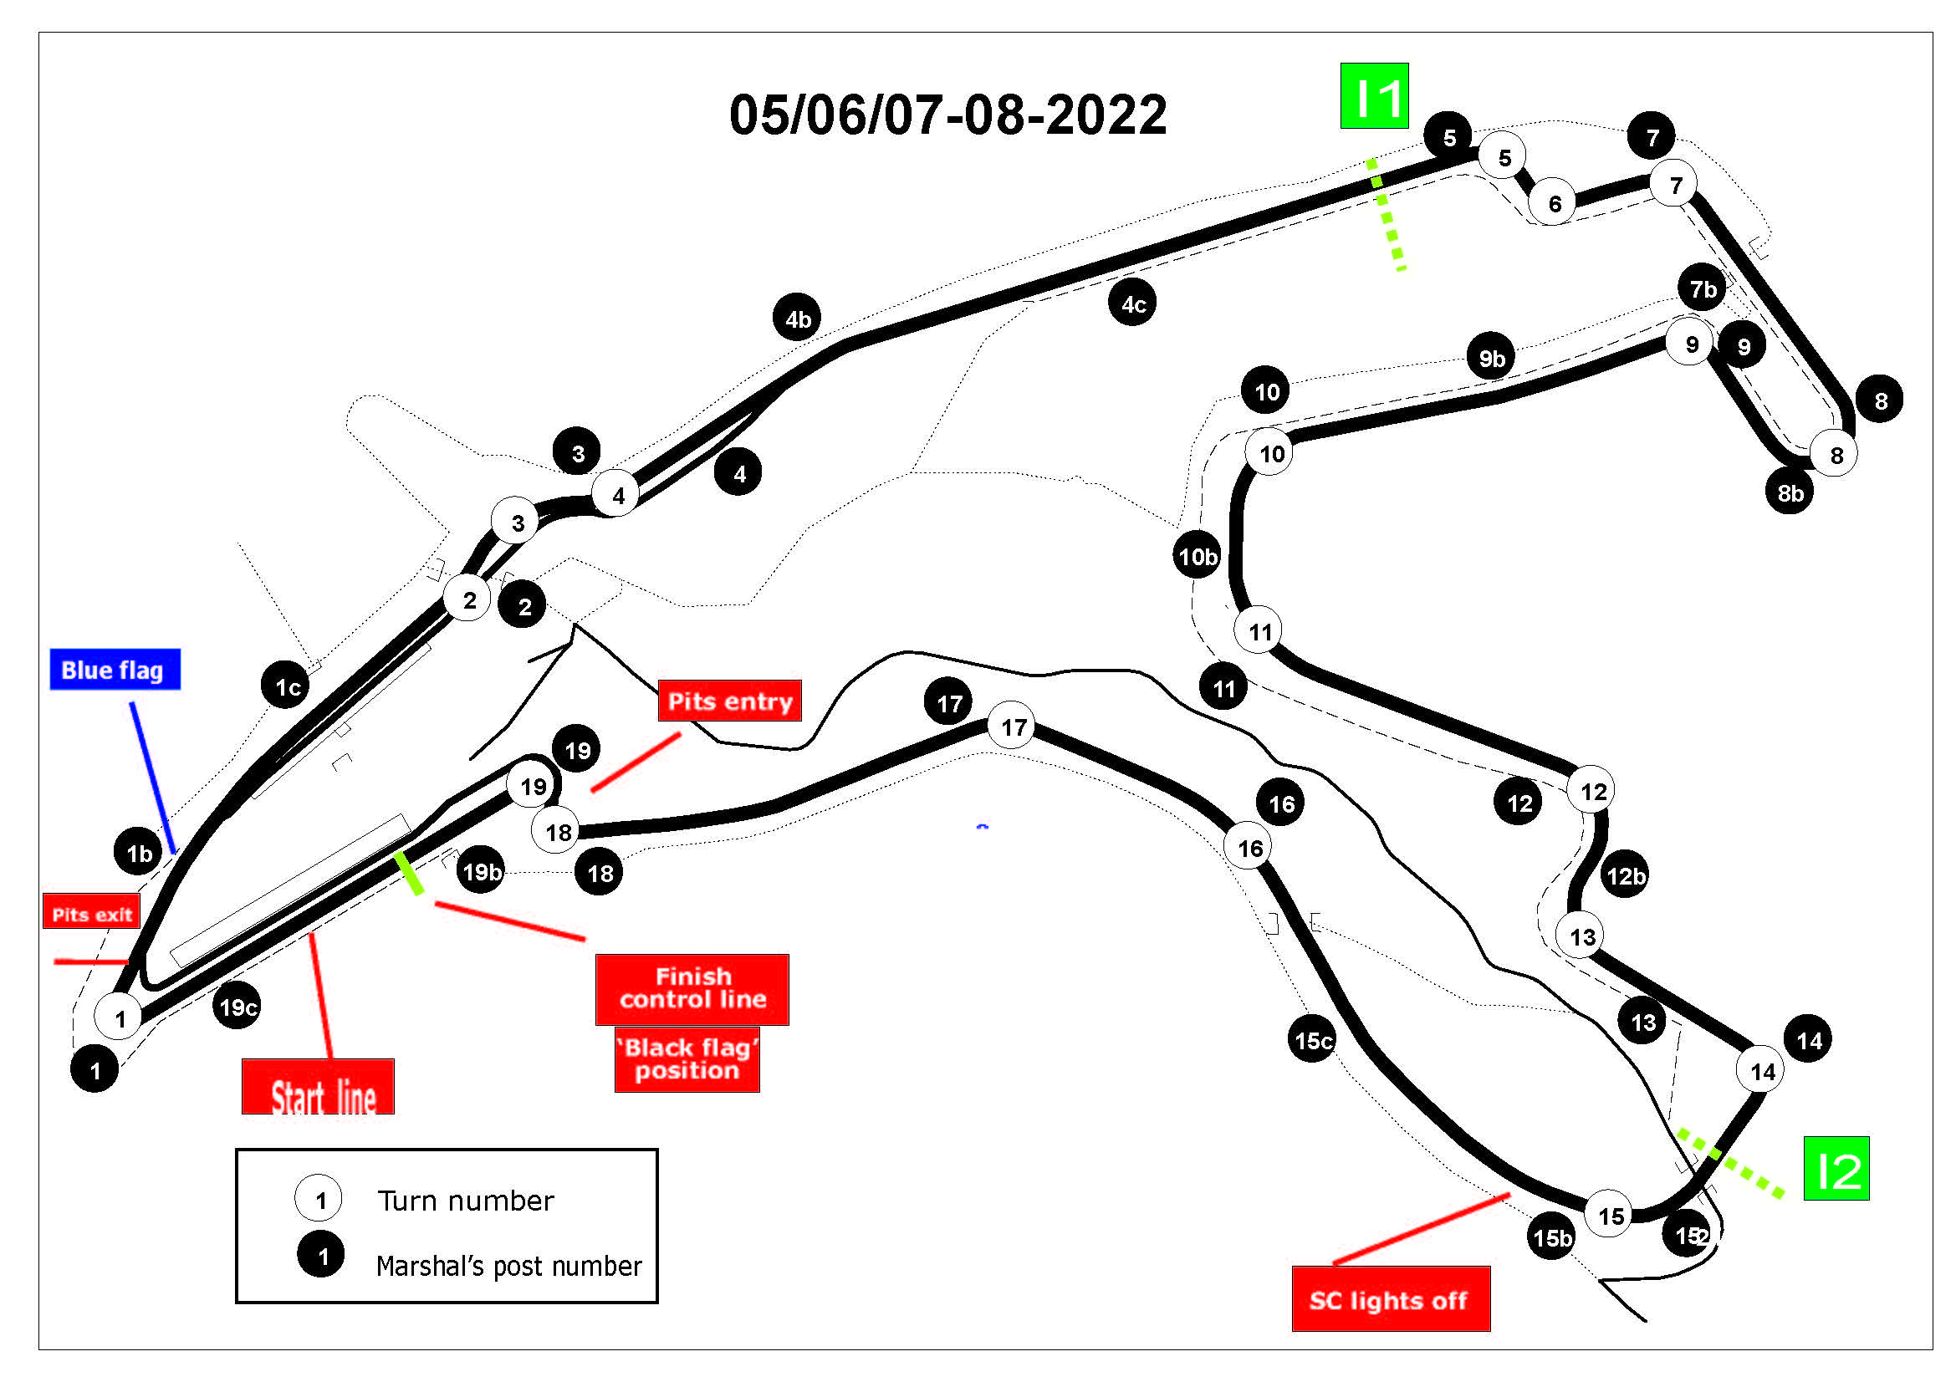
Circuit Map

Slide 3
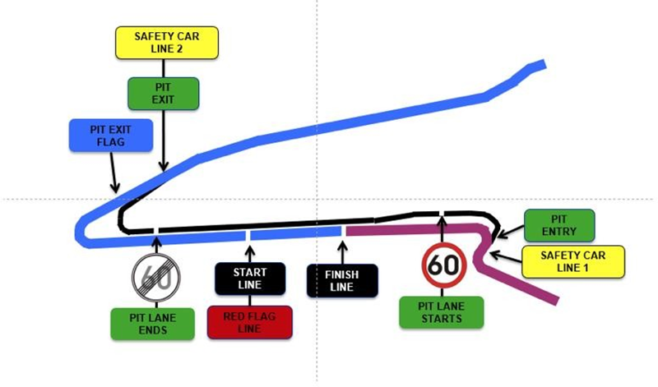
Pit Lane Map

Slide 4
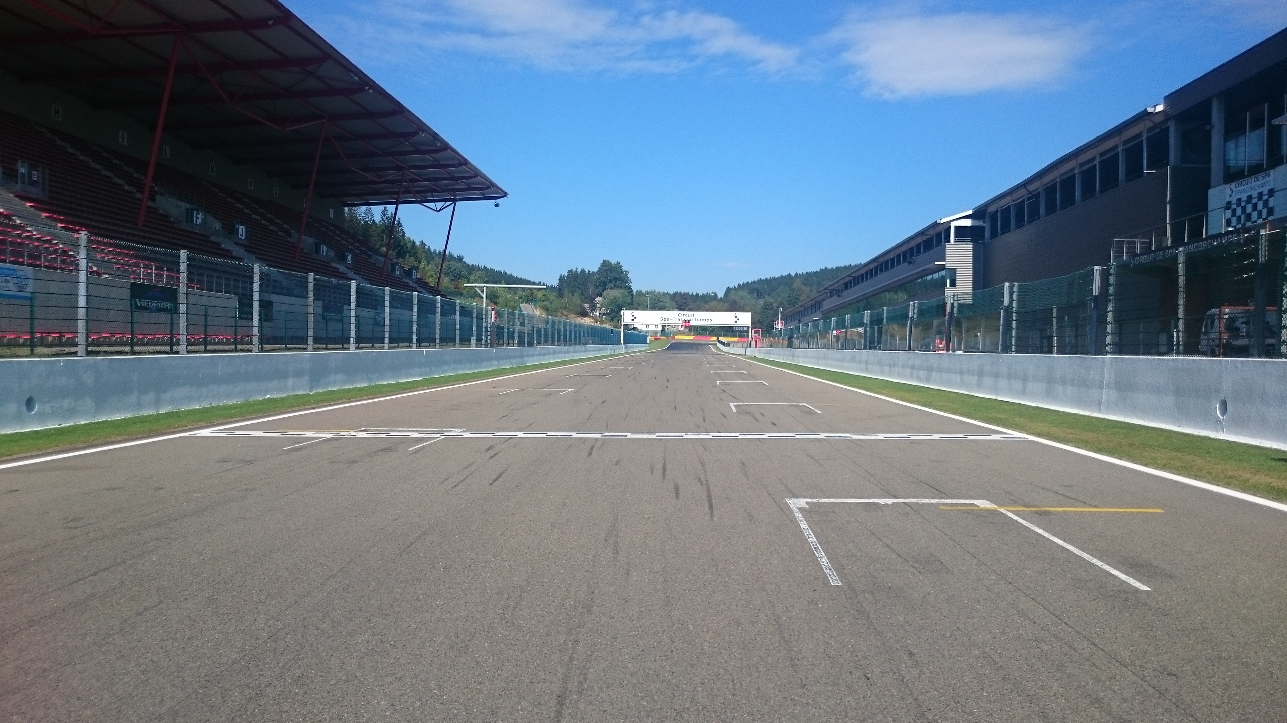
Control – Finish Line

Slide 5
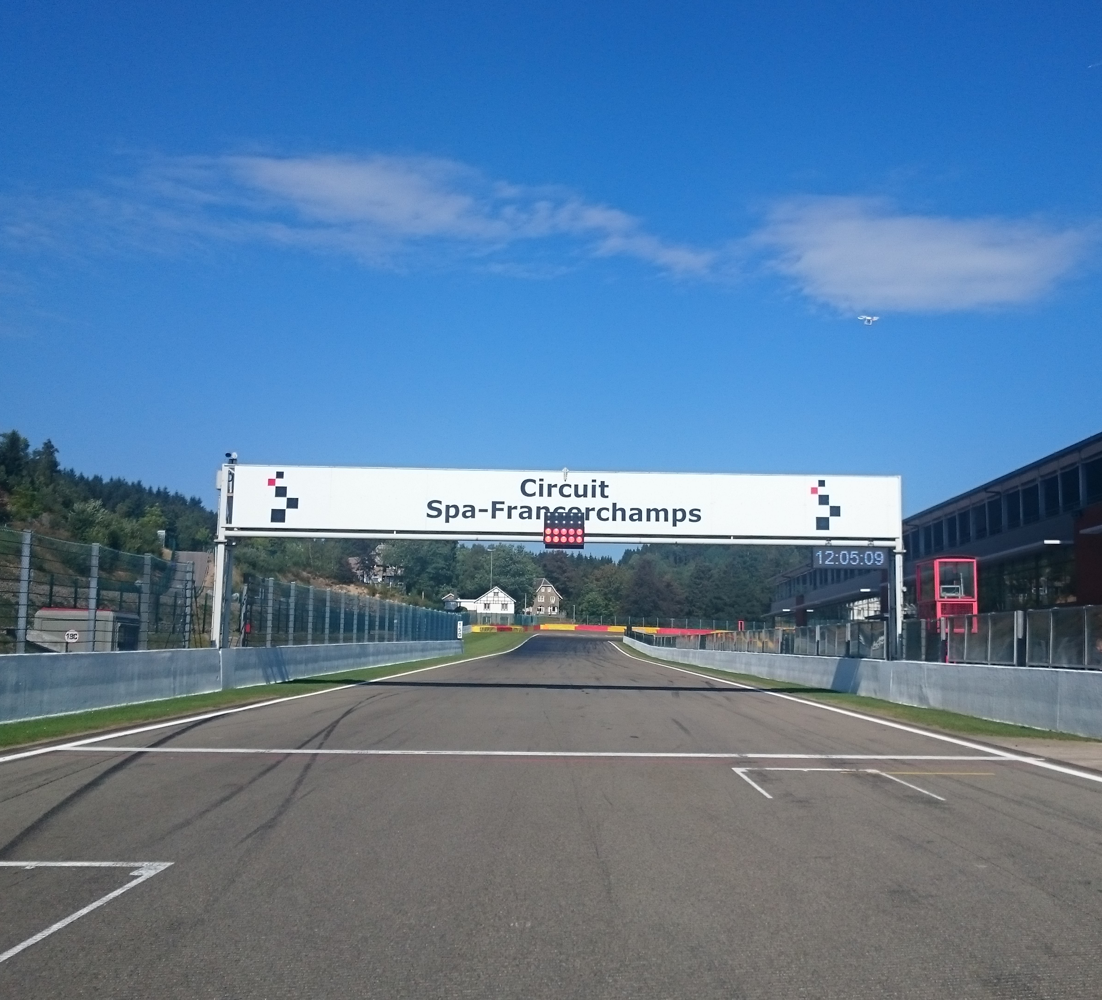
Start Line

Slide 6
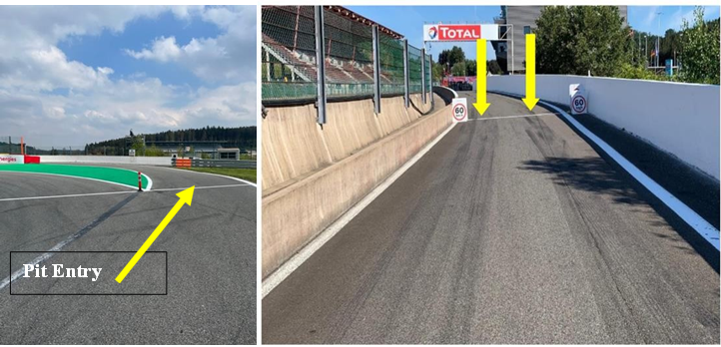

Pits entry RHS after T18

Slide 7
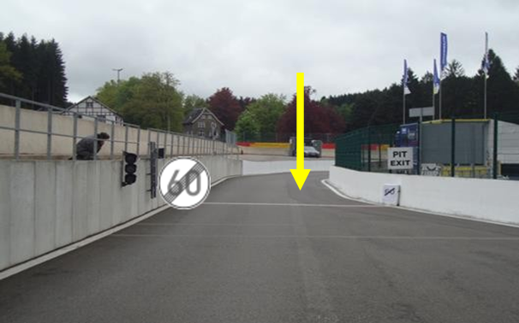
Pits exit – speed limit ends

Slide 8
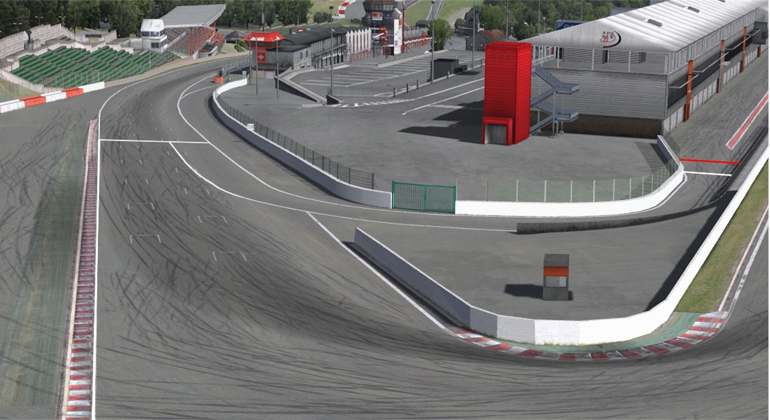


Repeater Blue Flag Marshal @ Pits exit

Slide 9
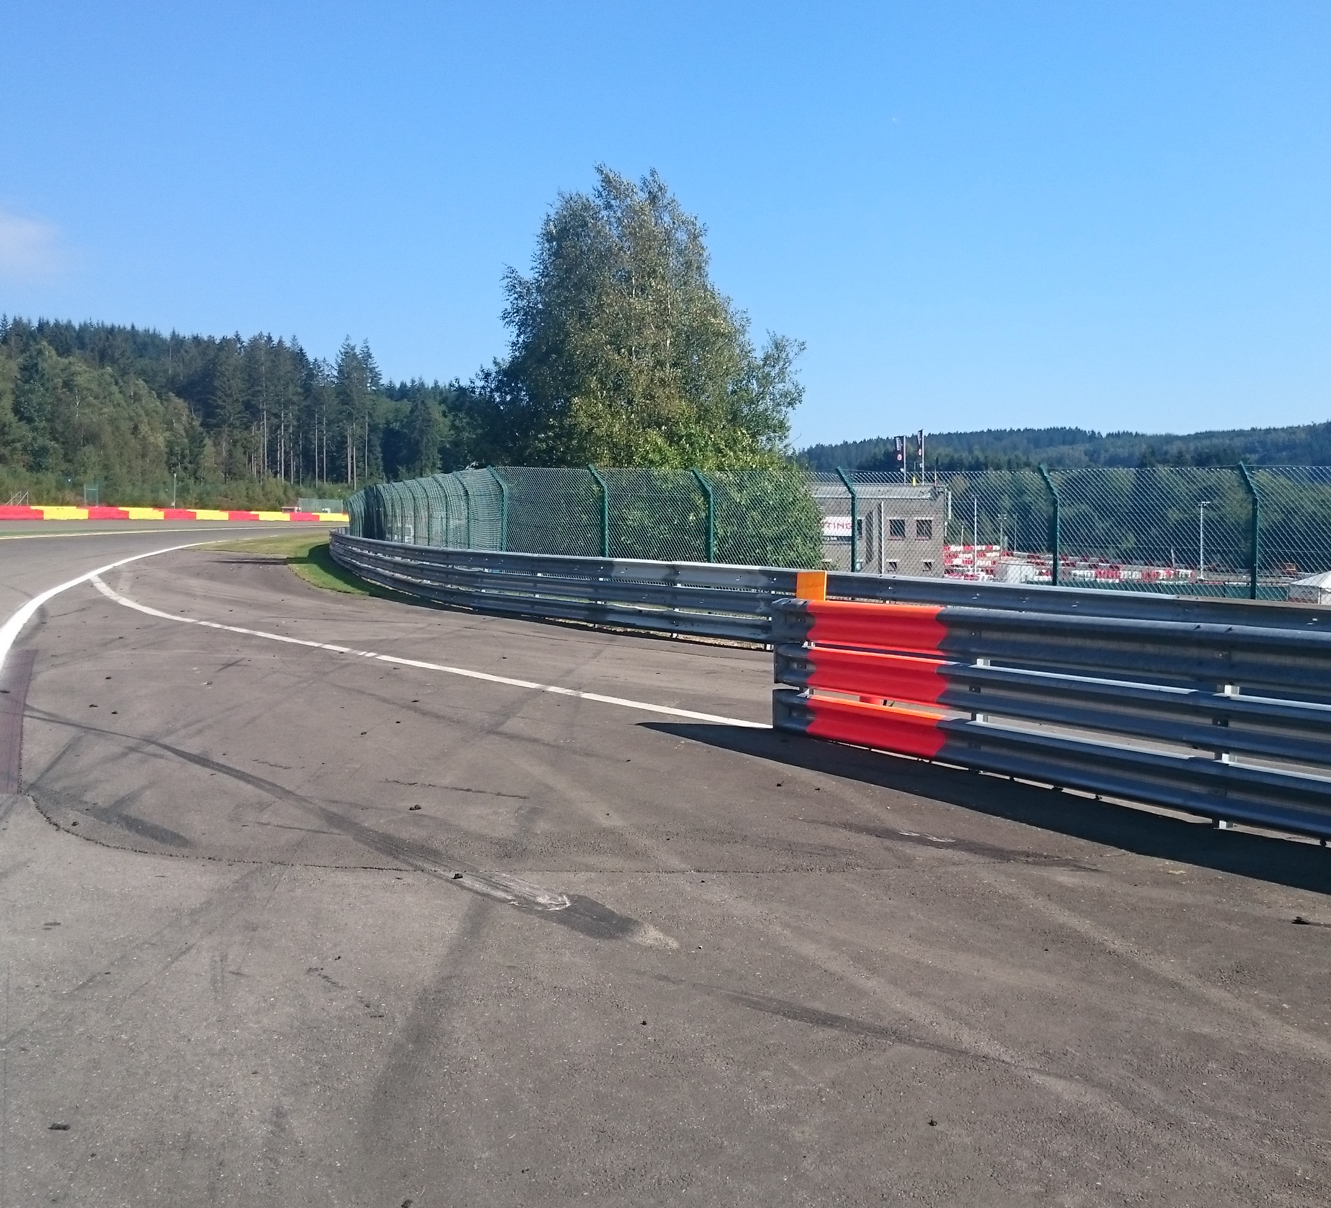
Openings for cars

Slide 10
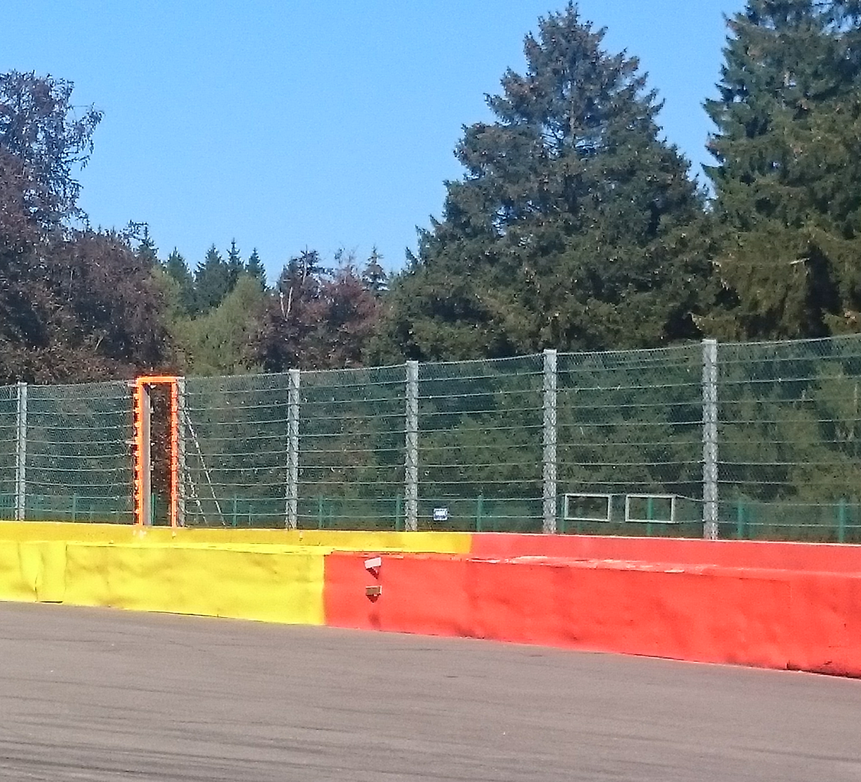
Emergency windows

Slide 11
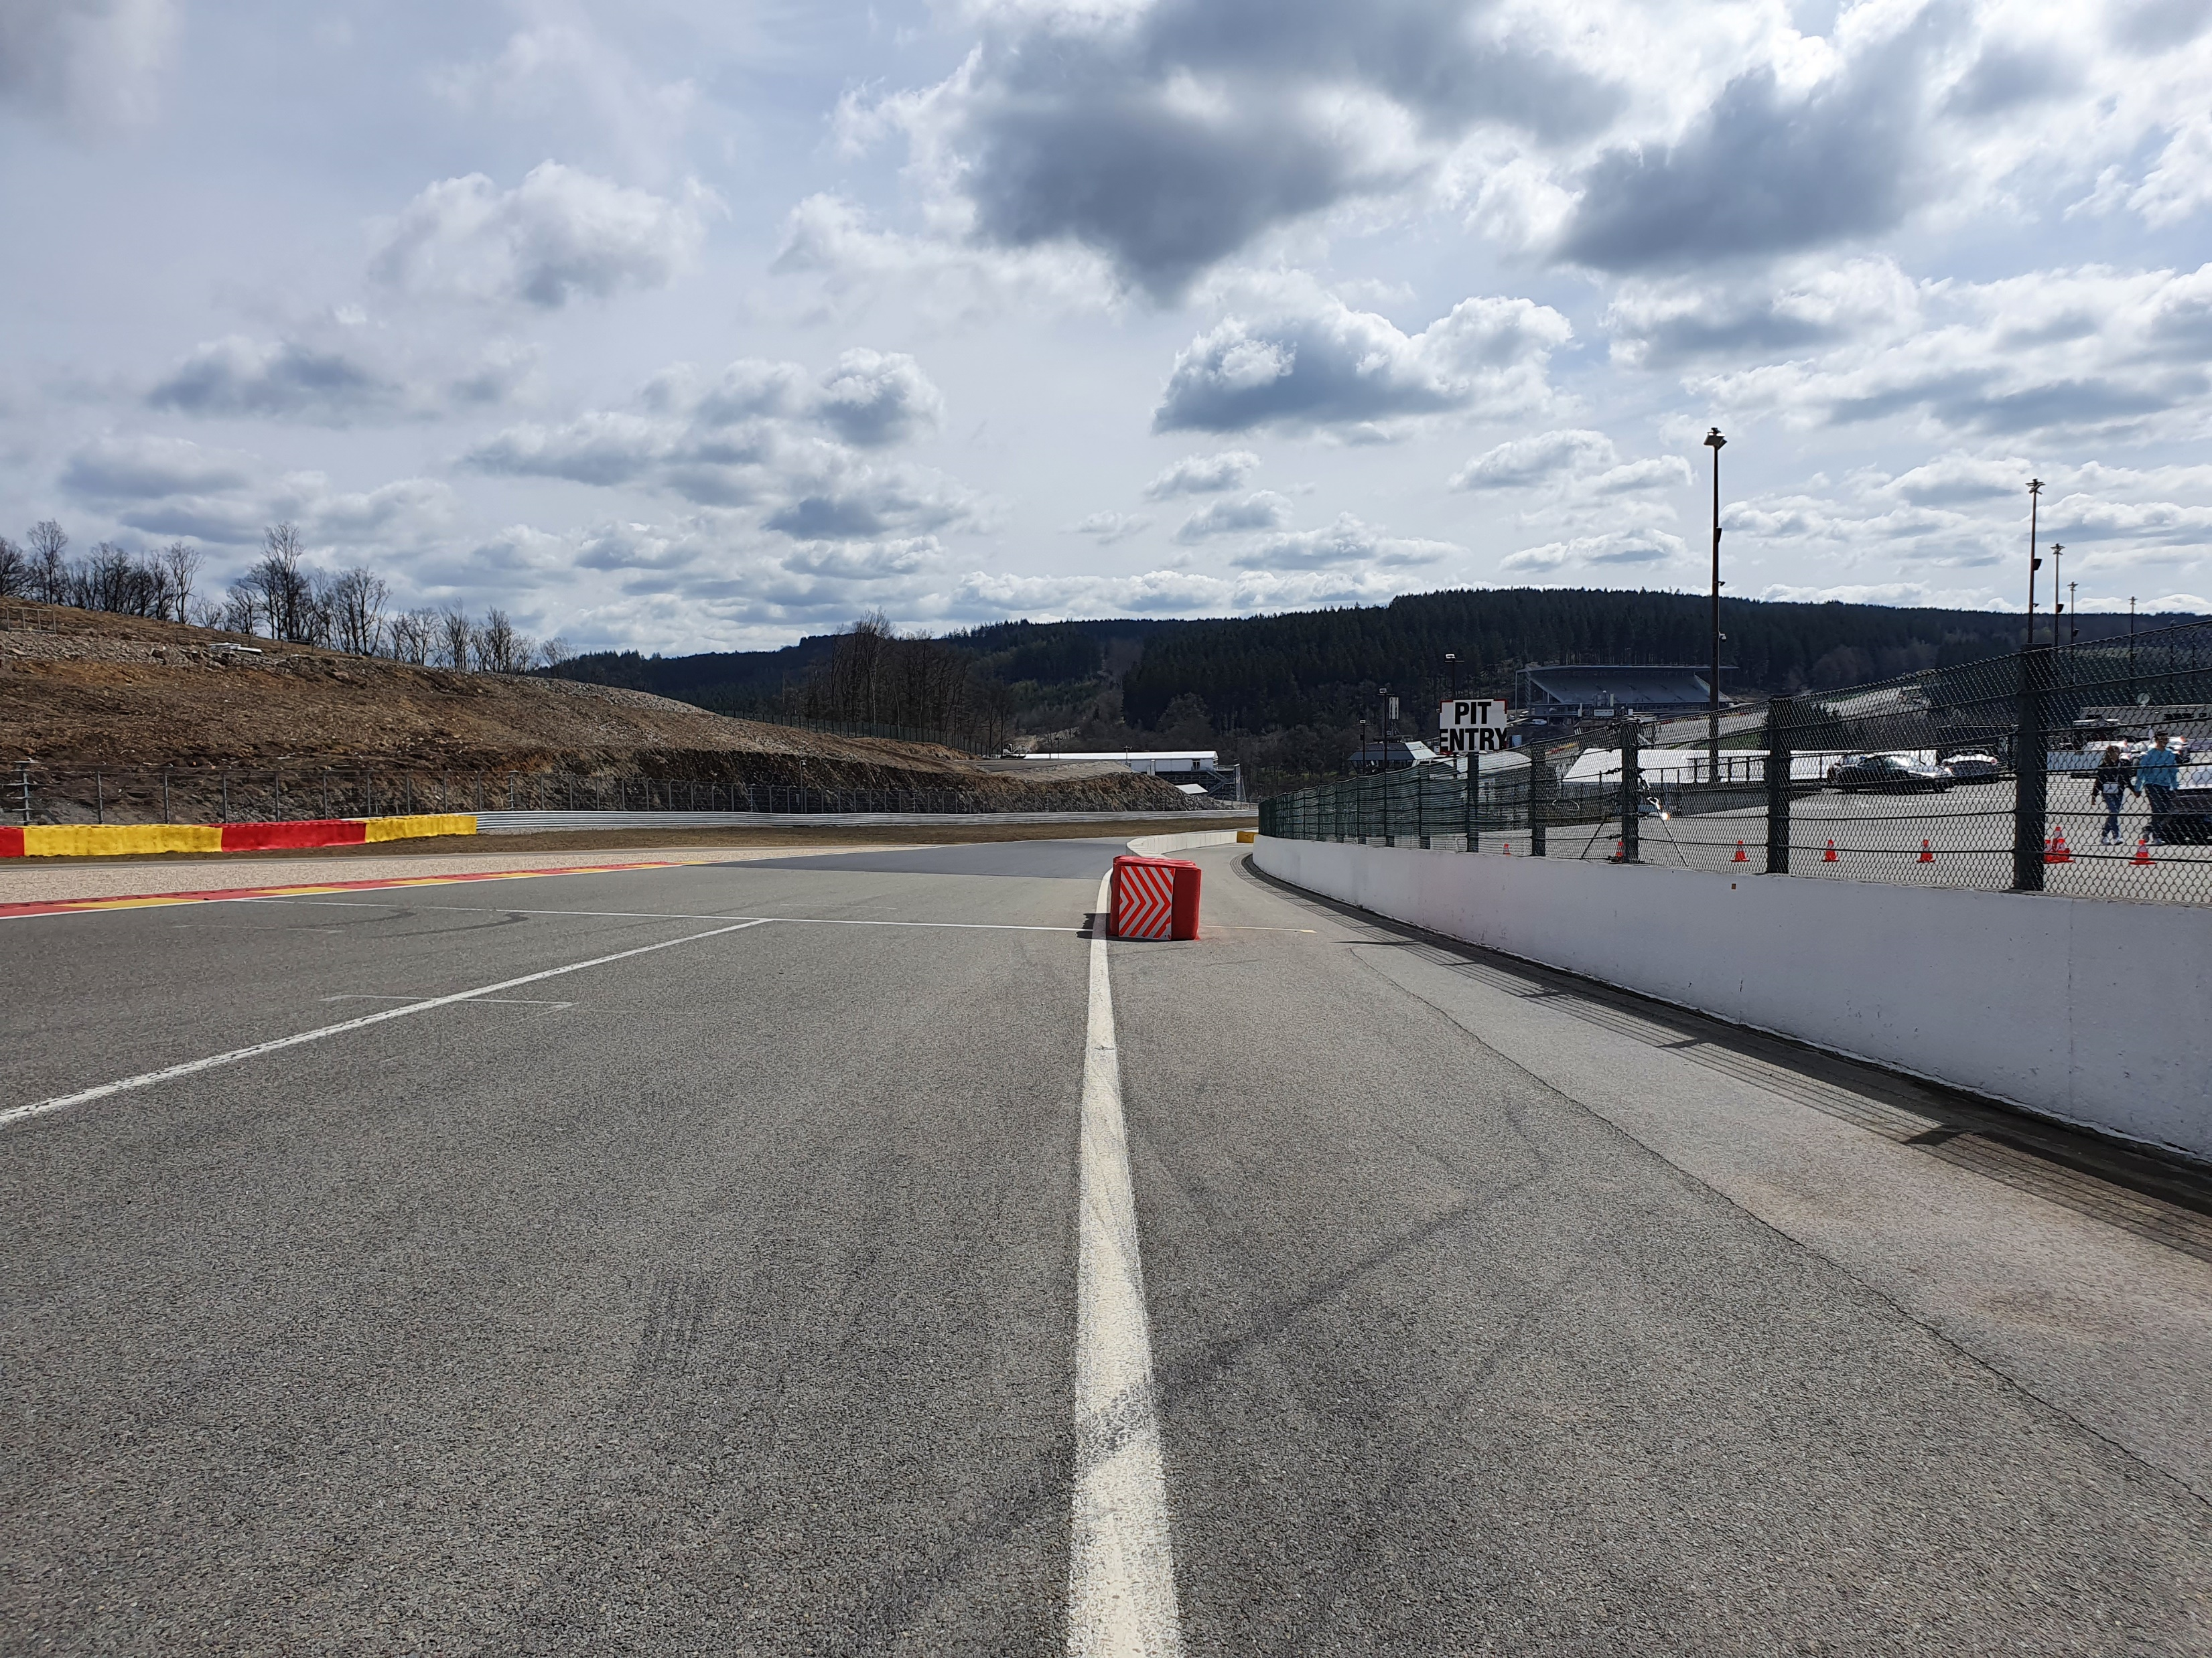
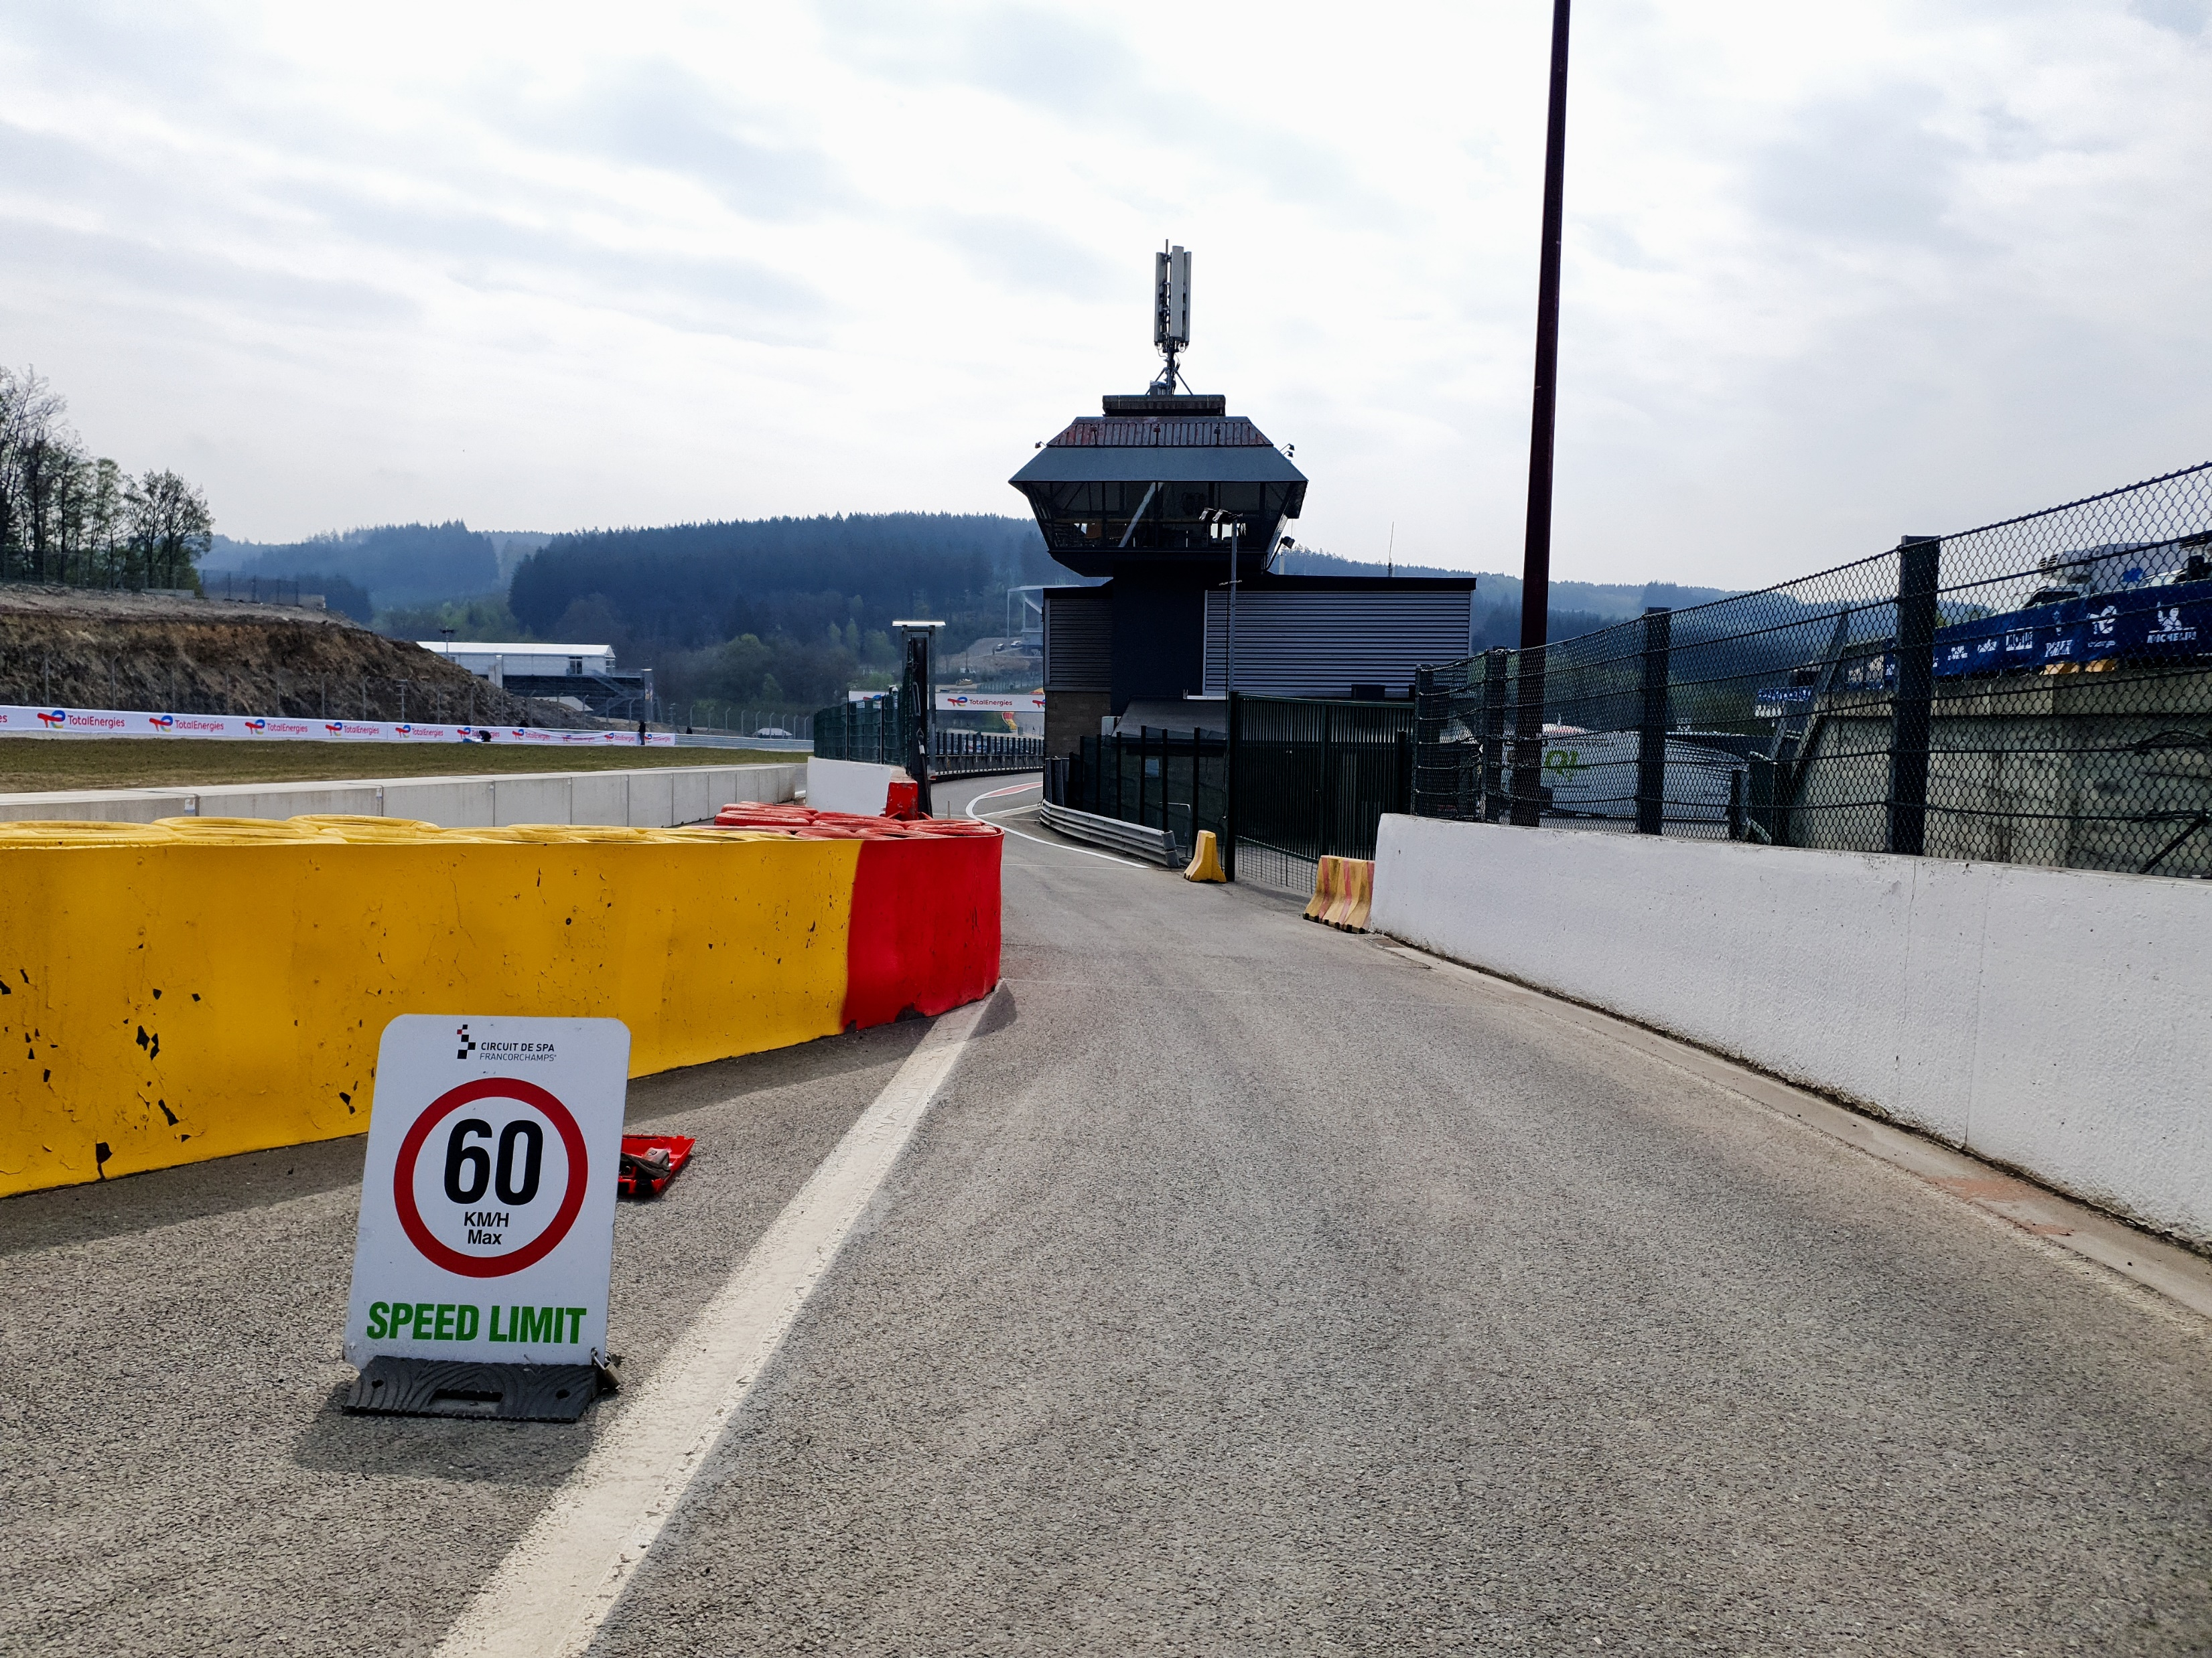
End of the Races
No deceleration lap
All cars by T1 la source in endurance pit -> end of the pit
Follow the map assembly in appendix of written briefing notes to join your dedicated area

Slide 12
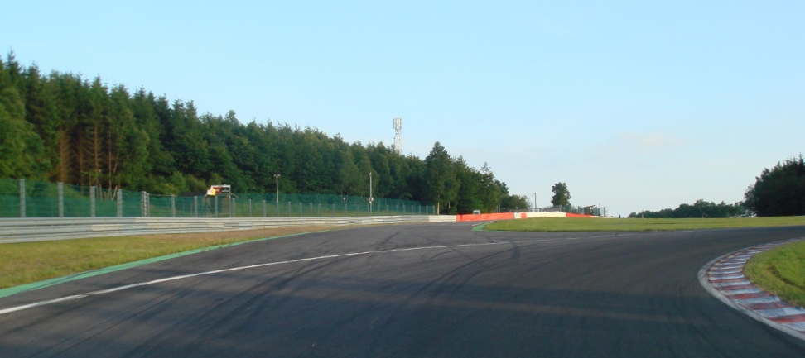
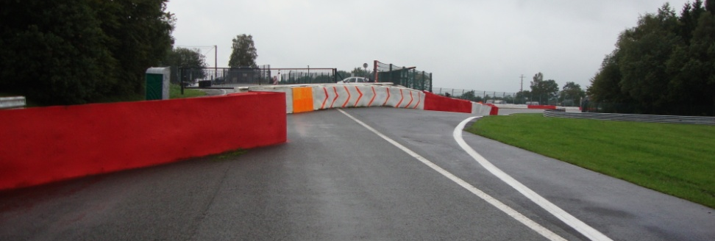
Escape road @ Turns 5 – 7

Slide 13
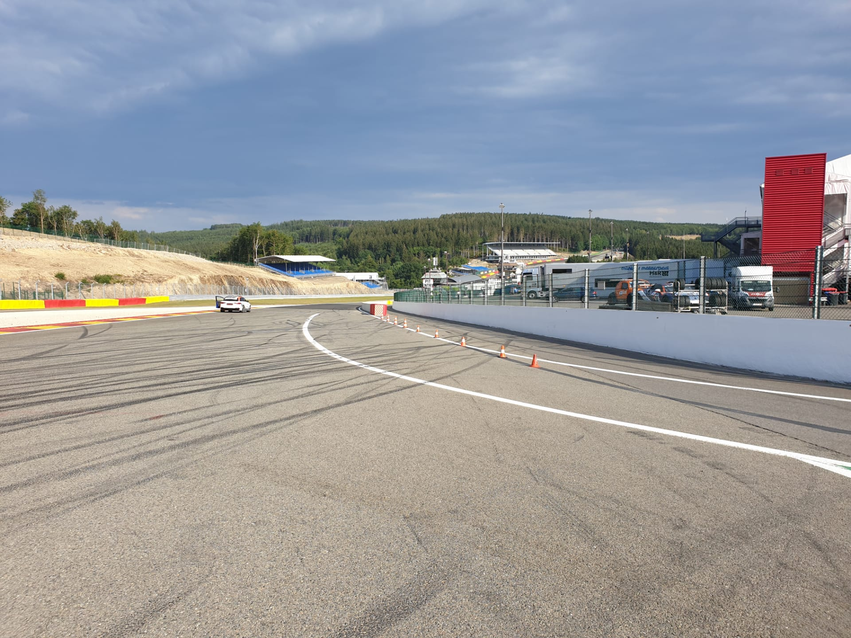

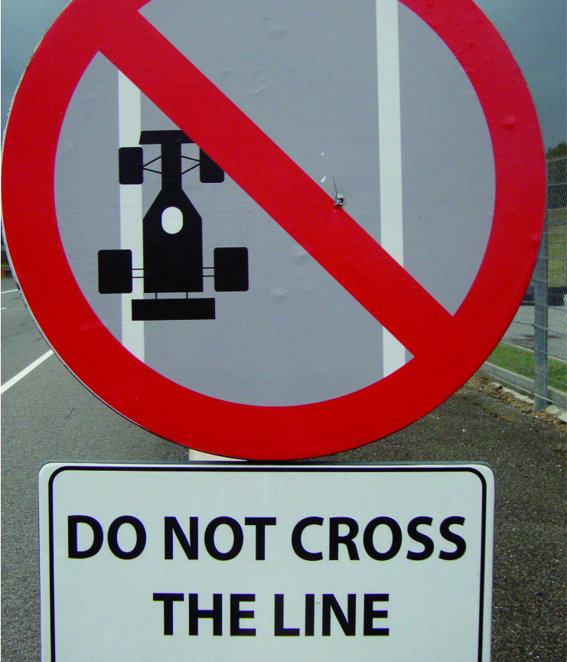
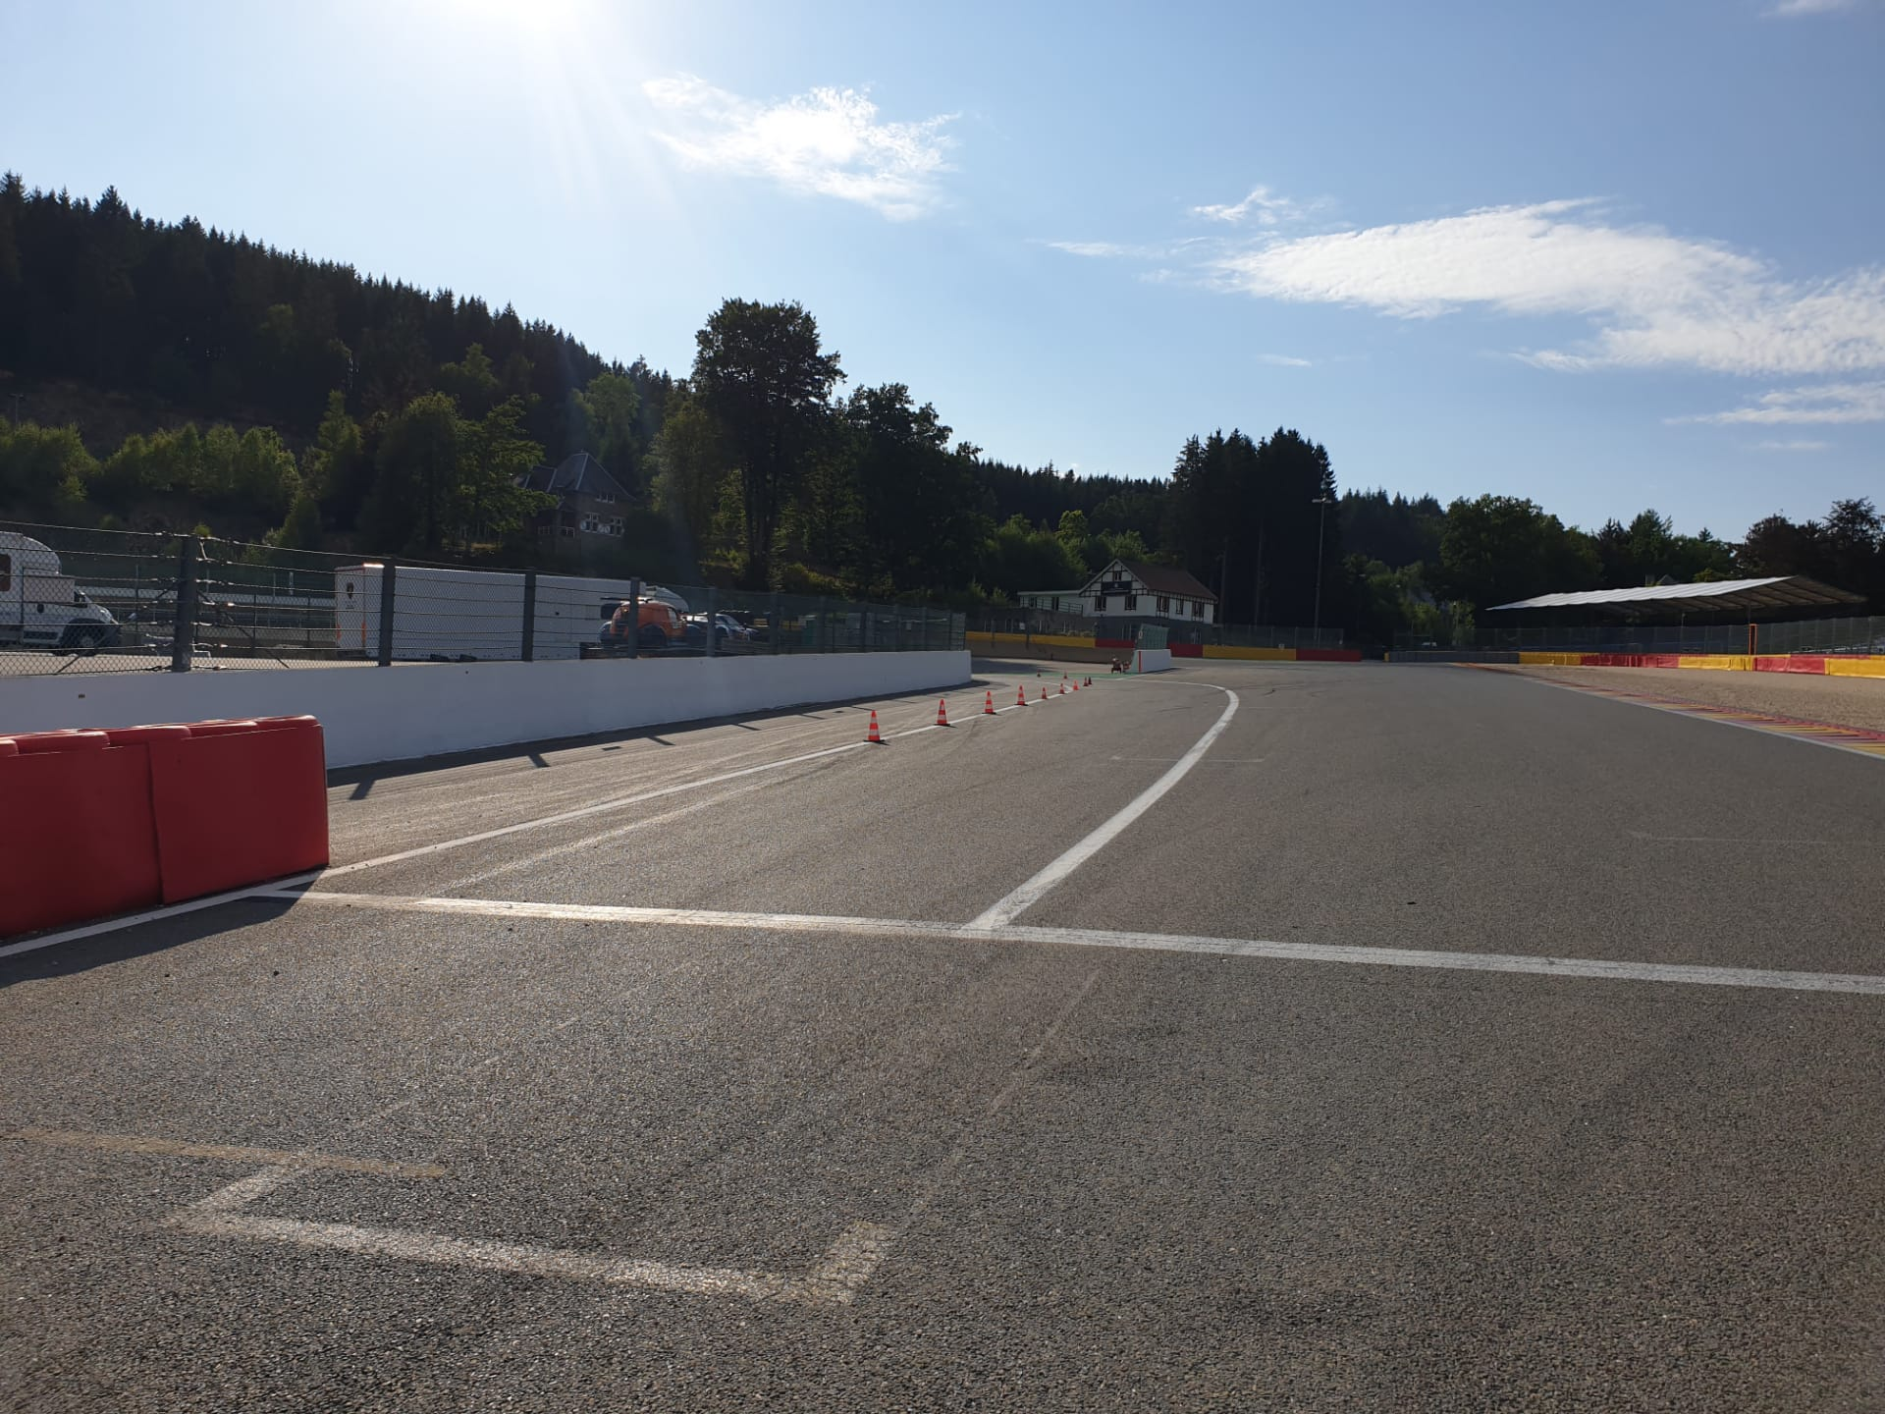
Pits entry & exit Lines & bollards
Pictures Pit exit F1 after T1

Slide 14
Formation lap from Eau rouge gate
Proceed to the assembly area at the time indicated in the written information notes in the Green Paddock - Follow the marshals' instructions to proceed to the Eau Rouge gate for the formation lap.
When aproaching the starting grid it will be directly the start -> light procedure

Slide 15
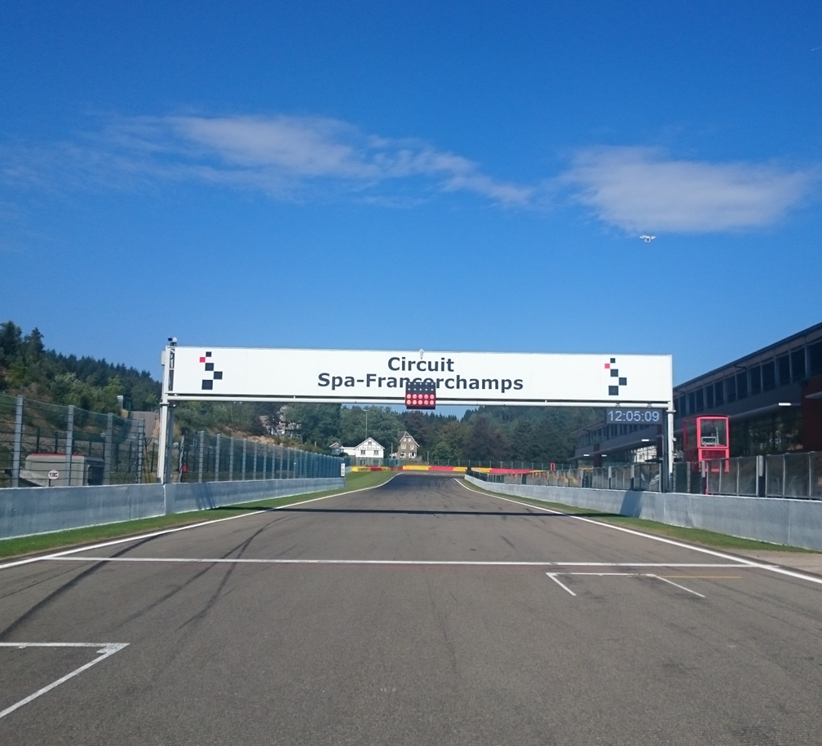
Start line

Slide 16
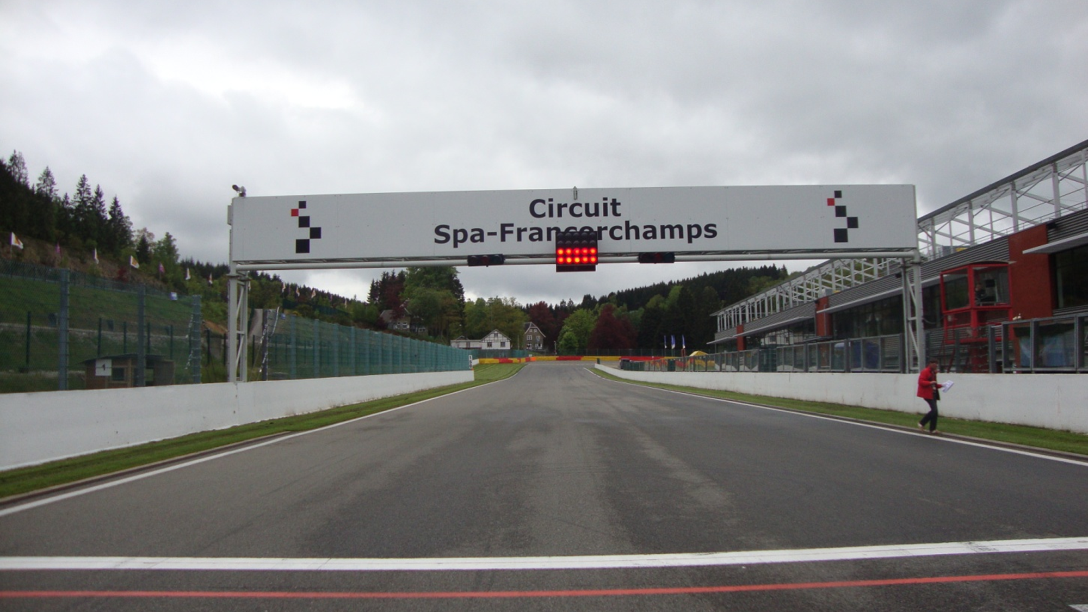
Red On/Off

Slide 17
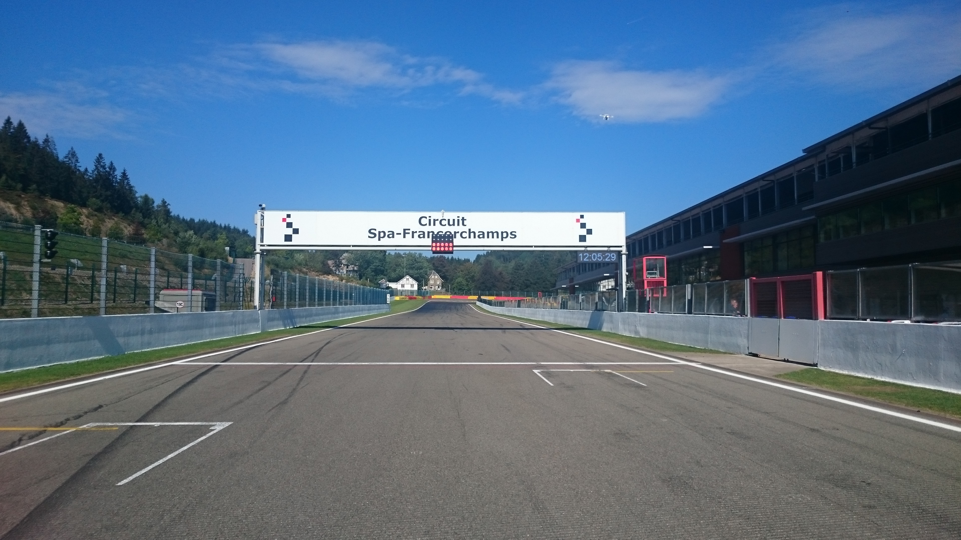


Aborted Start Lights

Slide 18
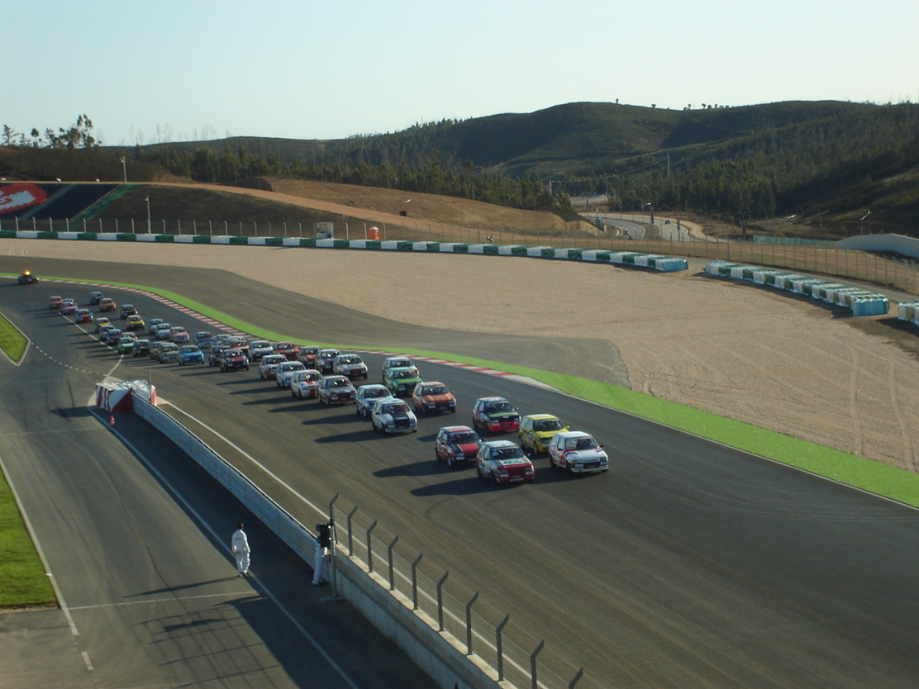
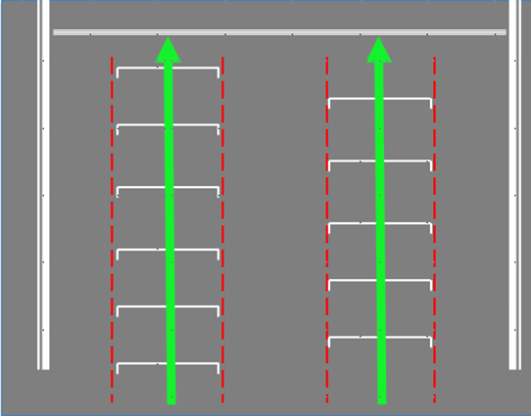
Example of right formation
The cars must hold the starting formation by driving from the beginning over the „starting boxes“ on their respective sides (starting corridors).

Slide 19
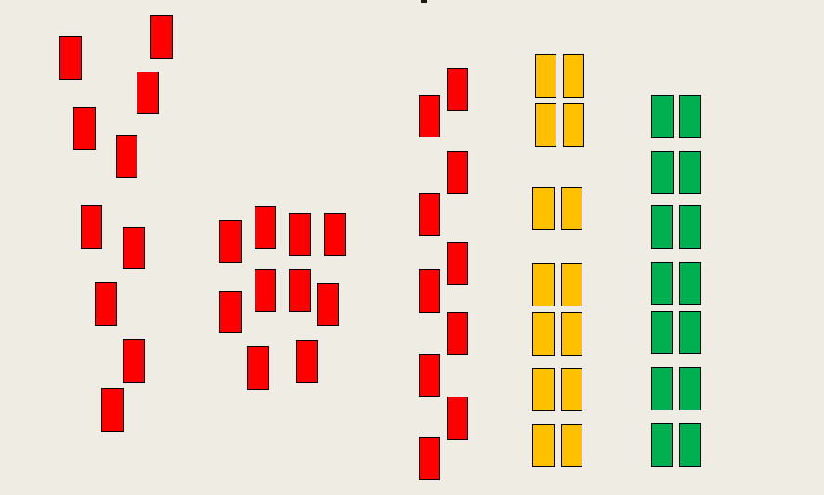
Formation: Must be as in green

Slide 20
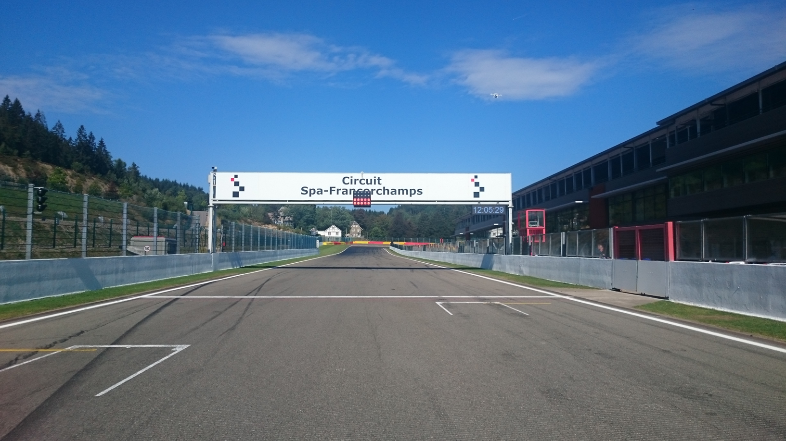
Red Flag Line – Race Suspended

Slide 21
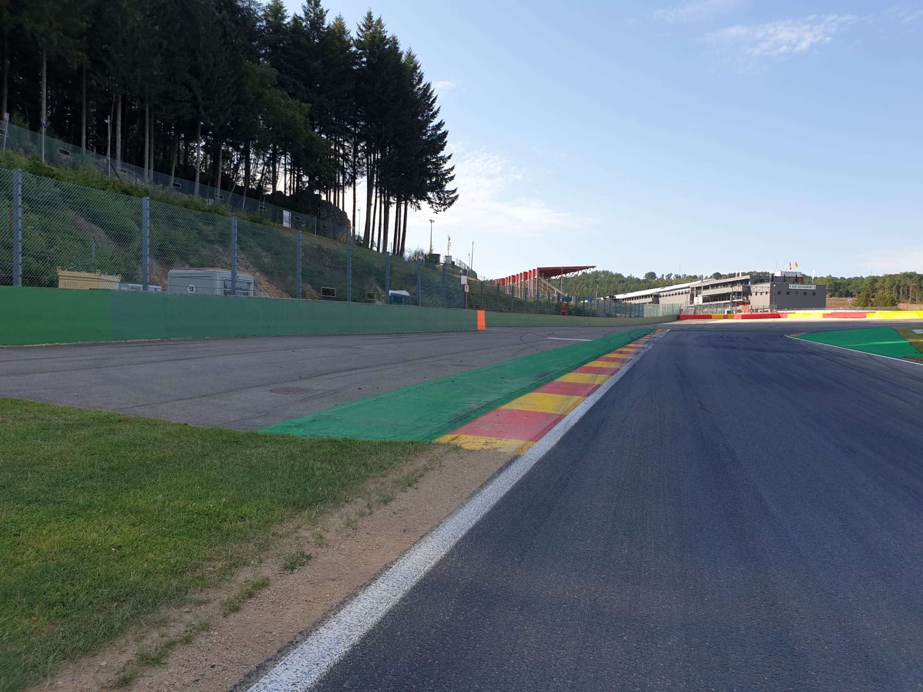

Safety-Car Arrow Man
SC

Slide 22
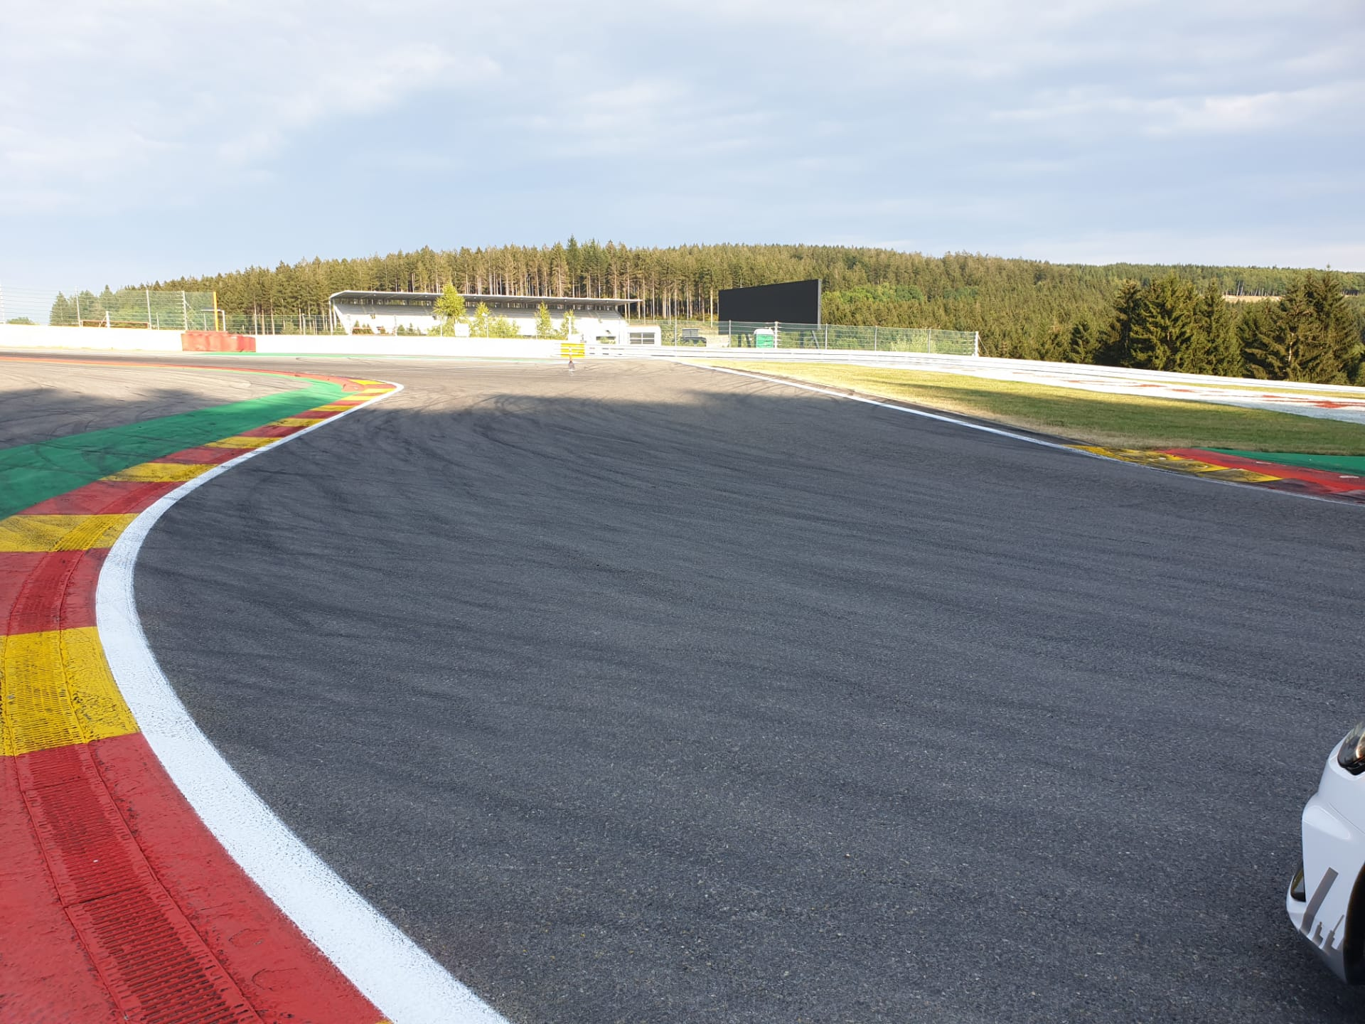
Safety Car Line 1

Slide 23
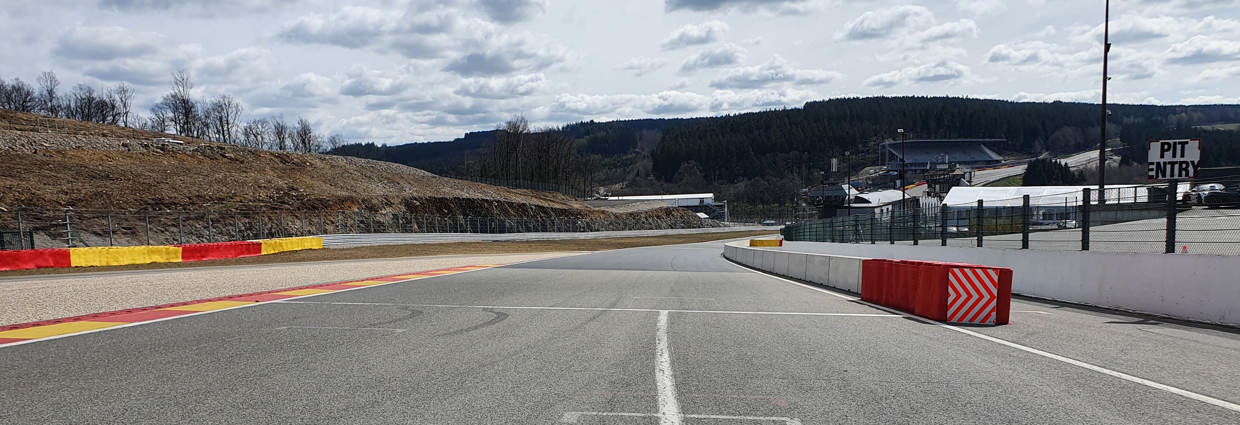
Safety Car Line 2

Slide 24
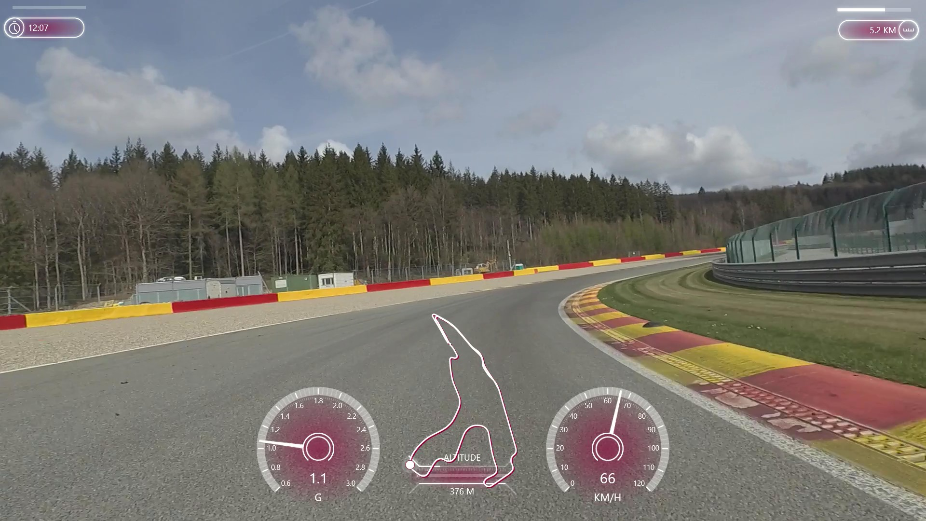
Safety-Car Lights OFF

Slide 25
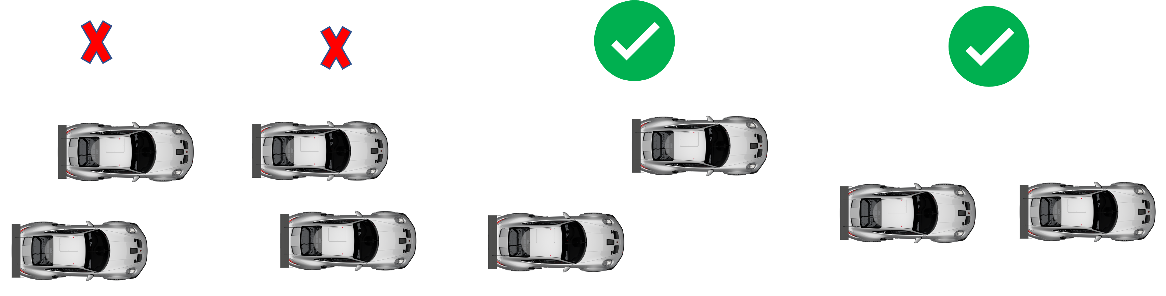
Re-start under safety-car

Slide 26
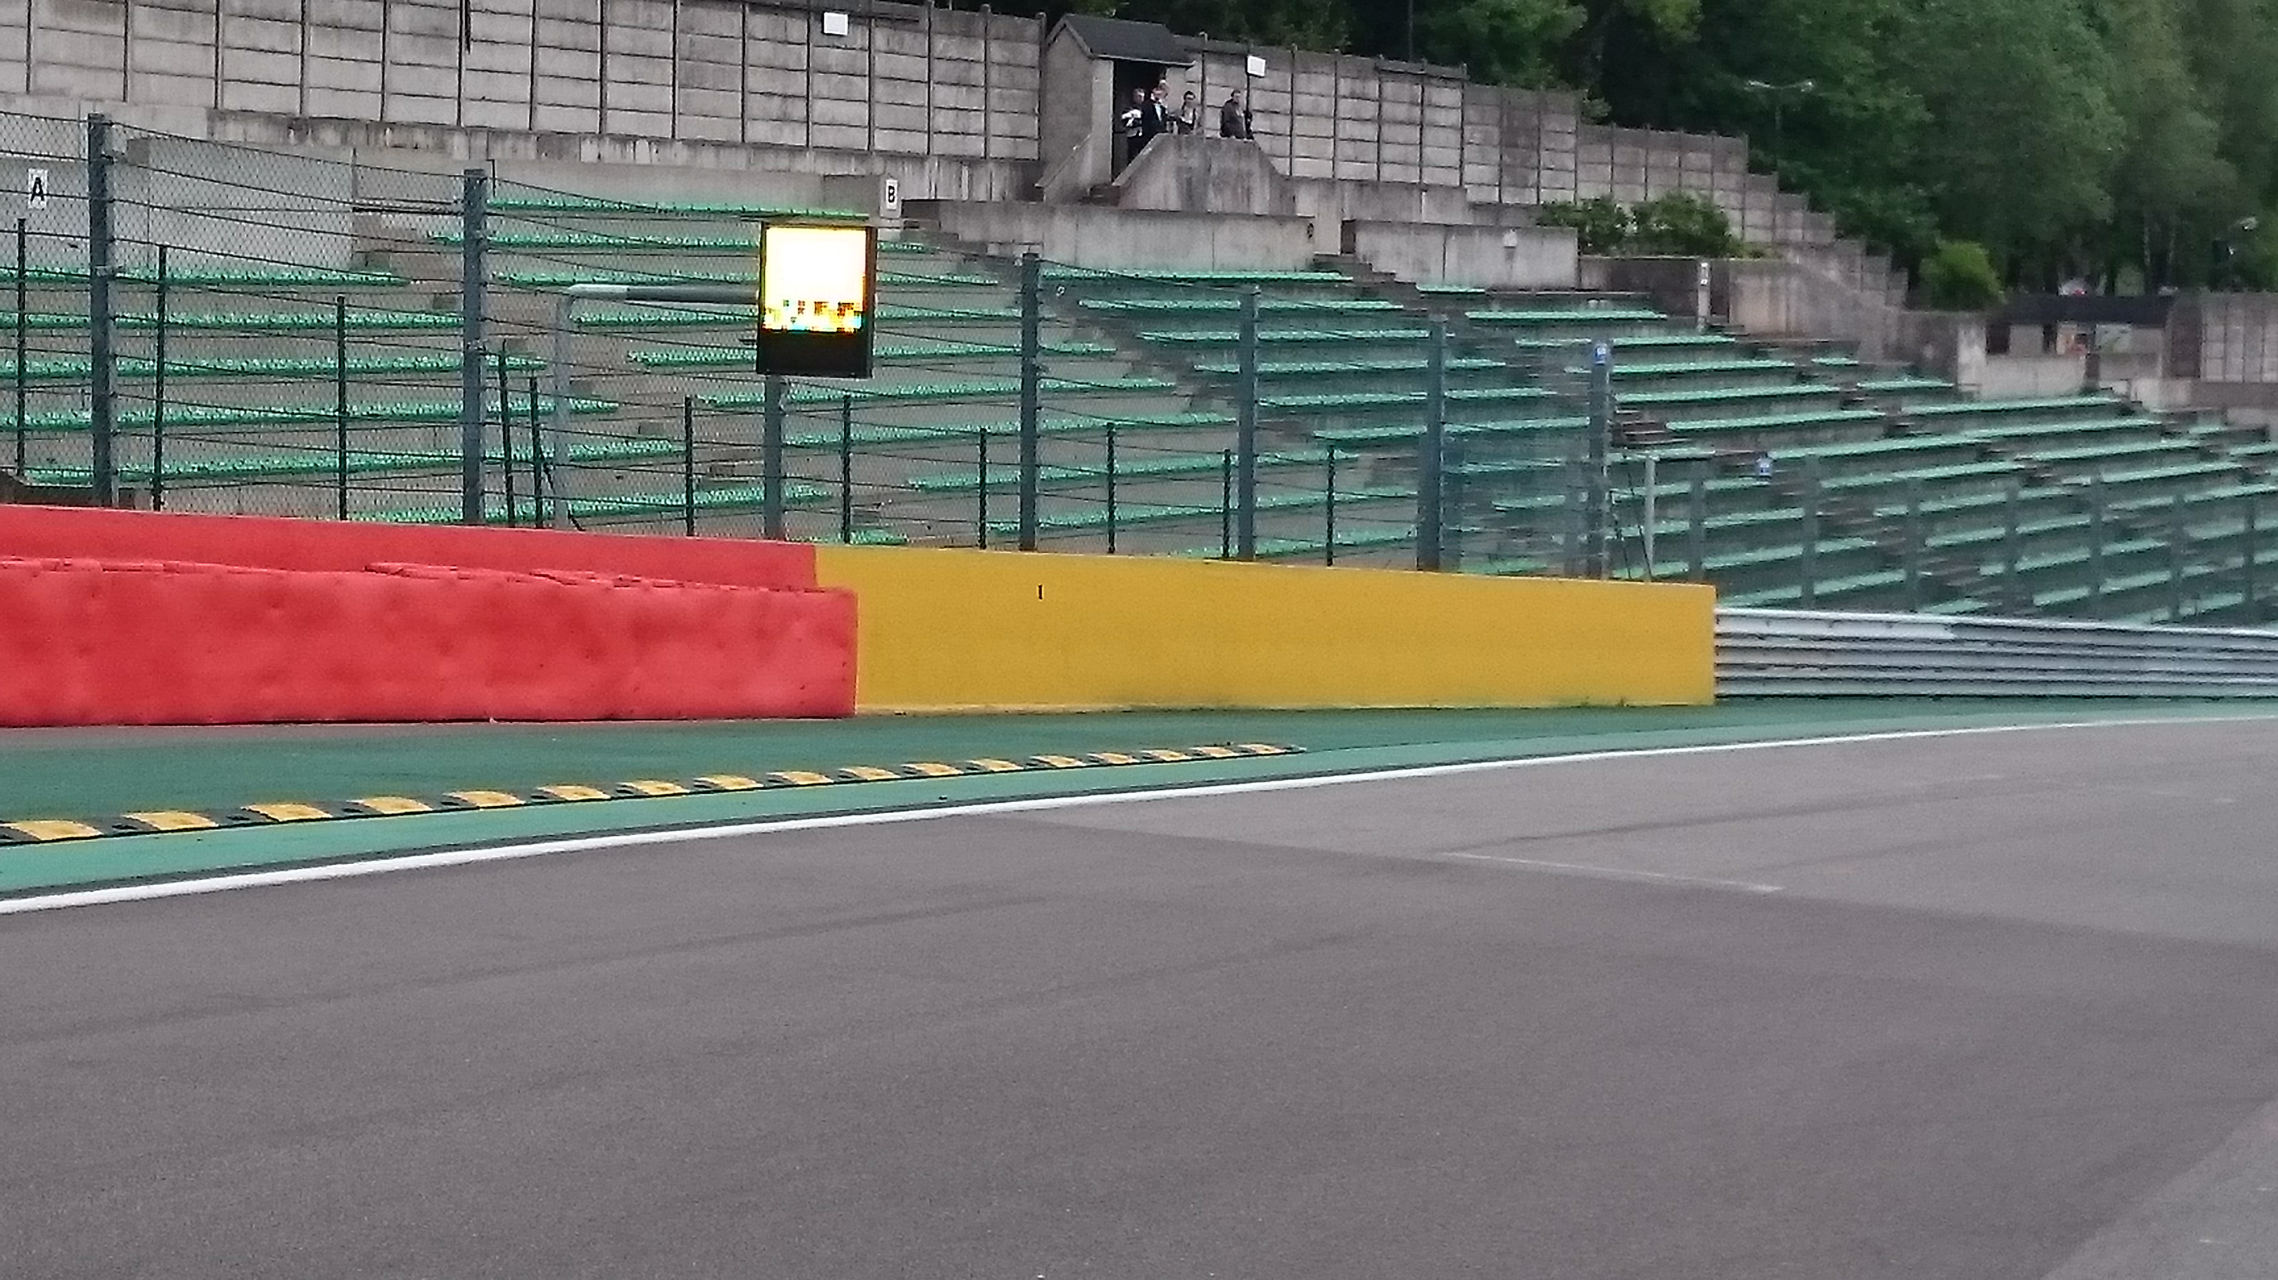
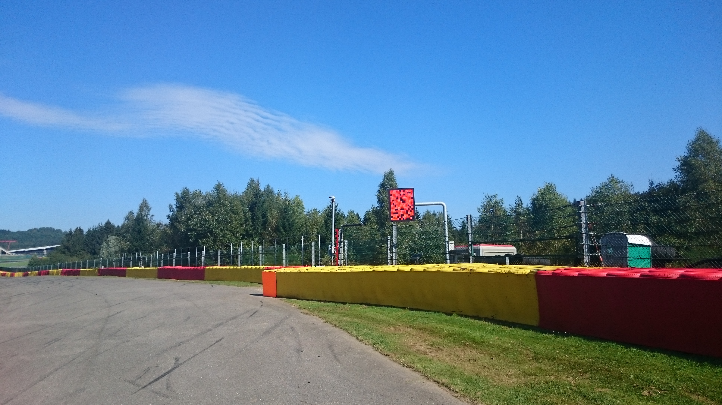
Yellow Flags – Marshaling Lights System

Slide 27
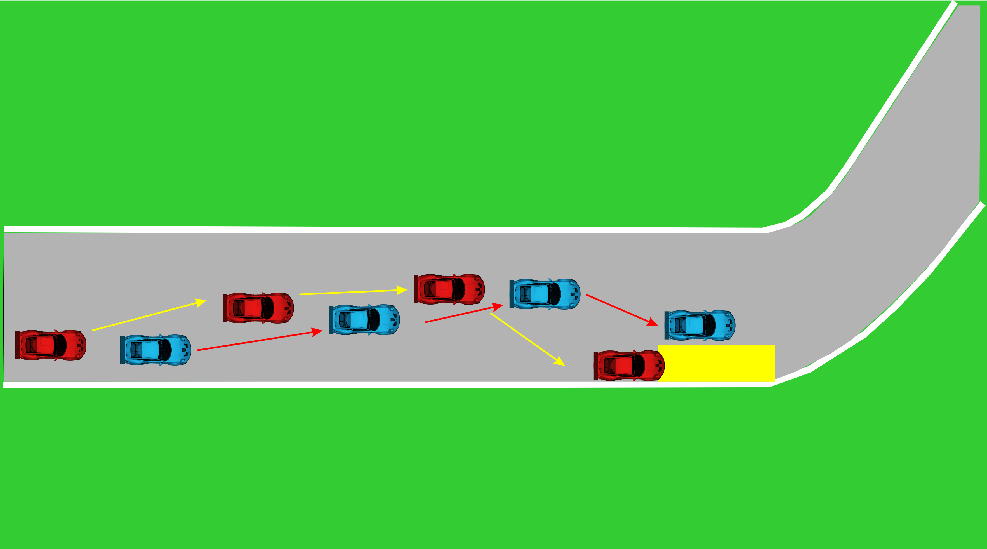
Overtaking

Slide 28
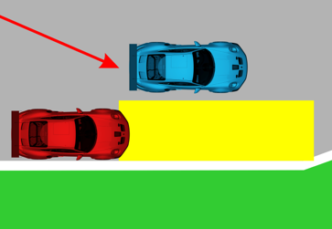
Overtaking

Slide 29
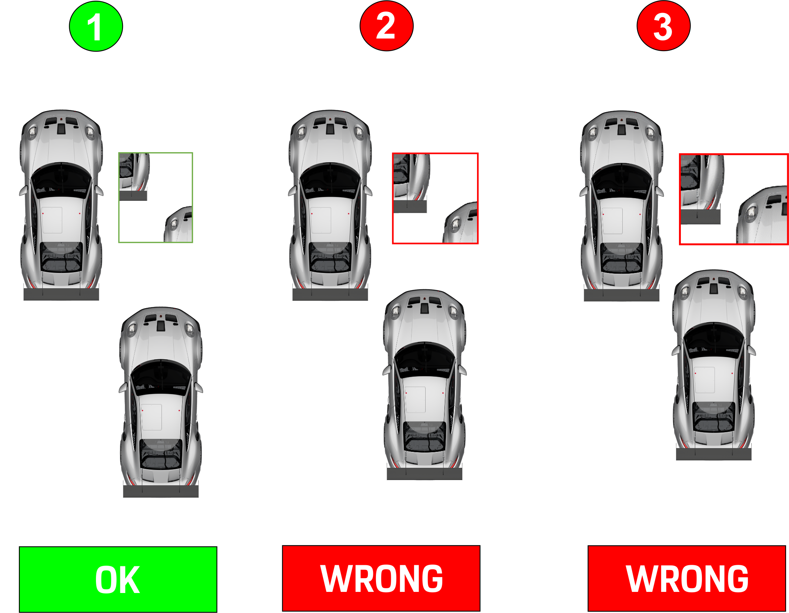
Overtaking

Slide 30
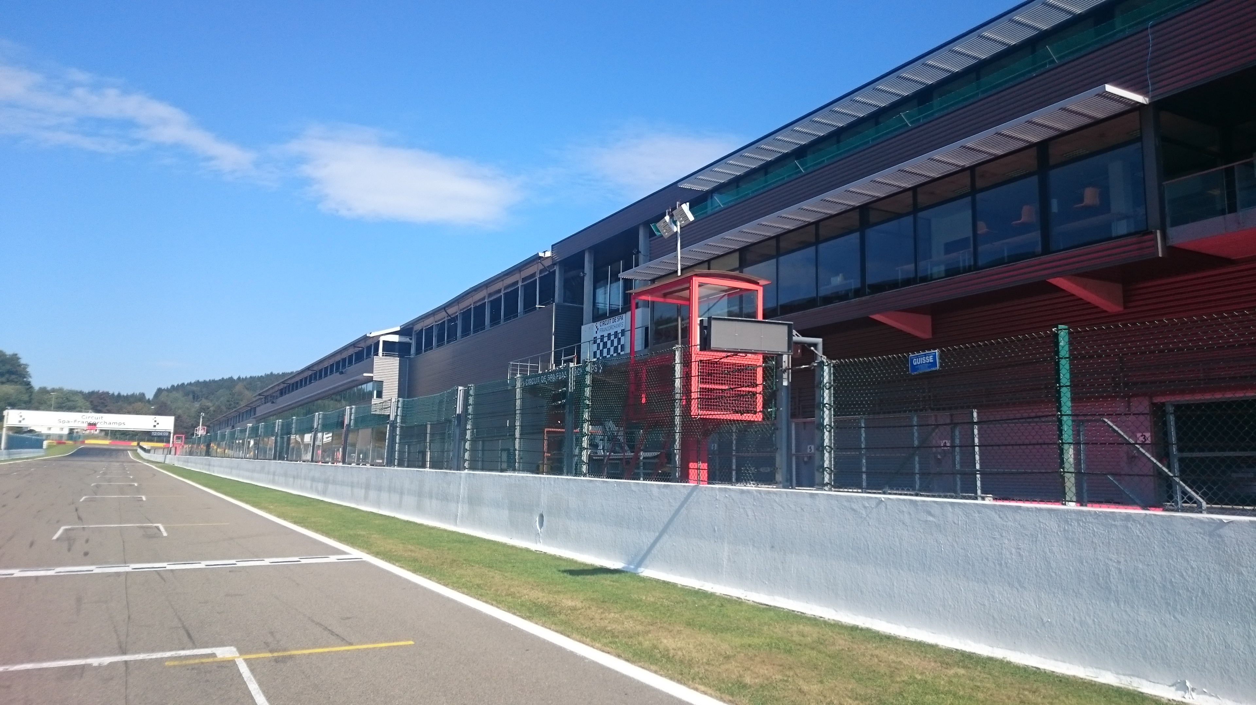




Signaling Platform

Slide 31
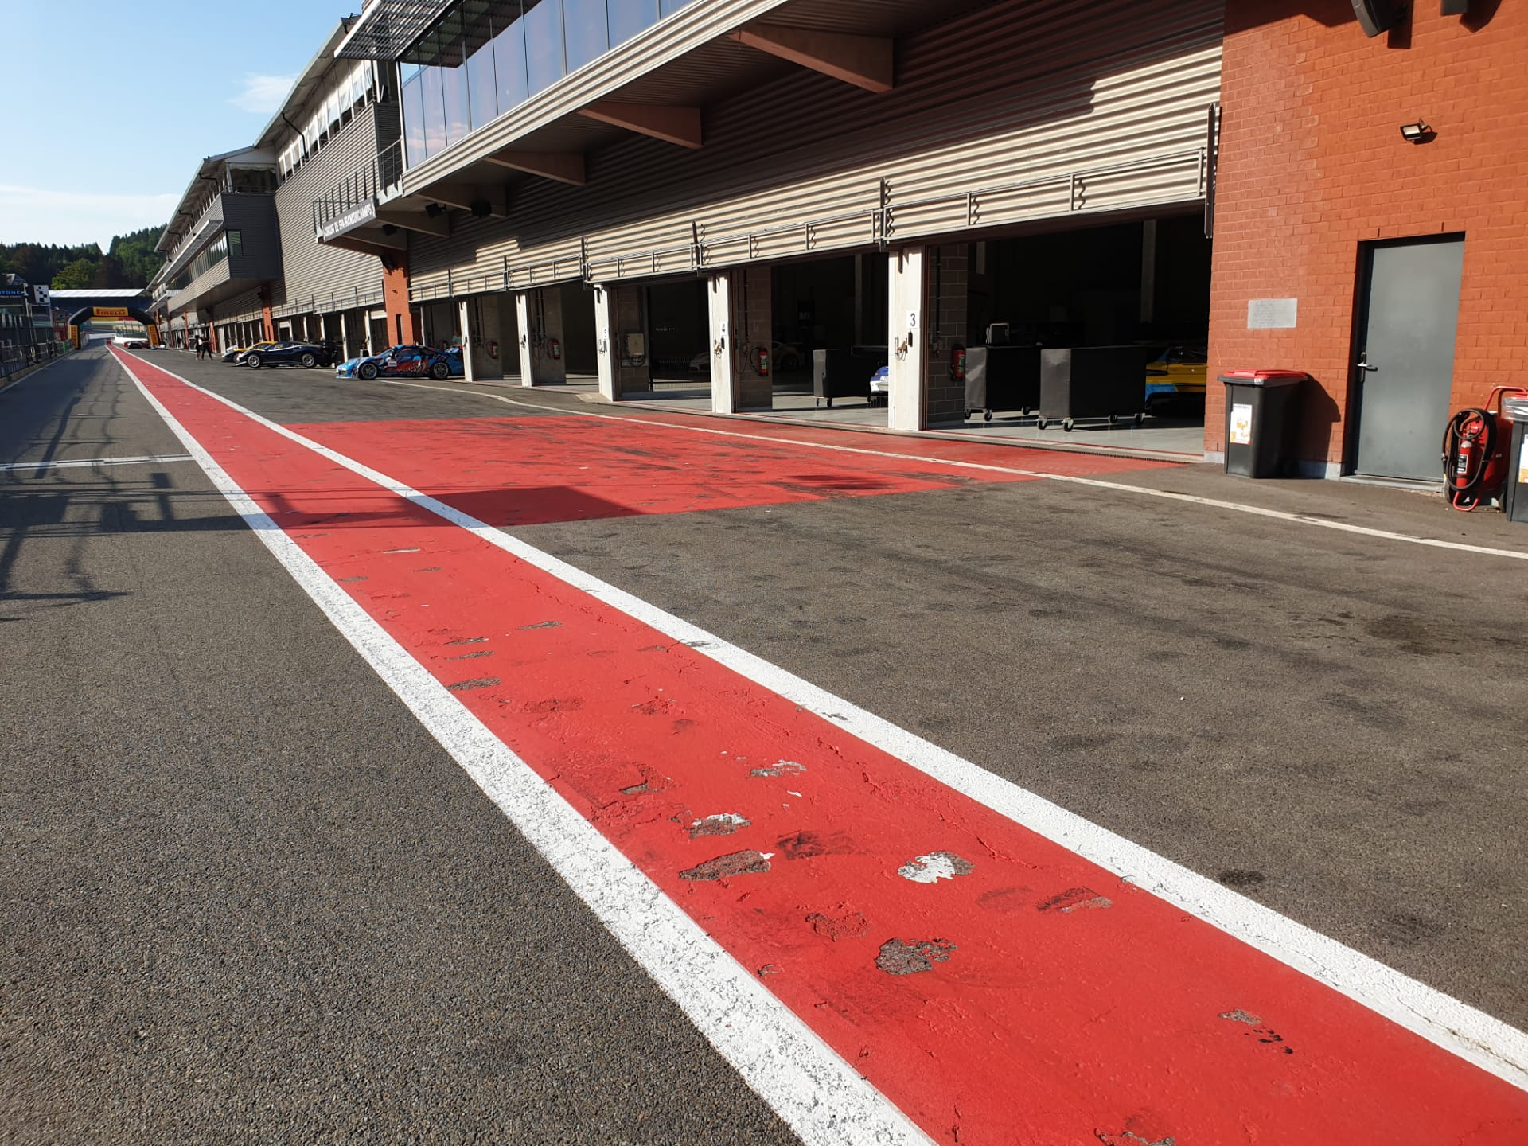
Stop & Go penalty box

Slide 32
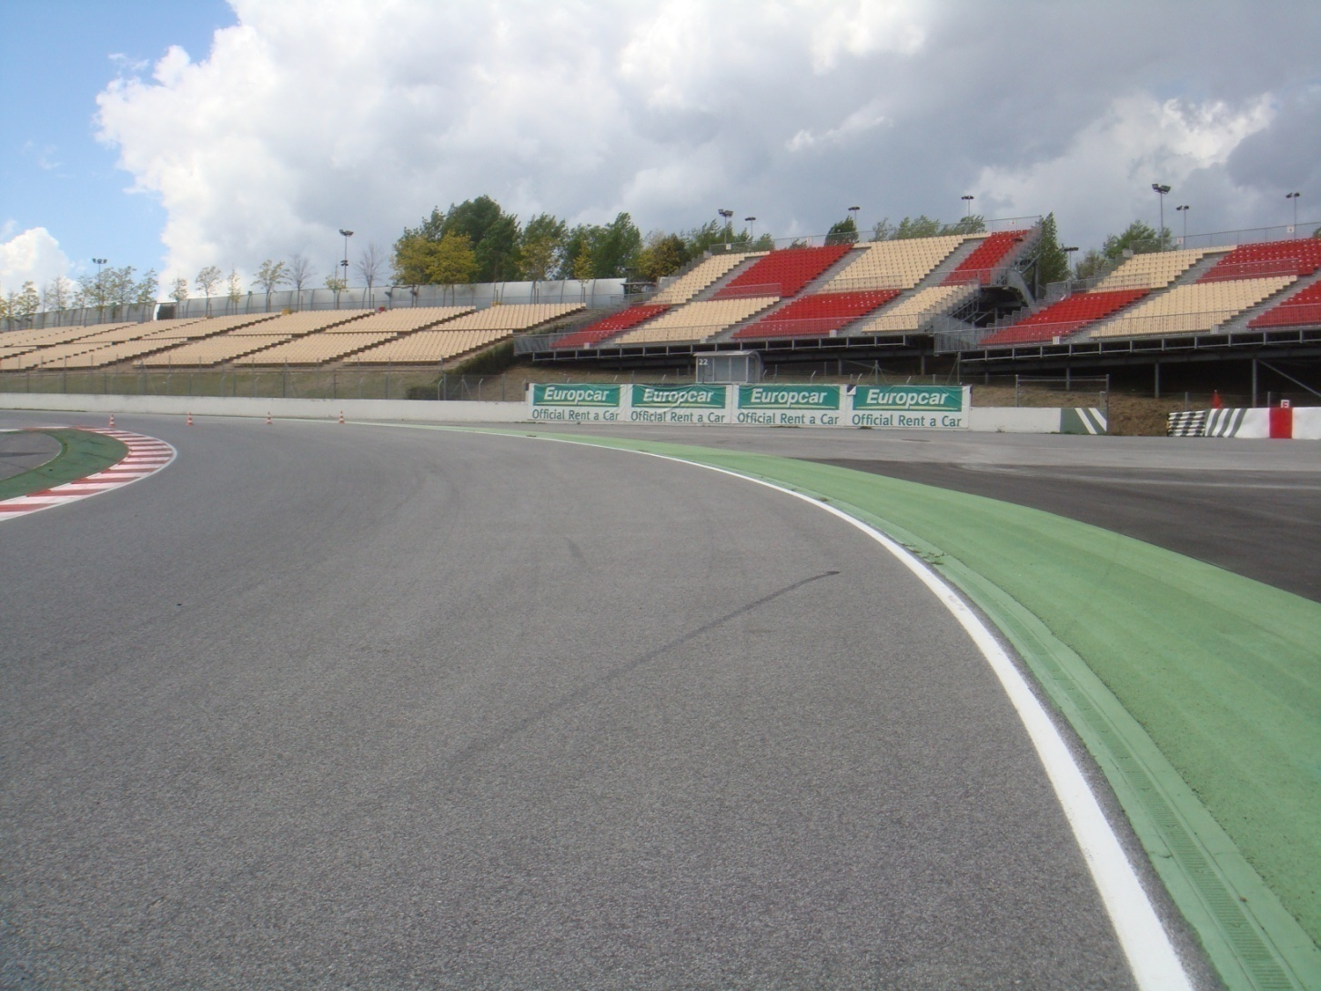
Appendix L – Track Limits

Slide 33
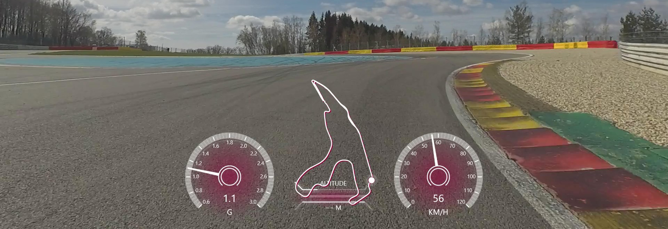
T5

Slide 34
Track access & Track exit
Track access : Eau Rouge gate, map in appendix
Track exit T1 la source – No deceleration lap -> endurance pit

Slide 35
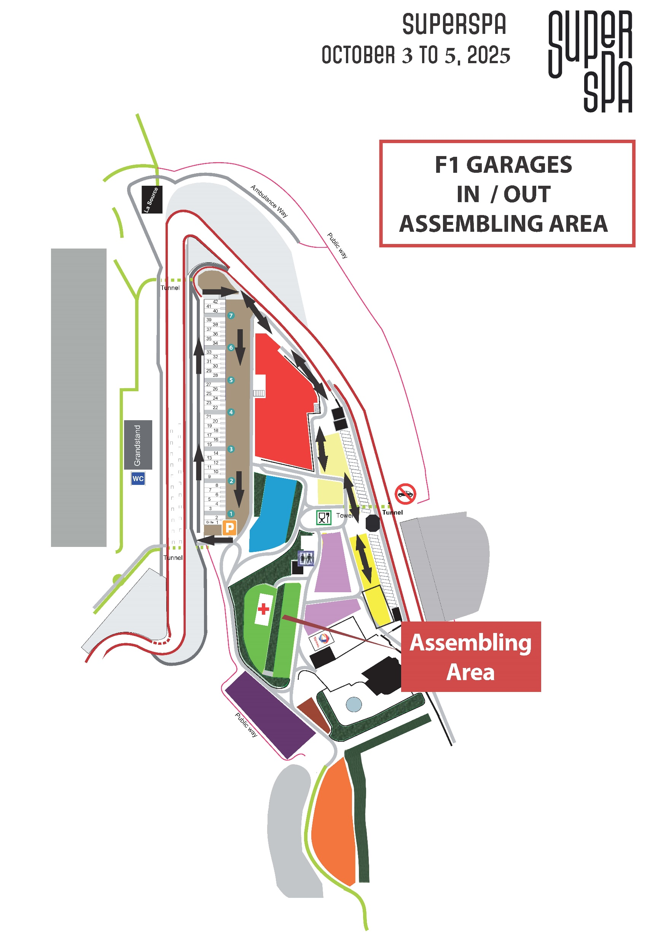
Assembling area

Slide 36
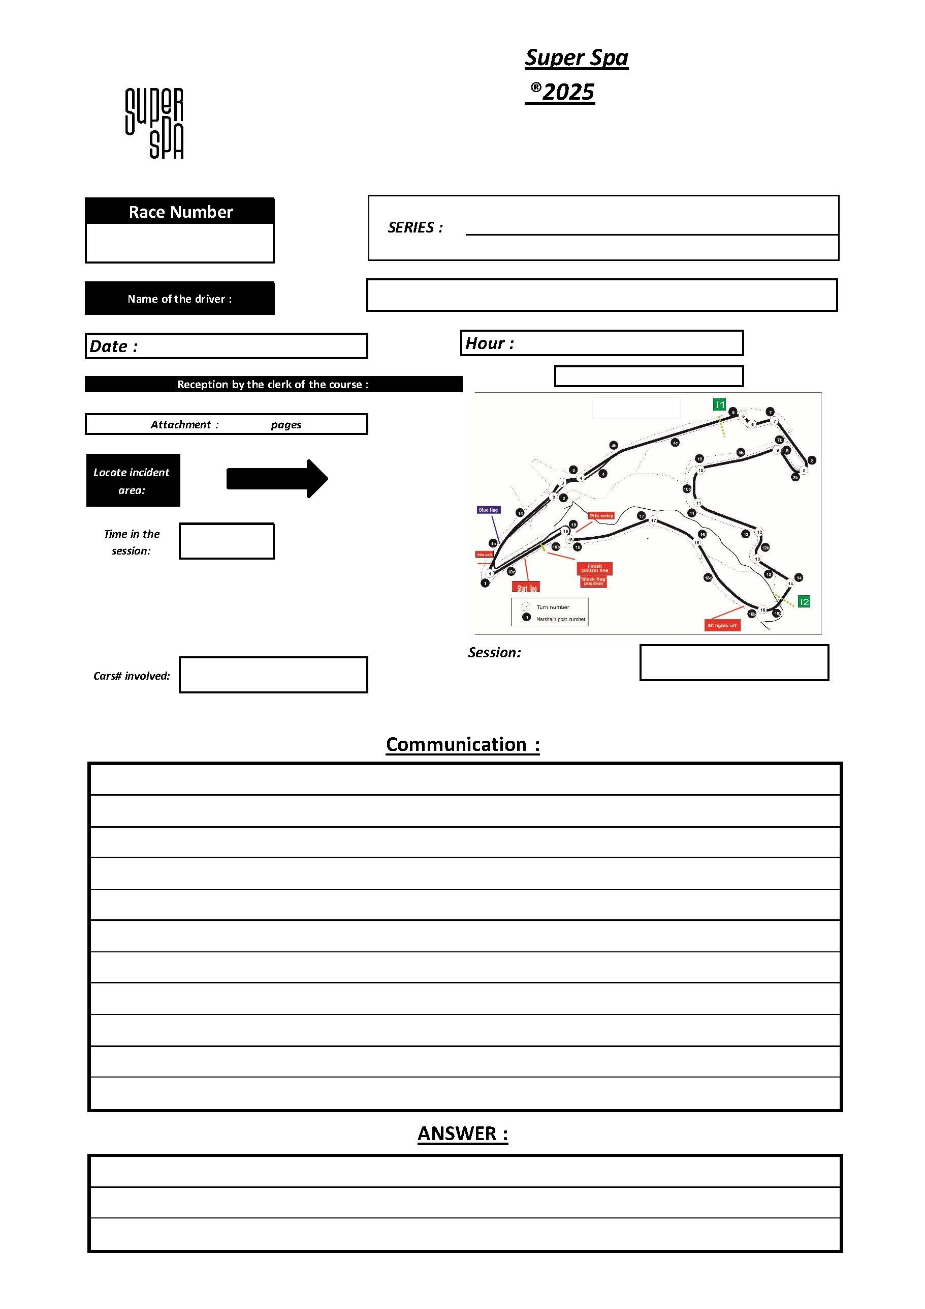
Enquiry Form

Slide 37

Have a nice & safe Race

